Slide 1


Games as Methods to enhance Innovation and Entrepreneurship

Slide 2












Download @
Corporate Sustainability
Innovation Game
Version 1.1
Developed in cooperation with Deutsche Telekom and by Henning Breuer (UXBerlin) and Kiril Ivanov (HMKW)

Slide 3






Turn sustainability challenges at your workplace into seeds for innovation.
1. Intro & Quiz (35 min)
Warmup and learn about corporate sustainability
2. Dilemmas (45 min)
Deal with corporate sustainability dilemmas
5. Scenario 2030 (45 min)
Pitch “How your idea changed the future?”
4. Ideation (60 min)
Co-create innovative approaches
3. Challenge Sourcing (45 min)
Identify your own challenges
Instructions at www.uxberlin.com/wp-content/uploads/2020/08/20200820_CSI_Game_Preparative_Instructions.pdf

Slide 4



Corporate Sustainability
Innovation Game
Play!
User Guide

Slide 5
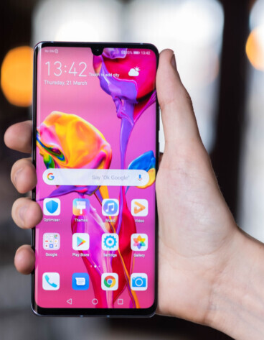
Let’s warm-up with a quick round of introductions
Players, please share a few words about yourself and show us the object you brought to share your perspective on corporate sustainability.
Please keep this short, and use just one or two sentences to introduce the object and its meaning.
For example:
  My name is Henning Breuer, and I am one of the initiators of the GAMIFY project which brings us together today, and which allowed us to develop this gamified workshop format.
  This Samsung phone (from one of your hardware partners) reminds me that we have to look behind the surface, for instance into the supply chain, to understand and manage our corporate sustainability.
Notes:
@Moderator: Define fixed sequence of players (1 to x) to clarify turn-taking

Slide 6




Definitions of the four domains of sustainability
Issues relating to sustainability concerns, sustainable innovation management and corporate sustainability in an overarching perspective including trade-offs between economic, social and ecological dimensions of sustainability.
Issues relating to economic approaches to continuous use of resources and elimination of waste.
Issues relating to the freedom from discrimination and inherent rights of all human beings, regardless of race, sex, nationality, ethnicity, language, religion, or any other status, including rights to access, use, create and publish digital media.
Activities relating to the UN Sustainable Development Goal 13 to combat climate change and its impacts.
Overarching
Circular Economy
Human & Digital Rights
Climate Action

Slide 7

Normative Directives of Deutsche Telekom
Responsible behaviour along the value chain;
digital transformation, digital participation for all.
Sustainable and transparent supply chain; eco design principles; waste reduction and recycling; environmentally sound and legal compliant disposal of waste; helping customers to conserve resources; promoting the sharing economy.
Equal opportunities for participating in the global information society; sovereign and safe actions in the digital world; strengthen democracy through digital media; public spaces for participation, exchange and innovation rather than hatred and agitation; responsible employment; adherence of human rights in the supply chain.
Low carbon and environmentally friendly society; 100 percent use of electricity from renewable energy sources; reduction of emissions from the supply chain and customers; efficient network technologies; national and international cooperation for climate-friendly society.
Overarching
Circular Economy
Human & Digital Rights
Climate Action
Notes:
We are committed to responsible behavior along our value chain and to take responsibility in the face of the environmental, social and economic challenges of our time.
We accompany the digital transformation and simplify and enrich people’s lives sustainably.
We enable digital participation for all members of society.
Circular Economy
We work to develop a more sustainable and transparent supply chain.
We emphasize the use of eco design principles including use of recycled materials in order to avoid resource consumption in the design and production phase.
We place importance on reducing waste and recycling valuable resources, e.g. by addressing repairability and modularity to prolong lifecycles.
Where reuse or recycling is not possible we ensure environmentally sound and legal compliant disposal of remaining waste.
We help our customers to conserve resources.
We promote the sharing economy by connecting people with each other on a variety of platforms.
Human & Digital Rights
We promote equal opportunities for participating in the global information society and knowledge economy.
We enable sovereign and safe actions in the digital world.
We empower and encourage people to strengthen democracy through the use of digital media.
We want public spaces, including our internal and external networks, to be used for participation, exchange and thus innovation. We don't want to leave them to those who abuse them for hatred and agitation.
We strengthen our efforts to be a responsible employer.
We safeguard the adherence of human rights in our supply chain.
Climate Action
We promote a low carbon and environmentally friendly society.
We aim to achieve a 100 percent use of electricity from renewable energy sources across the Group.
We focus on reducing emissions from the supply chain and that our customers generate when using our products and solutions.
We are investing in efficient network technologies and optimizing our data centres, networks and other own operations.
We engage in initiatives for national and international cooperation that contribute to a more climate-friendly society.

Slide 8




Any questions
before we start?

Slide 9
1. Warmup Quiz
Use and enrich your knowledge about corporate sustainability
Notes:
Moderator uses 15 minutes for the quiz.
Each player answers one-two quiz questions

Slide 10

Warmup Quiz
Overarching | Quotes | Circular Economy | Human & Digital Rights | Climate Action
10 | 10 | 10 | 10 | 10
20 | 20 | 20 | 20 | 20
30 | 30 | 30 | 30 | 30
40 | 40 | 40 | 40 | 40
50 | 50 | 50 | 50 | 50
15 min
2. Dilemmas
Notes:
Let us now warm-up with a quick quiz game that will allow you to use and enrich your knowledge about corporate sustainability.
In the quiz we have questions from the four domains of corporate sustainability. In addition, we have a fifth category of questions, named “Quotes”, where you have to guess who among famous politicians, CEOs and activists has made a certain statement about sustainability. You might be familiar with the rules of the game from the famous TV show, Jeopardy. You can choose a category of questions and a number of points to play for. The more are the points you go for, the more difficult will the questions get.
Moderator records individual scores in a separate file (table)

Slide 11

  1. When a company uses exclusively green energy.
Overarching
What is
greenwashing?
  2. When a company introduces measures for environmental control in all areas of its business.
  3. When a company spends more resources to appear as being green than actually being green.
10 Points
  4. When a company uses environmentally friendly detergents

Slide 12
  1. When a company uses exclusively green energy.
Overarching
What is
greenwashing?
  2. When a company introduces measures for environmental control in all areas of its business.
  3. When a company spends more resources to appear as being green than actually being green.
i
10 Points
  4. When a company uses environmentally friendly detergents
Notes:
Sources: https://www.highspeedtraining.co.uk/hub/corporate-social-responsibility-quiz/
Delmas, M. A., & Burbano, V. C. (2011). The drivers of greenwashing. California Management Review, 54(1), 64-87.
Explanation: Greenwashing refers to the act of “combining poor environmental performance with positive communication about environmental performance” (Delmas & Burbano, 2011, 84). A common indication of greenwashing in an organization are spending differences: when significantly more money or time have been invested in advertising "green" performance (i.e. environmental sustainability), than is actually spent on positive environmental practices.

Slide 13
  1. US$ 200 to 300 billion
Overarching
What is the estimated annually amount that needs to be invested globally, to achieve the UN’s 17 Sustainable Development Goals?
  2. US$ 500 to 700 billion
  3. US$ 1 trillion
20 Points
  4. US$ 5 to 7 trillion

Slide 14
  1. US$ 200 to 300 billion
Overarching
What is the estimated annually amount that needs to be invested globally, to achieve the UN’s 17 Sustainable Development Goals?
  2. US$ 500 to 700 billion
  3. US$ 1 trillion
i
20 Points
  4. US$ 5 to 7 trillion
Notes:
Explanation: The UN Conference on Trade and Development has estimated a staggering amount of annual investment requirements between US$ 5 and 7 trillion in all countries to achieve the SDGs (UNDP, 2018). According to the report there is an annual financing gap of US$ 2.5 trillion particularly in developing countries. This means that the active engagement of the private sector is critical for the achievement of the goals.

Slide 15
1. A legislation for regulating the proper disposal and recycling of mobile phones and other electronic devices in Europe.
Overarching
What is the “European Green Deal”?
2. The new trade agreement between Europe and the US to reduce trade barriers for food and farming products
3. A proposed law to remove hemp from the list of controlled substances and make it an ordinary agricultural commodity.
30 Points
4. A set of policy initiatives brought forward by the European Commission with the aim of making Europe climate neutral in 2050.

Slide 16
1. A legislation for regulating the proper disposal and recycling of mobile phones and other electronic devices in Europe.
Overarching
What is the “European Green Deal”?
2. The new trade agreement between Europe and the US to reduce trade barriers for food and farming products
3. A proposed law to remove hemp from the list of controlled substances and make it an ordinary agricultural commodity.
i
30 Points
4. A set of policy initiatives brought forward by the European Commission with the aim of making Europe climate neutral in 2050.
Notes:
Explanation: The “European Green Deal” plan includes potential carbon tariffs for countries that don't curtail their greenhouse gas pollution at the same rate, a circular economy action plan and a sustainable and smart mobility strategy. It also suggests increased investments in green technologies, sustainable solutions and new businesses.

Slide 17
1. An approach to innovation whose primary goal is to generate a sustainable source of income for organizational stakeholders.
Overarching
What is sustainable innovation?
2. A process that integrates social, environmental and economic criteria into the development of products, services or processes.
3. Practices that enhance the competitiveness of a company while also advancing the economic and social conditions in the communities where it operates.
40 Points
4. An innovation approach based on continuously upgrading a product or service in response to the customers’ demand.

Slide 18
1. An approach to innovation whose primary goal is to generate a sustainable source of income for organizational stakeholders.
Overarching
What is sustainable innovation?
2. A process that integrates social, environmental and economic criteria into the development of products, services or processes.
3. Practices that enhance the competitiveness of a company while also advancing the economic and social conditions in the communities where it operates.
i
40 Points
4. An innovation approach based on continuously upgrading a product or service in response to the customers’ demand.
Notes:
Explanation: Sustainable innovation integrates principles of sustainability, refering to its three interconnected aspects: environmental, economic and social.

Slide 19
1. An innovation that addresses a social problem while the profits it realizes are reinvested in the development of further socially-oriented solutions.
Overarching
What is values-based innovation?
2. An approach to innovation that aims at maximising companies’ financial value.
3. A framework that investigates and applies notions of the desirable to manage innovation.
50 Points
4. A type of innovation that contributes to establishing new values in society.

Slide 20
1. An innovation that addresses a social problem while the profits it realizes are reinvested in the development of further socially-oriented solutions.
Overarching
What is values-based innovation?
2. An approach to innovation that aims at maximising companies’ financial value.
3. A framework that investigates and applies notions of the desirable to manage innovation.
i
50 Points
4. A type of innovation that contributes to establishing new values in society.
Notes:
Explanation: The task of values-based innovation management is to identify and systematically use values as source and guide for innovation processes. These values may be integrated in organisations in a more or less top-down (e.g. diffusing from an authoritative top management directive) and/or in a bottom-up fashion (e.g. from employees’ initiatives or in reaction to changing customer or societal values).

Slide 21
„?“
  1. Greta Thunberg
  (Swedish environmental activist)
Quotes
Whose quote
is that?
  2. Angela Merkel
  (Chancellor of Germany)
10 Points
  3. Mark Zuckerberg
  (Founder and CEO of Facebook)
“We get that our greatest challenges need global responses too — no country can fight climate change alone or prevent pandemics. Progress now requires coming together not just as cities or nations, but also as a global community.”
  4. Al Gore
  (American politician and environmentalist)

Slide 22
„?“
  1. Greta Thunberg
  (Swedish environmental activist)
Quotes
Whose quote
is that?
  2. Angela Merkel
  (Chancellor of Germany)
10 Points
  3. Mark Zuckerberg
  (Founder and CEO of Facebook)
“We get that our greatest challenges need global responses too — no country can fight climate change alone or prevent pandemics. Progress now requires coming together not just as cities or nations, but also as a global community.”
  4. Al Gore
  (American politician and environmentalist)
Notes:
Source: https://news.harvard.edu/gazette/story/2017/05/mark-zuckerbergs-speech-as-written-for-harvards-class-of-2017/

Slide 23
„?“
  1. Viktor Orbán
  (Prime Minister of Hungary)
Quotes
Whose quote
is that?
  2. Angela Merkel
  (Chancellor of Germany)
20 Points
  3. Alexander Gauland
  (German politician and co-founder of the party AfD)
"The Internet is new territory for all of us, and of course it also enables enemies and opponents of our basic democratic order to endanger our way of life with completely new possibilities and completely new approaches.“
  4. Julian Assange
  (Australian activist and founder of WikiLeaks)

Slide 24
„?“
  1. Viktor Orbán
  (Prime Minister of Hungary)
Quotes
Whose quote
is that?
  2. Angela Merkel
  (Chancellor of Germany)
20 Points
  3. Alexander Gauland
  (German politician and co-founder of the party AfD)
"The Internet is new territory for all of us, and of course it also enables enemies and opponents of our basic democratic order to endanger our way of life with completely new possibilities and completely new approaches.“
  4. Julian Assange
  (Australian activist and founder of WikiLeaks)

Slide 25
„?“
  1. Angela Merkel
  (Chancellor of Germany)
Quotes
Whose quote
is that?
  2. Martin Schulz
  (German politician, former leader of the SPD party)
30 Points
  3. António Guterres
  (Secretary-General of the United Nations)
"It is crucial that the companies also live what they have written for themselves - and not just in announcements. In politically troubled times, this should be the case, companies should also have a political position.”
  4. Timotheus Höttges
  (CEO of Deutsche Telekom)

Slide 26
„?“
  1. Angela Merkel
  (Chancellor of Germany)
Quotes
Whose quote
is that?
  2. Martin Schulz
  (German politician, former leader of the SPD party)
30 Points
  3. António Guterres
  (Secretary-General of the United Nations)
"It is crucial that the companies also live what they have written for themselves - and not just in announcements. In politically troubled times, this should be the case, companies should also have a political position.”
  4. Timotheus Höttges
  (CEO of Deutsche Telekom)

Slide 27
„?“
  1. Donald Trump
  (Former president of the US)
Quotes
Whose quote
is that?
  2. Timotheus Höttges
  (CEO of Deutsche Telekom)
40 Points
  3. Ursula von der Leyen
  (President of the European Commission)
"Our world and what we have achieved cannot be taken for granted. We have to stand up for our values."
  4. Greta Thunberg (Swedish environmental activist)

Slide 28
„?“
  1. Donald Trump
  (Former president of the US)
Quotes
Whose quote
is that?
  2. Timotheus Höttges
  (CEO of Deutsche Telekom)
40 Points
  3. Ursula von der Leyen
  (President of the European Commission)
"Our world and what we have achieved cannot be taken for granted. We have to stand up for our values."
  4. Greta Thunberg (Swedish environmental activist)

Slide 29
„?“
    1. Greta Thunberg
    (Swedish environmental activist)
Quotes
Whose quote
is that?
  2. Leonardo DiCaprio
  (American actor, producer, and environmentalist)
50 Points
  3. Barack Obama
  (Former president of the US)
“Our generation has inherited an incredibly beautiful world from our parents and they from their parents. It is in our hands whether our children and their children inherit the same world. We must not be the generation responsible for irreversibly damaging the environment.”
  4. Richard Branson
  (British entrepreneur and founder of Virgin Group)

Slide 30
„?“
    1. Greta Thunberg
    (Swedish environmental activist)
Quotes
Whose quote
is that?
  2. Leonardo DiCaprio
  (American actor, producer, and environmentalist)
50 Points
  3. Barack Obama
  (Former president of the US)
“Our generation has inherited an incredibly beautiful world from our parents and they from their parents. It is in our hands whether our children and their children inherit the same world. We must not be the generation responsible for irreversibly damaging the environment.”
  4. Richard Branson
  (British entrepreneur and founder of Virgin Group)

Slide 31
Circular Economy
  1. Eliminating waste and supporting continual use of resources.
What are the most important components of a circular economy?
  2. Using money to earn a higher return by investing in other assets having the same amount of risk.
  3. Using exchange of goods rather than money to build a more sustainable economic system.
10 Points
  4. Trading goods in a closed loop of manufacturers, distributors and customers.

Slide 32
Circular Economy
  1. Eliminating waste and supporting continual use of resources.
What are the most important components of a circular economy?
  2. Using money to earn a higher return by investing in other assets having the same amount of risk.
  3. Using exchange of goods rather than money to build a more sustainable economic system.
i
10 Points
  4. Trading goods in a closed loop of manufacturers, distributors and customers.
Notes:
Explanation: The circular economy aims to keep products, equipment and infrastructure in use for longer, thus improving the productivity of these resources. It can be understood as the opposite to a linear economy, where resources are extracted, manufactured into goods, distributed and sold, and when they reach the end of their useful lifespan they are either disposed in landfills, or are only patially recycled or downcycled.

Slide 33
Circular Economy
1. They degrade over time, releasing cancer-causing chemicals into the air.
How do many electronic items harm the environment?
2. Lead and mercury in components can cause metabolic changes in users.
3. They leach toxic metals in landfills and into ground water.
20 Points
4. They create electromagnetic fields that interfere with animal reproduction.

Slide 34
Circular Economy
1. They degrade over time, releasing cancer-causing chemicals into the air.
How do many electronic items harm the environment?
2. Lead and mercury in components can cause metabolic changes in users.
3. They leach toxic metals in landfills and into ground water.
i
20 Points
4. They create electromagnetic fields that interfere with animal reproduction.
Notes:
Explanation: Roughly 50 million metric tons of electronic waste are produced globally each year, with Europe being the second largest generator of e-waste per inhabitant. Toxic materials in electronic items generate air and water pollution when devices are incinerated, put in landfills or melted down. Informal processes of dismantling and disposing of electronic waste in developing countries lead to a number adverse human health and environmental impacts.

Slide 35
Circular Economy
  1. Recycle
Which of the following is NOT
among the
“Three R’s” hierarchy of waste management?
  2. Reduce
  3. Resell
30 Points
  4. Reuse

Slide 36
Circular Economy
  1. Recycle
Which of the following is NOT
among the
“Three R’s” hierarchy of waste management?
  2. Reduce
  3. Resell
i
30 Points
  4. Reuse
Notes:
Explanation: The waste management hierarchy is a set of priorities that protect the environment alongside resource and energy consumption from most favourable to least favourable actions. By reducing the amount of unnecessarily purchased items, reusing items more than once and disposing the items that can no longer be used at appropriate recycling centres, you can contribute towards a healthier planet.

Slide 37
Circular Economy
1. A method to evaluate the carbon footprint of a person throughout his or her entire life cycle from birth to death.
What is a life-cycle analysis?
2. A method to evaluate the impact that a product or system has on the environment in its entire existence.
3. A method to evaluate the impact that a product or system has on the environment while being used.
40 Points
4. None of the above

Slide 38
Circular Economy
1. A method to evaluate the carbon footprint of a person throughout his or her entire life cycle from birth to death.
What is a life-cycle analysis?
2. A method to evaluate the impact that a product or system has on the environment in its entire existence.
3. A method to evaluate the impact that a product or system has on the environment while being used.
i
40 Points
4. None of the above
Notes:
Explanation: A life-cycle analysis involves a thorough inventory of the energy and materials that are required across the entire value chain of a product, process or service. The assessment of environmental impacts follows from raw material extraction and processing, through manufacturing, distribution and use, to the recycling or final disposal of materials.

Slide 39
Circular Economy
  1. 10 percent
How many percent of the materials
in a smartphone can be recycled?
  2. 40 percent
  3. 70 percent
50 Points
  4. 100 percent

Slide 40
Circular Economy
  1. 10 percent
How many percent of the materials
in a smartphone can be recycled?
  2. 40 percent
  3. 70 percent
i
50 Points
  4. 100 percent
Notes:
Explanation: Around 70 percent of a mobile phone is made up of completely recyclable materials. It is estimated that recycling circuit boards can extract 30 to 40 times more precious metals, such as copper and gold, than mining for ore. However, just as any other type of e-waste, smartphones are often recycled informally in developing countries, exposing residents to serious health and environmental risks.

Slide 41
Human & Digital Rights
  1. A compulsory manual on workplace safety
What is a “code
of conduct”?
  2. A set of procedures that help employees to communicate without violating corporate privacy
  3. A set of guidelines for how people must behave at work
  4. A legal document that can be used to settle disputes between a company and its employees
10 Points

Slide 42
Human & Digital Rights
  1. A compulsory manual on workplace safety
What is a “code
of conduct”?
  2. A set of procedures that help employees to communicate without violating corporate privacy
  3. A set of guidelines for how people must behave at work
i
  4. A legal document that can be used to settle disputes between a company and its employees
10 Points
Notes:
Explanation: A company code of conduct is a set of rules which protects the business and informs the employees of the company's expectations. In its code of conduct, the Deutsche Telekom Group asserts that all employees must comply with their legal obligations, thus creating essentials such as trust, credibility and good reputation.

Slide 43
Human & Digital Rights
  1. Heresy
What can be defined as
"public speech that
expresses hate or encourages
violence towards a person or
group based on something such as race, religion, sex, or sexual orientation“?
  2. Libel
  3. Hate speech
  4. Intolerance
20 Points

Slide 44
Human & Digital Rights
  1. Heresy
What can be defined as
"public speech that
expresses hate or encourages
violence towards a person or
group based on something such as race, religion, sex, or sexual orientation“?
  2. Libel
  3. Hate speech
i
  4. Intolerance
20 Points
Notes:
Source:
https://dictionary.cambridge.org/us/dictionary/english/hate-speech
Explanation: Hate speech is a violation of human rights, typically expressed on the Internet or social media but may also appear in workplace environments, such as on the corporate Intranet. It is not protected by freedom of expression and figures as a legal term in most developed countries, where its expressions can be accordingly prosecuted and punished.

Slide 45
Human & Digital Rights
  1. Right to privacy
What human rights can
be put at risk through
the use of
Information and Communication Technologies (ICTs)?
  2. Right to a fair trial
  3. Freedom of speech
  4. All of the above
30 Points

Slide 46
Human & Digital Rights
  1. Right to privacy
What human rights can
be put at risk through
the use of
Information and Communication Technologies (ICTs)?
  2. Right to a fair trial
  3. Freedom of speech
i
  4. All of the above
30 Points
Notes:
Explanation: According to a report by the Institute for Human Rights and Business hackers but also government agencies and companies have used ICTs to intrude personal privacy in the past. Furthermore, surveillance technologies can limit the exchange of information and suppress freedom of speech as well as the right to a fair trial, for example by intruding in privileged communications, such as between a lawyer and client.
Source:
https://www.ihrb.org/uploads/reports/IHRB%2C_Telecommunications_and_Human_Rights_-_An_Export_Credit_Perspective%2C_Feb_2017.pdf

Slide 47
Human & Digital Rights
  1. Web disparity
The social inequality that
occurs due to the access
of one group to digital
technology and another group’s lack of access is known as the…
  2. Internet inequality
  3. Technological imbalance
  4. Digital divide
40 Points

Slide 48
Human & Digital Rights
  1. Web disparity
The social inequality that
occurs due to the access
of one group to digital
technology and another group’s lack of access is known as the…
  2. Internet inequality
  3. Technological imbalance
i
  4. Digital divide
40 Points
Notes:
Explanation: A digital divide is any uneven distribution in the access to, use of, or impact of ICTs. Because of the high costs associated with ICTs, their adoption and utilization is highly unbalanced across the globe. Further barriers to closing the gap include: physical, cognitive, geographic, demographic, institutional, political and cultural factors.

Slide 49
Human & Digital Rights
  1. Strengthen democratic processes
Which of the following
items is among the
strategic objectives of the German’s Ministry of Economic Cooperation and
and Development (BMZ) “Digital Agenda”?
  2. Help people seeking refuge
  3. Create jobs that will be sustainable in the future
  4. All of the above
50 Points

Slide 50
Human & Digital Rights
  1. Strengthen democratic processes
Which of the following
items is among the
strategic objectives of the German’s Ministry of Economic Cooperation and
and Development (BMZ) “Digital Agenda”?
  2. Help people seeking refuge
  3. Create jobs that will be sustainable in the future
i
  4. All of the above
50 Points
Notes:
Explanation: BMZ’s “Digital Agenda” emphasises that information and communication technology has comprehensive impacts on all 17 of the UN’s Sustainable Development Goals, playing an essential role as a means of accomplishing them.
Source:
https://www.kfw.de/nachhaltigkeit/KfW-Group/Sustainability/sustainability-report-2017/digitalisierung-foerdert-menschenrechte/

Slide 51
Climate Action
  1. ICT
Which of the following industries could be negatively affected by climate change?
  2. Insurance
  3. Wine making
10 Points
  4. All of the above

Slide 52
Climate Action
  1. ICT
Which of the following industries could be negatively affected by climate change?
  2. Insurance
  3. Wine making
i
10 Points
  4. All of the above
Notes:
Explanation: ICT infrastructure may be damaged by floods and other disasters while data centres will incur greater costs for cooling and energy. Insurance companies can expect to pay out more in disaster claims. Some vineyard regions will no longer be able to sustain grape harvest.
Source:
https://www.nationalgeographic.com/environment/global-warming/global-warming-quiz/

Slide 53
Climate Action
  1. 5 percent
Global e-Sustainability Initiative
(GeSI) suggests that by 2030 ICT
can enable reduction of global
carbon emissions by:
  2. 15 percent
  3. 10 percent
20 Points
  4. 20 percent

Slide 54
Climate Action
  1. 5 percent
Global e-Sustainability Initiative
(GeSI) suggests that by 2030 ICT
can enable reduction of global
carbon emissions by:
  2. 15 percent
  3. 10 percent
i
20 Points
  4. 20 percent
Notes:
Explanation: Connectivity through ICT can significantly reduce global greenhouse gas emissions by helping companies and consumers to more intelligently use and save energy. For example, it enables us to operate with data online, use services in the cloud and substitute regular meetings and workshops with videoconferences.
Source:
https://www.weforum.org/agenda/2015/12/how-the-communications-industry-can-help-tackle-climate-change/
https://unfccc.int/news/ict-sector-helping-to-tackle-climate-change

Slide 55
Climate Action
  1. Transportation
Globally, which of the following
economic sectors emits the
largest percentage of greenhouse
gas emissions?
  2. Industry
  3. Buildings
30 Points
  4. Electricity and heat production

Slide 56
Climate Action
  1. Transportation
Globally, which of the following
economic sectors emits the
largest percentage of greenhouse
gas emissions?
  2. Industry
  3. Buildings
i
30 Points
  4. Electricity and heat production
Notes:
Explanation: The electricity and heat production sector emits the largest percentage of global greenhouse gas emissions at 25 percent. ICTs account for 8-10 percent of the European electricity consumption and up to 4 percent of its carbon emissions.
Sources:
https://www.epa.gov/ghgemissions/global-greenhouse-gas-emissions-data
https://www.earthday.org/the-climate-change-quiz/
https://ictfootprint.eu/en/about/ict-carbon-footprint/ict-carbon-footprint

Slide 57
Climate Action
  1. User devices
Which types of information and
communication technology has
the highest CO2 emission?
  2. Data centres and enterprise networks
  3. ICT networks
40 Points
  4. Communication satellites

Slide 58
Climate Action
  1. User devices
Which types of information and
communication technology has
the highest CO2 emission?
  2. Data centres and enterprise networks
  3. ICT networks
i
40 Points
  4. Communication satellites
Notes:
Explanation: A recent study (Malmody & Lunden, 2018) showed that despite the continuous growth of the ICT sector its carbon footprint is shrinking. One of the reasons is that many large ICT data centres and network operators are users of renewable energy. The study concludes that TVs, PCs and monitors have the largest footprints, but smartphones have also a significant footprint due to their large sales volumes.
Source:
Malmodin, J., & Lundén, D. (2018). The energy and carbon footprint of the global ICT and E&M sectors 2010–2015. Sustainability, 10(9), 3027.

Slide 59
Climate Action
1. A method that calculates the CO2 footprint of raw materials and helps to optimize the sustainability of their supply
What is “materiality assessment” and how can it help to reduce carbon footprint more effectively?
2. A technique that estimates the material wealth of a company and helps it define how much to invest in reducing CO2 emissions
3. A methodology that assess the environmental impact of office equipment and helps to reduce energy consumption
50 Points
4. A process that analyses the importance of sustainability issues for different stakeholders and helps to prioritize the ones with most severe impact

Slide 60
Climate Action
1. A method that calculates the CO2 footprint of raw materials and helps to optimize the sustainability of their supply
What is “materiality assessment” and how can it help to reduce carbon footprint more effectively?
2. A technique that estimates the material wealth of a company and helps it define how much to invest in reducing CO2 emissions
3. A methodology that assess the environmental impact of office equipment and helps to reduce energy consumption
i
50 Points
4. A process that analyses the importance of sustainability issues for different stakeholders and helps to prioritize the ones with most severe impact
Notes:
Explanation: Materiality assessment is the process of identifying which Environmental, Social and Governance issues have highest priority to be addressed by a business. It evaluates the potential of each issue to positively or negatively influence organizational growth, cost, or trust and how important is each issue to different stakeholder groups. This helps to define a company’s strategy, targets and reporting.
Sources:
https://youmatter.world/en/definition/materiality-assessment-definition/

Slide 61
2. Dilemmas
Deal with corporate sustainability dilemmas and
judge how others deal with them.
Play!
Guide
Notes:
Moderator: Use 5 minutes for explanations and choice of stakeholder cards. Players solve dilemmas in the next 40 minutes

Slide 62

Deal with dilemmas and judge decisions
The two winners from the quiz will take the role of decision-makers to solve typical corporate sustainability dilemmas.
Dilemmas are grouped in relation to the four focus domains. You can choose from closed dilemmas that offer you 3 alternatives to choose from or open dilemmas, where you need to come up with your own response.
As a decision maker you will “pick” one of the dilemma cards and read it out. Take a decision
and justify it in front of the other players.
Solving the dilemmas, please consider the normative directives of Deutsche Telekom.
Overarching
Notes:
Dealing with corporate sustainability we all run into different dilemmas. You will work with dilemmas from the four focus domains of sustainability.
Please take the perspective of your persona When solving closed dilemmas you will choose from one of 3 generic alternatives.

Slide 63

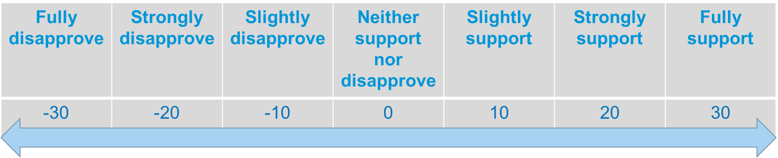
How to evaluate the decisions
Martin, the Customer
In order to evaluate the decision maker’s answer, the other players take the perspective of one stakeholder.
Use the evaluation scale and tell the moderator the amount of Impact Investment Points that you award to or deduct from the decision maker. The moderator may ask you to reason about your feedback.
Following the feedback from the other players the decision maker also self-evaluates his/her choice and likewise adds or deducts up to 30 points.
The decision-maker who wins more points from the dilemmas will become a leader of the group and will be able to use two extra votes in the voting sessions afterwards.
+ Evaluation Scale
Notes:
The moderator asks one to two of the stakeholder players to reason about his/her feedback.
The moderator keeps track of the points.
The moderator also mentions that the dilemmas conclude the first part of the game, which is about focusing on raising awareness and competing, and are followed by the second part where the focus is put on ideation and collaboration.

Slide 64





Pick your stakeholder for judging the decisions
Robert, the Shareholder
Jennifer, the
NGO Representative
Martin, the Customer
Sara, the Journalist
Tobias, the Colleague
Notes:
Moderator asks players if they remember what stakeholders they’ve picked
Moderator takes note of the player’s choices

Slide 65
Stakeholder Card
Persona:
Martin – the hipster, 33 years, single, sales representative
Customers include all private or business actors that are buying or may become buyers of Telekom’s products or services.
Values
Prestige, fairness, public opinion, privacy, sustainability, personalized interactions
Interests
Affordability, efficient and reliable services, quality of service, transparency in billing
Pain points
High prices, low performance of products and services, bad reputation, loss of trust
Prefers popular, affordable offerings.
Extensively uses his smartphone for work.
Wants to buy more sustainable products.
Likes to do sports and spend time in nature.
Does not like to be lied to and to be criticized by peers.
Martin, the Customer

Slide 66
Stakeholder Card
Persona:
Robert – the number cruncher, 42 years, married, private investor (small business owner)
Shareholders are Telekom’s private investors that have economic benefit from the ownership of their shares.
Values
Profitability, certainty, transparency, public opinion
Interests
Balance between short-term and long-term gain, strategic influence, transparent communication
Pain points
Financial risk, bad reputation, loss of competitive advantage, lack of market expansion and innovations
Buys and sells shares from different companies every month.
Follows Bloomberg and social media channels daily.
Has 4 kids and pays a mortgage.
Likes to spend time with family.
Does not like to feel uncertain about the future.
Robert, the Shareholder

Slide 67
Stakeholder Card
Persona:
Sara – The investigative critic, 32 years, single, newspaper journalist
Journalists includes media representatives & bloggers report from the corporate world.
Values
Public opinion, transparency, fairness, femocracy, freedom of speech and information, equality, sustainability, ethics
Interests
Defending interests of the public and the environment, looking for sensations
Pain points
Violation of human rights, violation of laws and ethical standards, lack of environmental responsibility, loss of integrity, hidden information
Wants to become a famous investigating journalist.
Follows political news on social media channels daily.
Enrages about discrimination, climate change and political issues.
Likes to party on the countryside.
Does not like fake news and hate speech.
Sara, the Journalist

Slide 68
Stakeholder Card
Persona:
Jennifer – The idealist, 49 years, married, NGO executive
Representatives of non-governmental organizations engaged in environmental protection and human rights.
Values
Legality, Cooperation, Transparency, Fairness, Equality, Sustainability, Ethics
Interests
Defending the interests of the public and the environment, creating relationships with the public and private sectors, Proposing solutions
Pain points
Violation of human rights, Pollution, Violation of laws and ethical standards, Lack of social and environmental responsibility
Wants her kids to live in a better world.
Gets upset when companies are hiding information.
Protests against discrimination and climate change.
Likes to take care of children, animals and nature.
Does not like companies that care more about profit than about people or the planet.
Jennifer, the
NGO Representative

Slide 69
Stakeholder Card
Persona:
Tobias – The grumpy colleague, 36 years, married, Telekom employee
Direct Colleagues on the same level of hierarchy, as the decision-maker in a particular dilemma.
Values
Appreciation, Legality, Reliability, Team work, Transparency, Ethics
Interests
Compliance with corporate strategic goals and values, adherence to corporate guidelines and code of conduct, cost efficiency, process efficiency
Pain points
Unmet deadlines, unnecessary expenditures, bad reputation, violation of laws and ethical standards, loss of integrity, lack of willingness to cooperate
Made an impressive career in big corporations.
Does not shy away from conflicts.
Seeks ways to improve the work environment.
Likes to speak out whatever comes to his mind.
Does not like when people are not transparent or do not keep their promises.
Tobias, the Colleague

Slide 70




Overarching
Circular Economy
Human & Digital Rights
Climate Action
Losing Sustainability
or Customers
Corporate versus
customer privacy
B1
C1
Budget trade-offs
Negotiating for sustainability
The CEO on
the political scene
Smartphones
A1
B2
C2
D1
Closed dilemmas
External or internal
An underground
affair
Evaluate violations
of human rights
Reducing
energy costs
A2
B3
C3
D2
Cooperate
for the environment
Media literacy of citizens
B4
C4
Share or not
Subcontractor
B5
C5
short-term /
long-term goal
Speak or
remain silent
A3
D3
Feel ready for small steps
Gender equality
Open dilemmas
B6
C6
Operation and innovation
Flying
A4
D4
Not good enough
Hiring process
B7
C7
4. Challenge Sourcing
Notes:
Moderator records individual scores in a separate file (table)
Telekom-specific dilemmas are marked with a pink contour

Slide 71

A: Overarching
Deutsche Telekom has initiated a large savings project that does not stop at the corporate responsibility department, where you are in an executive position. Some budgets in your department cannot be attacked, for example due to underlying legal obligations with respect to reporting, or long-term contracts and partnerships. Ultimately, the question arises as to which activities should be discontinued in order to achieve the savings goals: commitment to the environment and ecology or commitment in the social area?
A1. The budget
trade-offs of
corporate responsibility
What do you do?

Slide 72
  You cut down environmental projects arguing that Deutsche Telekom as a telecommunications provider has low emissions compared to other industries. Its main focus should be directed towards the social aspects of sustainability, such as media and democracy literacy. Thus, you terminate a R&D project for developing energy efficiency solutions for the company’s data centres.
A: Overarching
A
A1.
What do you do?
B
  You reduce the costs related to social sustainability projects arguing that due to global warming and current environmental crisis this must be a top priority. Thus, you decide to close a teenage social media education platform that is being run by the company.
C
  You try to balance the reductions in both areas and present arguments in support of each one’s importance in order to convince their respective stakeholders. However, for the time put on hold both the teenage social media education platform as well as the energy efficiency R&D project.

Slide 73
A: Overarching
You are in charge for Deutsche Telekom’s initiative to improve customer support. The plan is to set up a new call centre service with 2,000 newly hired employees. You are on a tight budget. As a result, you can either engage the needed personnel internally but offer them only minimum salary conditions per hour of work. Or, you can outsource the service to a provider in the developing world, which will cost less and you will be able to offer workers a high compensation according to local standards. However, outsourcing the service abroad means that Telekom’s employees will have to travel extensively to train the local staff. You also risk an exploitation of the local contractors workforce, since agreed standards are known to be frequently undermined in this country.
A2. Outsourcing
or internal advancement
What do you do?

Slide 74
  You hire the workers internally. Thus, you make sure that there will be no violations of labour rights and that the employees will work in a modern, energy efficient office environment close to the company’s headquarters.
A: Overarching
A
A2. Outsourcing
or internal advancement
B
  You outsource the service to a firm in the developing country. You contractually oblige the company to comply with high labour and sustainability standards and perform regular audits.
C
  You establish a new Telekom call centre in a European country where investment requirements relatively low. You offer good pay and working conditions but will still face the challenge of managing the office at a distance.

Slide 75
A: Overarching
You work at Telekom’s central innovation unit, where you lead a team responsible for developing new products for the broad private customer market. Your department is committed to deliver products that contribute to digital responsibility and the company’s positive influence on the digital world. However, since your subordinates’ contract duration is shorter than the expected achievement of such long-term impacts, members of your team do not feel identified with Telekom’s high-level strategic goals and lack motivation to pursue them. Although promising, the ideas and prototypes that they generate are only loosely addressing Telekom’s commitments to social responsibility. This leaves some of the targets that you pursue as a team leader unfulfilled.
A3. Working short-term
for a long-term goal
What do you do?

Slide 76
A: Overarching
As one of Europe’s largest providers of critical infrastructure, Deutsche Telekom is focused on running its processes in a very secure and safe manner in order to provide high reliability to end users. Being in charge of one of Telekom’s data centres you strive to provide an unintermittent service. Innovation development would allow you to enhance the energy efficiency and environmental sustainability of the data centre, for example, by introducing new processes for upgrading, refurbishing and recycling of obsolete hardware components or by integrating state-of-the-art smart grid technologies and energy storage facilities. Such innovations can mitigate costs and environmental impact in the long run, but they require substantial investments and compromise the reliability of service provision in the short-term.
A4. Trading off operations
and innovation
What do you do?

Slide 77
B: Circular Economy
You manage Telekom’s product portfolio of smartphones in line with the values of sustainability pursued by the company. Recently a large smartphone manufacturer has received criticism for sourcing precious metals from mines that were involved in major environmental incidents. Pollution from the mines ended up in drinking water and destroyed local habitats. Nevertheless, neither the mines have suspended their operations nor the smartphone manufacturer has stopped working with them. Therefore, you decide to overhaul the product portfolio by removing the offerings of smartphones produced by this company. However, since the removed offerings were among Telekom’s top-sellers you realize that are loosing customers and revenues.
B1.
Losing sustainability or losing customers
B
What do you do?

Slide 78
A
  Nothing, it is important to establish Telekom as a brand that adheres to its values and contributes to a more sustainable development.
B: Circular Economy
B1.
Losing sustainability or losing customers
  You are a big client so you negotiate with the manufacturer to restart offering its products, but only under the condition that it terminates its relationships with the hazardous mines and improves the sustainability of its supply chain.
B
  You value the customers’ preferences and respond to them by bringing the top-selling models back for sale. That is the only way to stay competitive on the market. However, you negotiate for a larger commission on their sales.
C

Slide 79
B: Circular Economy
You work as a procurement manager at Deutsche Telekom and you are looking for new suppliers of raw materials in a developing country. You need to decide between the two main suppliers of these materials. One has been featured among the most environmentally responsible companies in the country, but sells at higher prices. The other offers low prices but has been accused for disposing industrial waste unsafely. Nevertheless, as there are no strict environmental policies in the country, no laws were broken and there were no legal proceedings against the second supplier.
B2. Negotiating
the price of sustainability
B
What do you do?

Slide 80
A
  You negotiate with the cheaper supplier and ask them about the measures they take in order to prevent new incidents. If they can guarantee that they have taken the necessary actions, you purchase from them.
B: Circular Economy
B2. Negotiating
the price of sustainability
B
  You are a big customer. You negotiate with the expensive supplier to reduce the price.
C
  You buy from the expensive but impeccable supplier. Reference to its good reputation can serve to promote the sustainability of Telekom’s supply chain.

Slide 81
B: Circular Economy
You are working at Telekom’s procurement department and are responsible for conducting regular audits with the company’s high-risk suppliers. During one of your visits to a developing country you ask your partner where he is disposing the factory’s hazardous waste. He tells you that he buries it, which he doesn't like, but the local authorities have requested him, as they are unable to collect the hazardous waste from the area.
B3. Sustainability cannot be an underground affair
B
What do you do?

Slide 82
A
  You immediately terminate your partnership with this supplier. Burying hazardous waste is unacceptable and there is no room for discussion.
B: Circular Economy
B3. Sustainability cannot be an underground affair
B
  You give the supplier a deadline. If they want to keep their contract with Telekom they need to ensure that all hazardous waste is safely disposed.
C
  You collaborate with the supplier to find a way for secure disposal and look for options to offer him financial support for any additional costs.

Slide 83
B: Circular Economy
Due to the excessive incidence of pollution coming from rare metal mines, the government and NGOs have suggested to introduce new environmental labelling for cell phones and other electronic devices. As one of Telekom’s procurement mangers you have been invited to participate in a government working group on the subject and comment on the NGOs proposals. However, you do not have precise data about the environmental impact of your supply chain partners.
B4. How to cooperate for the environment?
B
What do you do?

Slide 84
A
  You refuse to participate until you have carried out a complete and precise analysis of your products’ life cycle.
B: Circular Economy
B4. How to cooperate for the environment?
B
  You agree to take part and encourage the suggestion for labelling. You can use it to put pressure on your partners and competitors for reducing their environmental impact.
C
  You try to develop your own research projects and proposals with other companies in your industry.

Slide 85
B: Circular Economy
You are responsible for managing the manufacturing process of one of Telekom’s products. Your team has recently discovered a new process which significantly reduces the amount of harmful substances in the product. In order to take full advantage of the new process, you must share details about it with one of your suppliers. However, this supplier is also partnering with one of the Telekom’s major competitors, which means that there is a risk that the competitor may find out about the process, replicate your invention and develop a similar product.
B5. To share or not to share?
B
What do you do?

Slide 86
B: Circular Economy
You are managing one of Telekom’s large facilities and have identified a number of ways through which the employees can reduce their environmental impact on the site. These improvements refer to simple actions such as better recycling, eliminating paper cups and double-sided printing. Although small, these actions can create substantial impacts in the long run. Nevertheless, when you present your ideas are not well received by the local managers. There are many objections and arguments against the changes that you propose and as to how reasonable they might be.
B6. Not everyone feels ready for small steps towards ecology
B
What do you do?

Slide 87
B: Circular Economy
Although it is primary associated with the provision of ICT products, services and infrastructure, Telekom also wants to engage in addressing ecological challenges, sharpen its employees' attitudes and serve as a role model in society. Therefore, it enables employees to participate and experience the company’s impact on a daily basis, such as “zero plastic” in canteens, “paperless office” and energy conservation. As one of Telekom’s managers you naturally encourage the members of your team to actively support these initiatives. However, some of them openly criticize the activities and discourage their colleagues. They label them as “greenwashing” and “not very relevant”, arguing that the company’s actual operations have higher overall impact on ecology, for example in the areas of energy saving and climate impact.
B7. Good eco practices are not good enough
B
What do you do?

Slide 88

C: Human & Digital Rights
At Telekom’s central innovation unit, you develop a new home automation system with artificial intelligence. Your superior turns to you in a private meeting with the request of integrating a special software within the product that will collect the users’ preferences, which can then be used for marketing purposes. According to you manager the software is currently being authorized by the company’s executives, and it will not violate any law, because customers will be informed in advance that the device collects their personal data. However, he is asking you to treat any information about this software as strictly confidential and to refrain from sharing it even with your colleagues. Because of that you begin to doubt the legality of the software as it seems that it can be used to violate the customers’ privacy.
C1. Corporate versus customer privacy
What do you do?

Slide 89
C: Human & Digital Rights
A
  You directly approach your superior and explain your doubts, asking for explanations and an official document that permits the software’s development.
C1. Corporate versus customer privacy
  You carry on with the new task despite your doubts and restrict yourself from any hasty reactions, especially since the product is still at an early development stage.
B
  You immediately use the corporate whistle-blower portal to report about a possible violation of the company’s code of conduct.
C

Slide 90
C: Human & Digital Rights
You are a member of Telekom’s executive board that has a new CEO in charge. The previous CEO has often openly expressed his commitment to socially relevant issues in the context of diversity, openness of society and democracy and did this with a lot of passion and authenticity. The majority of the company's employees were proud and welcomed Telekom’s commitment beyond the actual purpose of the company. After stepping into his position, the new CEO also engaged in several public debates. However, he expresses a different political stance: making anti-European comments, showing support for right-wing political parties and even criticizing some of the country’s minority groups.
C2. The CEO on the political scene
What do you do?

Slide 91
A
C: Human & Digital Rights
  Nothing, the CEO has the right to express his own political opinions and this has nothing to do with the company’s business.
  In the next board meeting you raise the issue that the CEO should have a political stance that corresponds with the company’s core values. You declare his behaviour as unacceptable. If he does not apologize about his comments you resign from the board.
B
C2. The CEO on the political scene
  You approach the new CEO privately and advise him that since his personal comments are being associated with the company and negatively impact its public image. Therefore, he should refrain from making further appearances in the media and lead the company’s business detached from any political agenda.
C

Slide 92
C: Human & Digital Rights
As one of Telekom’s procurement managers you negotiate with a new supplier overseas. The negotiations are going well and your superiors consider the deal as very promising and important for the business. However, you find out that the supplier has been subject to allegations in the media for violating the human rights of factory workers. You performed an audit at the company’s production site, but you found nothing to substantiate the allegations. The deadline for closing the deal is approaching fast and you need to decide whether to finalize it on time.
C3. The right to evaluate violations of human rights
What do you do?

Slide 93
A
C: Human & Digital Rights
  You finalize the deal despite the allegations. Your own reports have found no issues whatsoever.
C3. The right to evaluate violations of human rights
B
  You withdraw your offer. The risks are too high for the company’s image, even if the accusations in the media are unfounded.
  You speak to the supplier about the allegations. You inform them that before you finalize the deal you need to perform some extra audits. These must ensure that there are no violations of human rights at their premises.
C

Slide 94
C: Human & Digital Rights
You work in a management position at Telekom’s corporate responsibility department, which has long been responsible for initiating and supporting projects related to media literacy that are founded on basic democratic values. However, recently a growing number of customers, employees and other stakeholders started to support far-right positions, some of them being mislead by media manipulation, hate speech and fake news. They disapprove of Telekom’s involvement with such topics. They either feel attacked, or do not believe at all that a commercial enterprise should interfere in these issues beyond its core business and should not invest resources that either come at the expense of dividends or market prices. The company’s reputation and capital are threatened. Your superiors ask you to discontinue or justify your media literacy projects.
C4. Who should be responsible for the media literacy of citizens?
What do you do?

Slide 95
  You agree to discontinue the projects as this will lower the tensions within and towards the company. Such projects do not make a substantial difference and the government is responsible for media and democracy literacy of citizens.
A
C: Human & Digital Rights
C4. Who should be responsible for the media literacy of citizens?
  You try to convince your managers that support for such projects is most needed now. You ask for more resources and argue that Telekom’s commitment should be advertised in order to attract more attention to the problem.
B
  You argue that the media literacy projects are integral part of what both Telekom as a company and you as an employee stand for. You agree to discontinue the projects in order to avoid negative consequences for the company but argue that the same amount of investments should be redirected to similar projects outside Telekom.
C

Slide 96
C: Human & Digital Rights
Deutsche Telekom has a complex supply chain with more than 30,000 suppliers and service providers in over 80 countries. In these relationships it insists on compliance with high social and environmental standards and expects that contractors are running their businesses responsibly and transparently. As part of Telekom’s procurement department, you perform a social audit with a supplier from a developing country. During your visit you find out that the supplier has hired a subcontractor for some of your orders. You then find out that the employees hired by the subcontractor are working overtime hours, without protective clothing and for wages below the country’s minimum salary.
C5. A subcontractor on the verge
What do you do?

Slide 97
C: Human & Digital Rights
You are responsible for Telekom’s retail network in a certain German state. Recently you have appointed a woman as the new manager in one of the company’s flagship stores. Prior to this change the store has had very good turnover rates but since the new manager took charge sales have been decreasing. You are being told that the employees in that location dislike taking instructions from a woman. The personnel in the shop largely consists of men, apart from a couple of women, who also have been hired recently and don’t have much experience with sales. The workers in the shop have approached you and ask you to replace the female manger with a man.
C6. The cost of gender equality
What do you do?
Notes:
Nothing, the new manager has good qualifications and transferring her would be incorrect.
You are moving her to a different location, this would be the best solution for everybody.
You organize a training for all retail locations in the region about Telekom’s ethical and anti-discrimination standards. In the next few months you will monitor the situation in the shop and see if it improves.
...

Slide 98
C: Human & Digital Rights
You have recently started in an entry position at one of Telekom’s Human Resources teams. Your first task is to recruit employees for a newly opened store. Together with your managers you review the submitted CVs to pick applicants that will be invited for an interview. You notice that your superiors reject all candidates that appear to be with a foreign descent. However, you think that a few of these applicants are suitable for the job and you would like to invite them for an interview.
C7. The intricacies of a hiring process
What do you do?
Notes:
Nothing, you are sure that your managers have valid reasons not to invite these candidates.
You ask your superiors about their reasons for not inviting these applicants to an interview and you question their choice.
You do not say anything to your superiors but approach their manager to inform him about what happened and let him decide whether and what to undertake.
...
Additional alternative:
You don't say anything to your managers, but you speak to the HR department. You ask them to send a memo to senior executives reminding them of the company's recruitment and gender equality policies.

Slide 99

D: Climate Action
In the midst of an ongoing environmental crisis Deutsche Telekom has committed to allocate a considerable budget for raising the awareness of its customers and engaging them in the fight against global warming. As one of the company’s senior Public Relations managers you are assigned the budget to organize a large campaign for Christmas. Your team proposes reinvesting part of Telekom’s profits from selling smartphones during the Christmas shopping rush towards tree planting projects. Some of your team’s members strongly advocate the idea, arguing that it will attract public attention, increase sells and create positive environmental impact. Others warn that the idea can damage the reputation since it resembles greenwashing and capitalizes on values of consumerism, which are among the main causes of global warming.
D1. Can selling smartphones help the climate?
What do you do?

Slide 100
D: Climate Action
  You support the proposed idea because you believe that such campaign will attract contributions from a large number of people and lead to many trees planted, which cannot be bad for the company’s reputation.
A
D1. Can selling smartphones help the climate?
  You do not support the idea because you think that it will prevent customers to see the connection between the product and its use, which can lead to controversial slogans, e.g. “buy more to help the climate”.
B
C
  You support the idea but suggest to implement it with another kind of product or service, which will provoke fewer negative connotations in the public.

Slide 101
D: Climate Action
You are responsible for implementing a large savings project throughout Telekom’s facilities, with the aim of reducing energy costs. So far, each facility is individually responsible for the purchase of electricity and you recognize that in order to keep their expenditures low, many are using the cheapest possible energy, produced from coal. These company sites are already complying with your project’s cost reduction targets.
D2. Reducing energy costs across the company
What do you do?
Notes:
You concentrate on the facilities that exceed their budget for electricity and leave the sites that already have their expenses below the limit to continue with their operations undisturbed.
You suggest that each facility should introduce a CO2 reduction target as well.
You try to influence all company sites to introduce other forms of energy reduction, e.g. energy efficient lighting and behavior changes, in order to reduce their carbon footprint and achieve their cost reduction targets.

Slide 102
D: Climate Action
  You concentrate on the facilities that exceed their budget for electricity and leave the sites that already have their expenses below the limit to continue with their operations undisturbed.
A
D2. Reducing energy costs across the company
B
  You suggest that each facility should introduce a CO2 reduction target as well.
  You try to influence all company sites to introduce other forms of energy reduction, e.g. energy efficient lighting and behavior changes, in order to reduce their carbon footprint and achieve their cost reduction targets.
C

Slide 103
D: Climate Action
You work in the Human Resource department at one of Telekom’s corporate sites. You learn that one of the newly hired employees has written negative comments about the company on Facebook. The employee has claimed that Telekom’s commitments to environmental protection are superficial, have no real impact and are used as greenwashing. He is also criticizing the company’s managers for spending corporate money to fly around the world, while the company itself has promised to reduce its CO2 footprint.
D3. An employee’s right to speak or to remain silent
What do you do?
Notes:
You concentrate on the facilities that exceed their budget for electricity and leave the sites that already have their expenses below the limit to continue with their operations undisturbed.
You suggest that each facility should introduce a CO2 reduction target as well.
You try to influence all company sites to introduce other forms of energy reduction, e.g. energy efficient lighting and behavior changes, in order to reduce their carbon footprint and achieve their cost reduction targets.

Slide 104
D: Climate Action
You are an environmental manager responsible for reducing the company’s environmental impact. Your calculations show that a significant amount of the Telekom’s carbon footprint is produced due to employee air travel. Moreover, many of the frequently travelling employees earn free flight miles which they can also use for their private trips. Top managers travel the most.
D4. Flying as an issue
What do you do?
Notes:
Nothing, if you try to restrict the manager’s air travel you might experience disapproval from their side and you will need their support for other larger initiatives.
You suggest to curtail air travel throughout the company. You justify your proposal based on cost savings and do not mention the environment. This should attract more support for your idea.
You introduce a policy for collecting the free flight miles and using them for business trips only. This will limit the employees’ motivation to travel excessively.
...

Slide 105
3. Challenge Sourcing
Create your own dilemmas

Slide 106


3. Challenge Sourcing
45 min
Follow the link in the chat and go to the visual collaboration platform Mural to: 1) Associate, 2) Note challenges, 3) Vote
Identify dilemma with relevance for your own work.
Note associations to these dilemmas. Share sustainability-related challenges from your own work experience.
Example: Thinking of what happened to your own ideas you might recall: “I had an idea how to save energy, but
it was out of my area of competence”.
Consider values, interests or conflicts underlying this challenge?
Example: “Organisational differentiation versus free spreading of ideas” or “In how far should established competence areas apply to overarching sustainability issues?”
Translate challenge into a “how-might-we” question.
Vote for the challenge to pursue.
Link to MURAL Canvas
Notes:
Moderator link:
https://app.mural.co/invitation/mural/corporatesustainabilityinnov2207/1611749606207?sender=kivanov5643&key=7736ff35-5a27-4757-8ea8-762146dce62e
Visitor link:
https://app.mural.co/t/corporatesustainabilityinnov2207/m/corporatesustainabilityinnov2207/1611749606207/7ff662e7cafa3066fafec4b1e394ef436a8b7d77

Slide 107

4. Ideation
Come up with an innovative approach to address the challenge

Slide 108
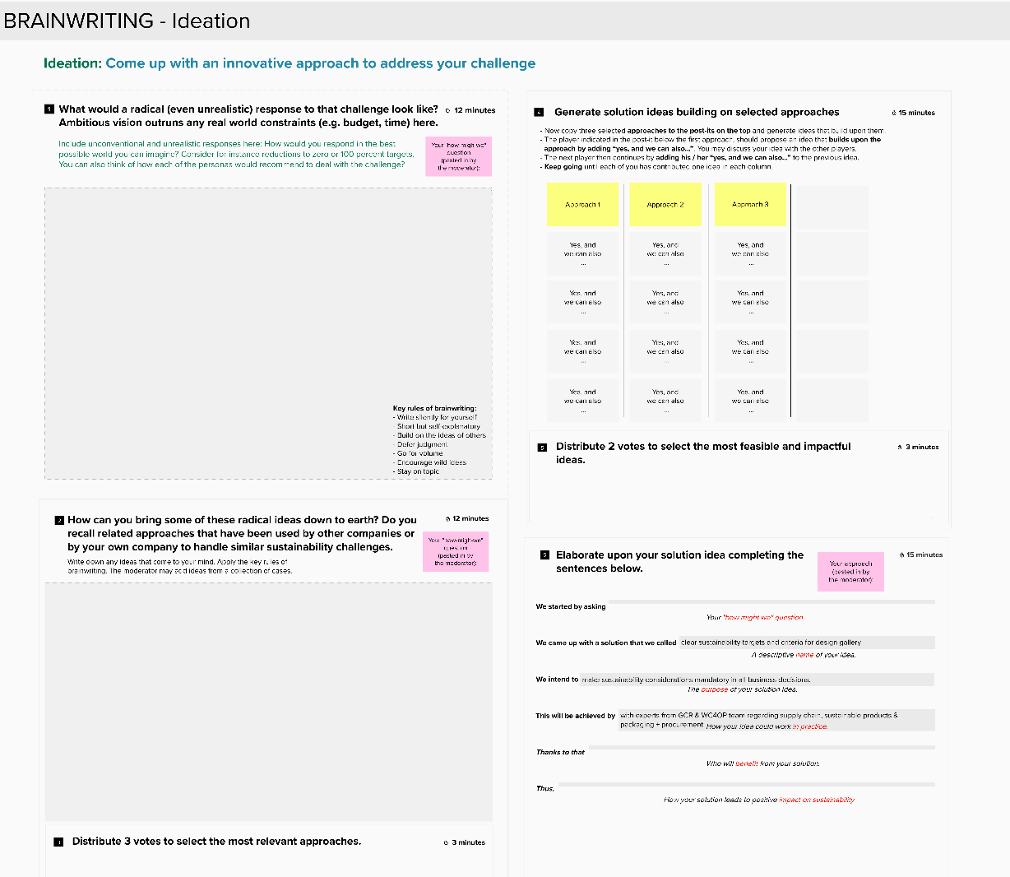
5. Ideation
60 min
Now you will join a group to collaboratively create a new response to the challenge that received the most votes.
We will assign you to one of two “ZOOM breakout rooms”. In each breakout room follow the link in the chat to a new Mural canvas where you will:
Come up with radical responses to the challenge.
Bring some of the radical responses down to earth and recall related approaches for addressing similar challenges
Select approaches to build upon.
Come up with solution ideas building upon these approaches
Select the most feasible and impactful idea.
Spell out your selected idea by using a template
Link to MURAL
Canvas for Group 1
Link to MURAL
Canvas for Group 2
Notes:
@Moderator:
Divides players in two groups.
Pastes result of step 6 from the ideation Mural in the Mural with the advertisement template and shows both results together for the pitch.
Copies chosen how might we question to the pink post-its in the following steps on Mural
In step 2 contributes with own knowledge of cases and good practices and guides the discussion if the players are stuck. See collection of cases in the backup (slide 124)
Players come back to joint zoom meeting for the pitch. Moderator presents next slide.
Group 1 Facilitator: https://app.mural.co/invitation/mural/corporatesustainabilityinnov2207/1611746864061?sender=kivanov5643&key=7bd217ec-4293-4ca0-98a0-e92dcb7e9240
Group 1 visitor link: https://app.mural.co/t/corporatesustainabilityinnov2207/m/corporatesustainabilityinnov2207/1611746864061/9143b5c05215ca2ed2714c5583fb73d074a40811
Group 2 Facilitator: https://app.mural.co/invitation/mural/corporatesustainabilityinnov2207/1611746879597?sender=kivanov5643&key=a11d621e-2563-44fa-829b-a242d621a499
Group 2 visitor link: https://app.mural.co/t/corporatesustainabilityinnov2207/m/corporatesustainabilityinnov2207/1611746879597/665cb22c35f27a99f012d7017b32fca5e5a46dca

Slide 109

5. Scenario 2030
Pitch “How your idea changed the future?”

Slide 110
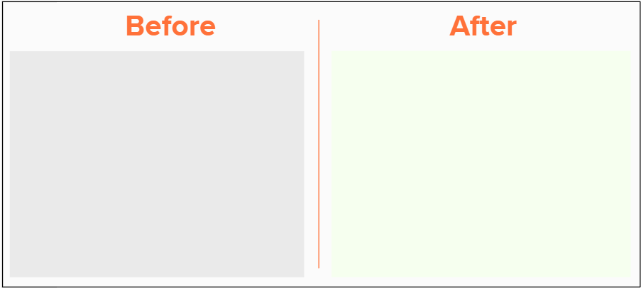
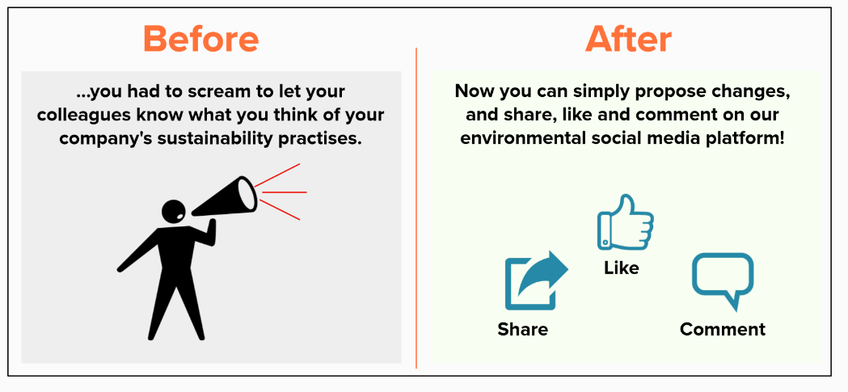
5. Scenario 2030
15 min
Follow a new Mural link to create a poster that presents the impact of your solution as an advertisement from the future.
Use the Before-After template to show how your solution changed the world in the year 2030
Play around with different design elements adding text, drawings, icons and images (searching the MURAL image database of pasting from your computer).
☺ Visuals and fun ideas outrun
accurate content on this last exercise ☺
Example: Environmental Social Media Intranet in the year 2030
Link to MURAL
Canvas for Group 1
Link to MURAL
Canvas for Group 2
Notes:
Before-after Group 1: https://app.mural.co/invitation/mural/corporatesustainabilityinnov2207/1611746821625?sender=kivanov5643&key=3cf37a37-3c00-4abe-a08d-63e27d52857e
Before-after Group 1 Visitor link: https://app.mural.co/t/corporatesustainabilityinnov2207/m/corporatesustainabilityinnov2207/1611746821625/220bc204ba9d0dae537fd0dd6faed823981fd8f7
Before-after Group 2: https://app.mural.co/invitation/mural/corporatesustainabilityinnov2207/1611746848048?sender=kivanov5643&key=8f0bbbdd-7dd1-4dd8-bd93-9c76330383d2
Before-after Group 2 Visitor link: https://app.mural.co/t/corporatesustainabilityinnov2207/m/corporatesustainabilityinnov2207/1611746848048/52361b945b84173467a30e5aff3ac3234afcd2c1

Slide 111

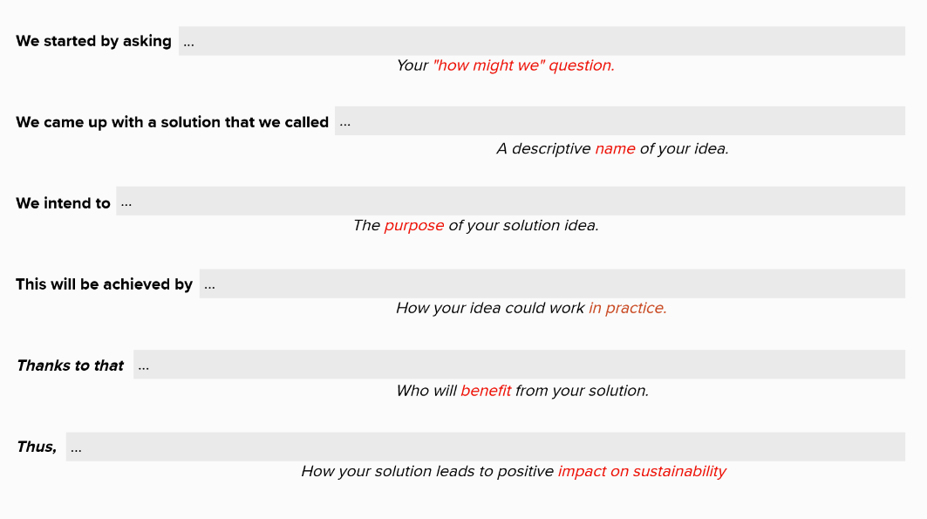
5. Scenario 2030 – pitch your solutions
Welcome back!
Now please take up to 4 minutes to pitch the idea of your group to the other players.
First explain:
what is then name your solution,
what is its purpose,
how it could work in practice,
who will benefit from it and
how it could lead to positive impact on corporate sustainability.
Then present your advertisement poster which we will share on the screen in ZOOM
Finally, everyone will give short feedback on the two ideas and vote for deciding which solution to implement.
Notes:
@Moderator: The leader gets 2 additional votes in deciding which solution to implement

Slide 112
Feedback
Please share your experiences and thoughts about the game:
    How easy was for you to solve the dilemmas? What surprised or puzzled you the most?
    Did you agree with the evaluations you received from the different stakeholders? What did you learn from them?
    What did you learn from the different perspectives you assumed while solving the dilemmas as an employee and while evaluating them as a stakeholder?
    What did you learn from the process of identifying challenges in your own work and then coming up with ideas on how to address them?
    What did you learn throughout the course of the game, as an individual and from the perspective of your organization.
Please take 5 minutes to complete our survey.
Click here
Notes:
Survey: https://ww2.unipark.de/uc/Telekom_Survey/
Observation guide: https://ww2.unipark.de/uc/Telekom_ObservationGuide/

Slide 113
Thank you for
your attention!
More on: www.gamify.site

Slide 114

GAMIFY is a Knowledge Alliance that brings together academia and industry to advance gamification for innovation and entrepreneurship (InnEn)
More on: www.gamify.site

Slide 116
References
Some contents of the “Corporate Sustainability Innovation Game” were partially drawn from the “The UN Global Compact Dilemma Game”, which can be purchased from
https://www.globalcompact.de/en/shop/produkte/Global-Compact-Dilemma-Spiel.php

Slide 117
Backup Slides

Slide 118
4. Challenge Sourcing
Exercise 1
Notes:
Moderator link:
https://app.mural.co/invitation/mural/corporatesustainabilityinnov2207/1598606276883?sender=henningbreuer3927&key=88f86ea1-5542-4786-8da6-d26e859d7b21
Visitor link:
https://app.mural.co/t/corporatesustainabilityinnov2207/m/corporatesustainabilityinnov2207/1598606276883/90853931cc8fca4a180738fe614b94394fb5d11a
Moderator: After everyone contributes with a challenge they vote for the ones they want to continue working on. Each player can distribute 3 voting points for those challenges he/she finds most relevant.

Slide 119
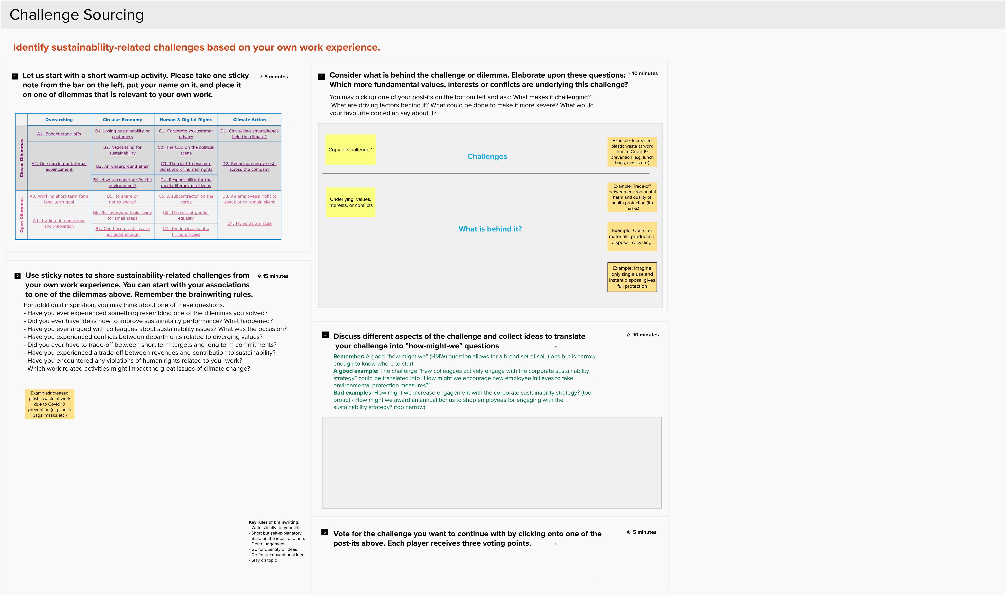
4. Challenge Sourcing
Exercise 2
Notes:
Moderator link:
https://app.mural.co/invitation/mural/corporatesustainabilityinnov2207/1598606276883?sender=henningbreuer3927&key=88f86ea1-5542-4786-8da6-d26e859d7b21
Visitor link:
https://app.mural.co/t/corporatesustainabilityinnov2207/m/corporatesustainabilityinnov2207/1598606276883/90853931cc8fca4a180738fe614b94394fb5d11a
Moderator: After everyone contributes with a challenge they vote for the ones they want to continue working on. Each player can distribute 3 voting points for those challenges he/she finds most relevant.

Slide 120

4. Challenge Sourcing
Exercise 3
Notes:
Moderator link:
https://app.mural.co/invitation/mural/corporatesustainabilityinnov2207/1598606276883?sender=henningbreuer3927&key=88f86ea1-5542-4786-8da6-d26e859d7b21
Visitor link:
https://app.mural.co/t/corporatesustainabilityinnov2207/m/corporatesustainabilityinnov2207/1598606276883/90853931cc8fca4a180738fe614b94394fb5d11a
Moderator: After everyone contributes with a challenge they vote for the ones they want to continue working on. Each player can distribute 3 voting points for those challenges he/she finds most relevant.

Slide 121
4. Challenge Sourcing
Exercise 4
Notes:
Moderator link:
https://app.mural.co/invitation/mural/corporatesustainabilityinnov2207/1598606276883?sender=henningbreuer3927&key=88f86ea1-5542-4786-8da6-d26e859d7b21
Visitor link:
https://app.mural.co/t/corporatesustainabilityinnov2207/m/corporatesustainabilityinnov2207/1598606276883/90853931cc8fca4a180738fe614b94394fb5d11a
Moderator: After everyone contributes with a challenge they vote for the ones they want to continue working on. Each player can distribute 3 voting points for those challenges he/she finds most relevant.

Slide 122


5. Ideation
Exercise 1
Notes:
Moderator link:
https://app.mural.co/invitation/mural/corporatesustainabilityinnov2207/1598606276883?sender=henningbreuer3927&key=88f86ea1-5542-4786-8da6-d26e859d7b21
Visitor link:
https://app.mural.co/t/corporatesustainabilityinnov2207/m/corporatesustainabilityinnov2207/1598606276883/90853931cc8fca4a180738fe614b94394fb5d11a
Moderator: After everyone contributes with a challenge they vote for the ones they want to continue working on. Each player can distribute 3 voting points for those challenges he/she finds most relevant.

Slide 123

5. Ideation
Exercise 2
Notes:
Moderator link:
https://app.mural.co/invitation/mural/corporatesustainabilityinnov2207/1598606276883?sender=henningbreuer3927&key=88f86ea1-5542-4786-8da6-d26e859d7b21
Visitor link:
https://app.mural.co/t/corporatesustainabilityinnov2207/m/corporatesustainabilityinnov2207/1598606276883/90853931cc8fca4a180738fe614b94394fb5d11a
Moderator: After everyone contributes with a challenge they vote for the ones they want to continue working on. Each player can distribute 3 voting points for those challenges he/she finds most relevant.

Slide 124

5. Ideation
Exercise 3
Notes:
Moderator link:
https://app.mural.co/invitation/mural/corporatesustainabilityinnov2207/1598606276883?sender=henningbreuer3927&key=88f86ea1-5542-4786-8da6-d26e859d7b21
Visitor link:
https://app.mural.co/t/corporatesustainabilityinnov2207/m/corporatesustainabilityinnov2207/1598606276883/90853931cc8fca4a180738fe614b94394fb5d11a
Moderator: After everyone contributes with a challenge they vote for the ones they want to continue working on. Each player can distribute 3 voting points for those challenges he/she finds most relevant.

Slide 125
5. Ideation
Exercise 5
Notes:
Moderator link:
https://app.mural.co/invitation/mural/corporatesustainabilityinnov2207/1598606276883?sender=henningbreuer3927&key=88f86ea1-5542-4786-8da6-d26e859d7b21
Visitor link:
https://app.mural.co/t/corporatesustainabilityinnov2207/m/corporatesustainabilityinnov2207/1598606276883/90853931cc8fca4a180738fe614b94394fb5d11a
Moderator: After everyone contributes with a challenge they vote for the ones they want to continue working on. Each player can distribute 3 voting points for those challenges he/she finds most relevant.

Slide 126

6. Scenario 2030
Exercise 1
Notes:
Moderator link:
https://app.mural.co/invitation/mural/corporatesustainabilityinnov2207/1598606276883?sender=henningbreuer3927&key=88f86ea1-5542-4786-8da6-d26e859d7b21
Visitor link:
https://app.mural.co/t/corporatesustainabilityinnov2207/m/corporatesustainabilityinnov2207/1598606276883/90853931cc8fca4a180738fe614b94394fb5d11a
Moderator: After everyone contributes with a challenge they vote for the ones they want to continue working on. Each player can distribute 3 voting points for those challenges he/she finds most relevant.

Slide 127
Results
Leg | P1 | P2 | P3 | P4 | P5 | P6 | P7 | P8 | P9
Quiz 1 | 0 | 30
Quiz 2
Sum Quiz | 0 | 30
Closed Dilemmas
Open Dilemmas
Sum Total

Slide 128
Fully disapprove | Strongly disapprove | Slightly disapprove | Neither support nor disapprove | Slightly support | Strongly support | Fully support
-30 | -20 | -10 | 0 | 10 | 20 | 30
Notes:
Consider: we need each stakeholder card printed x2

Slide 129
6. Scenario 2030
Option 1: Before-After
Example: Environmental Social Media Intranet in the year 2030
Notes:
Before-after Group 1: https://app.mural.co/invitation/mural/corporatesustainabilityinnov2207/1598038806460?sender=kivanov5643&key=ecc3b672-7bfe-4604-bb15-0b1d14913ff0
Before-after Group 1 Visitor link: https://app.mural.co/t/corporatesustainabilityinnov2207/m/corporatesustainabilityinnov2207/1598038806460/d832f929aaf21bcabaa73bcbc9fa386615d21d4e
Before-after Group 2: https://app.mural.co/invitation/mural/corporatesustainabilityinnov2207/1598019237038?sender=kivanov5643&key=5eacc33b-fc00-43f7-80d7-f81d57707d5b
Before-after Group 2 Visitor link: https://app.mural.co/t/corporatesustainabilityinnov2207/m/corporatesustainabilityinnov2207/1598019237038/ad9b9a490e5d132058477cfc9e1411e719994567

Slide 130
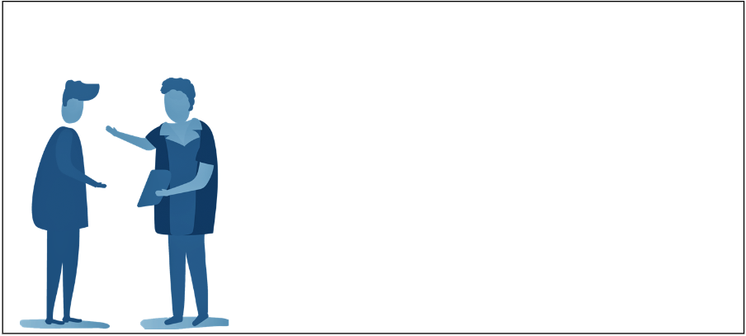
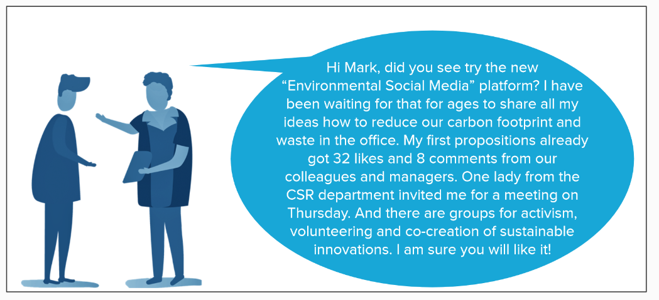
6. Scenario 2030
Option 2: Testimony
Example: Environmental Social Media Intranet in the year 2030
Notes:
Testimony Group 1: https://app.mural.co/invitation/mural/corporatesustainabilityinnov2207/1598038185205?sender=kivanov5643&key=f5915612-d870-4704-a8f1-d9be73c61ede
Testimony Group 1 Visitor link: https://app.mural.co/t/corporatesustainabilityinnov2207/m/corporatesustainabilityinnov2207/1598038185205/1b4558cd40294e34801e33f3fec05791d689643d
Testimony Group 2: https://app.mural.co/invitation/mural/corporatesustainabilityinnov2207/1598038898103?sender=kivanov5643&key=3c3fd6ee-09a0-4355-9a3f-6102096663d1
Testimony Group 2 Visitor link: https://app.mural.co/t/corporatesustainabilityinnov2207/m/corporatesustainabilityinnov2207/1598038898103/4fd500acb726483c4e9fa565fd884c817e8f65bb

Slide 131
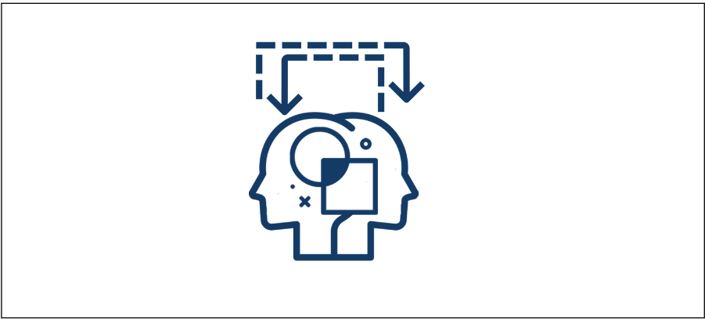
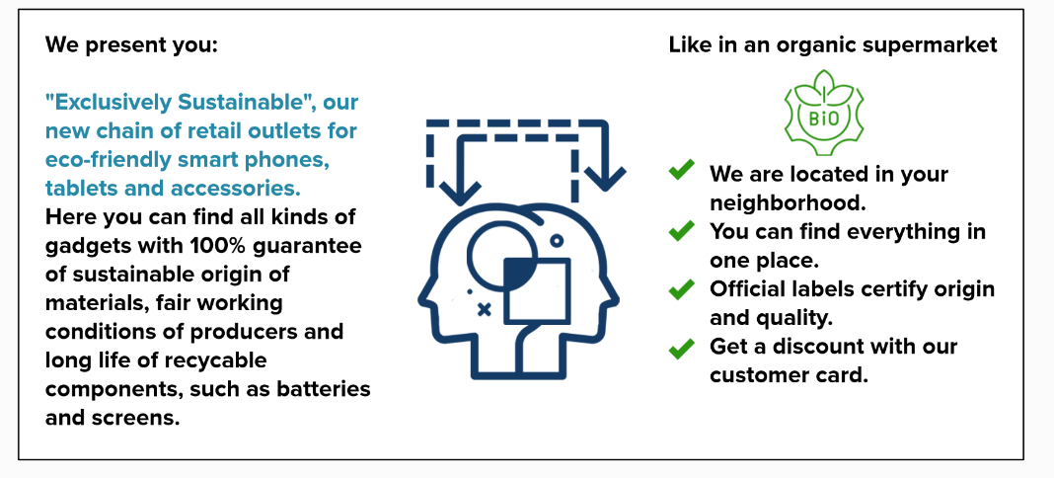
6. Scenario 2030
Option 3: Analogy
Example: Retail outlets for "Exclusively Sustainable" ICT products
Notes:
Analogy Group 1: https://app.mural.co/invitation/mural/corporatesustainabilityinnov2207/1598039035195?sender=kivanov5643&key=c415fa56-e5cf-4605-80fe-fe71f28da625
Analogy Group 1 Visitor link: https://app.mural.co/t/corporatesustainabilityinnov2207/m/corporatesustainabilityinnov2207/1598039035195/76d9322660fadf6cedb1342de0bab5c49cd7639c
Analogy Group 2: https://app.mural.co/invitation/mural/corporatesustainabilityinnov2207/1598039381968?sender=kivanov5643&key=1a828f8f-3937-471a-b855-8cb9b9efcd75
Analogy Group 2 Visitor link: https://app.mural.co/t/corporatesustainabilityinnov2207/m/corporatesustainabilityinnov2207/1598039381968/9e5f07accaea3ae6935fe9c36e787f8ebca5c6e8

Slide 132
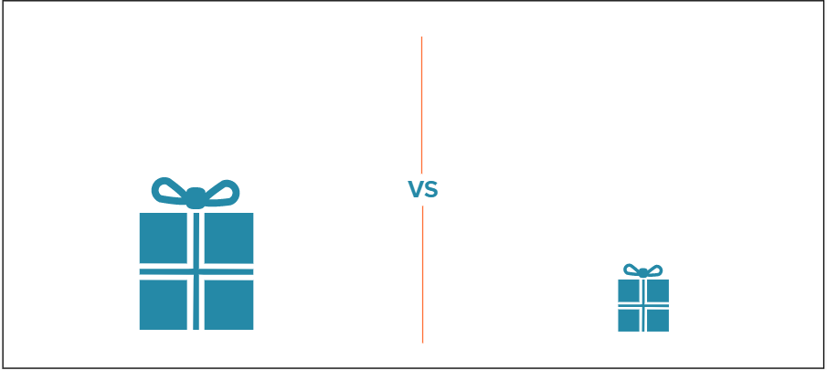
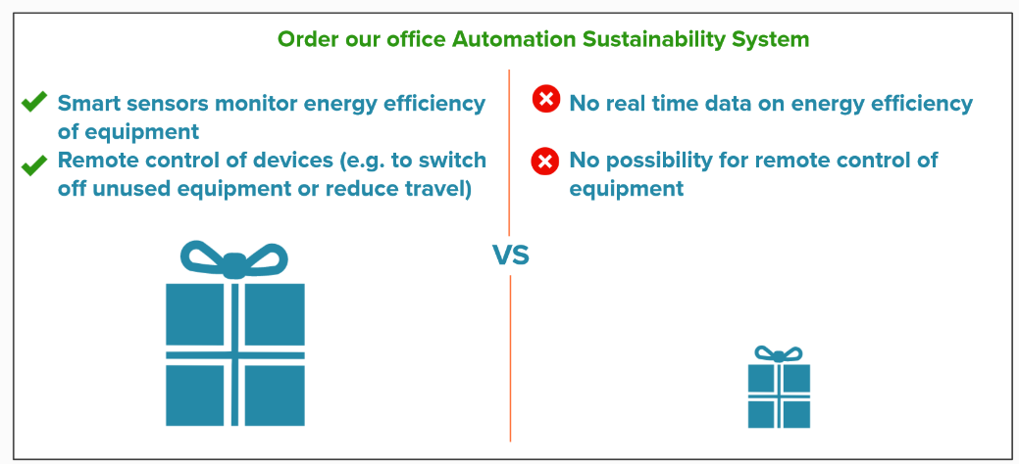
6. Scenario 2030
Option 4: Comparative evaluation
Example: Office Automation Sustainability System
Notes:
Comparative evaluation Group 1: https://app.mural.co/invitation/mural/corporatesustainabilityinnov2207/1598039612321?sender=kivanov5643&key=1d9de764-985f-4d71-85d0-f4b6a33073b8
Comparative evaluation Group 1 Visitor link: https://app.mural.co/t/corporatesustainabilityinnov2207/m/corporatesustainabilityinnov2207/1598039612321/260aabdcae70d696b44ba7004c6d40aa7c87a849
Comparative evaluation Group 2: https://app.mural.co/invitation/mural/corporatesustainabilityinnov2207/1598039748224?sender=kivanov5643&key=b759b588-a012-411e-9379-6f8446935239
Comparative evaluation Group 2 Visitor link: https://app.mural.co/t/corporatesustainabilityinnov2207/m/corporatesustainabilityinnov2207/1598039748224/bff19ede7f0eae88fb3a346a8b90eba68d502e67

Slide 133
6. Scenario 2030: Select one of the four templates
20 min
1. Before-After
3. Analogy
2. Testimony
4. Comparative evaluation

Slide 134
Quiz – Overarching 10 Points
Sources: https://www.highspeedtraining.co.uk/hub/corporate-social-responsibility-quiz/
  Delmas, M. A., & Burbano, V. C. (2011). The drivers of greenwashing. California Management Review, 54(1), 64-87.
  Explanation: Greenwashing refers to the act of “combining poor environmental performance with positive communication about environmental performance” (Delmas & Burbano, 2011, 84). A common indication of greenwashing in an organization are spending differences: when significantly more money or time have been invested in advertising "green" performance (i.e. environmental sustainability), than is actually spent on positive environmental practices.

Slide 135
Quiz – Overarching 20 Points
Explanation: The UN Conference on Trade and Development has estimated a staggering
amount of annual investment requirements between US$ 5 and 7 trillion in all countries to
achieve the SDGs (UNDP, 2018). According to the report there is an annual financing gap
of US$ 2.5 trillion particularly in developing countries. This means that the active
engagement of the private sector is critical for the achievement of the goals.

Slide 136
Quiz – Overarching 30 Points
Explanation: The “European Green Deal” plan includes potential carbon tariffs for countries that don't curtail their greenhouse gas pollution at the same rate, a circular economy action plan and a sustainable and smart mobility strategy. It also suggests increased investments in green technologies, sustainable solutions and new businesses.

Slide 137
Quiz – Overarching 40 Points
Explanation: Sustainable innovation integrates principles of sustainability, refering to ist
three interconnected aspects: environmental, economic and social.

Slide 138
Quiz – Overarching 50 Points
Explanation: The task of values-based innovation management is to identify and
systematically use values as source and guide for innovation processes. These values may
be integrated in organisations in a more or less top-down (e.g. diffusing from an
authoritative top management directive) and/or in a bottom-up fashion (e.g. from
employees’ initiatives or in reaction to changing customer or societal values).

Slide 139
Quiz – Circular Economy 10 Points
Explanation: The circular economy aims to keep products, equipment and infrastructure in use for longer, thus improving the productivity of these resources. It can be understood as the opposite to a linear economy, where resources are extracted, manufactured into goods, distributed and sold, and when they reach the end of their useful lifespan they are either disposed in landfills, or are only patially recycled or downcycled.

Slide 140
Quiz – Circular Economy 20 Points
Explanation: Roughly 50 million metric tons of electronic waste are produced globally each year, with Europe being the second largest generator of e-waste per inhabitant. Toxic materials in electronic items generate air and water pollution when devices are incinerated, put in landfills or melted down. Informal processes of dismantling and disposing of electronic waste in developing countries lead to a number adverse human health and environmental impacts.

Slide 141
Quiz – Circular Economy 30 Points
Explanation: The waste management hierarchy is a set of priorities that protect the
environment alongside resource and energy consumption from most favourable to least
favourable actions. By reducing the amount of unnecessarily purchased items, reusing
items more than once and disposing the items that can no longer be used at appropriate
recycling centres, you can contribute towards a healthier planet.

Slide 142
Quiz – Circular Economy 40 Points
Explanation: A life-cycle analysis involves a thorough inventory of the energy and materials that are required across the entire value chain of a product, process or service. The assessment of environmental impacts follows from raw material extraction and processing, through manufacturing, distribution and use, to the recycling or final disposal of materials.

Slide 143
Quiz – Circular Economy 50 Points
Explanation: Around 70 percent of a mobile phone is made up of completely recyclable materials. It is estimated that recycling circuit boards can extract 30 to 40 times more precious metals, such as copper and gold, than mining for ore. However, just as any other type of e-waste, smartphones are often recycled informally in developing countries, exposing residents to serious health and environmental risks.

Slide 144
Quiz – Human & Digital Rights 10 Points
Explanation: A company code of conduct is a set of rules which protects the business and
informs the employees of the company's expectations. In its code of conduct, the
Deutsche Telekom Group asserts that all employees must comply with their legal
obligations, thus creating essentials such as trust, credibility and good reputation.

Slide 145
Quiz – Human & Digital Rights 20 Points
Explanation: Hate speech is a violation of human rights, typically expressed on the Internet or social media but may also appear in workplace environments, such as on the corporate Intranet. It is not protected by freedom of expression and figures as a legal term in most developed countries, where its expressions can be accordingly prosecuted and punished.
Source:
https://dictionary.cambridge.org/us/dictionary/english/hate-speech

Slide 146
Quiz – Human & Digital Rights 30 Points
Explanation: According to a report by the Institute for Human Rights and Business hackers but also government agencies and companies have used ICTs to intrude personal privacy in the past. Furthermore, surveillance technologies can limit the exchange of information and suppress freedom of speech as well as the right to a fair trial, for example by intruding in privileged communications, such as between a lawyer and client.
Source:
https://www.ihrb.org/uploads/reports/IHRB%2C_Telecommunications_and_Human_Rights_-_An_Export_Credit_Perspective%2C_Feb_2017.pdf

Slide 147
Quiz – Human & Digital Rights 40 Points
Explanation: A digital divide is any uneven distribution in the access to, use of, or impact of ICTs. Because of the high costs associated with ICTs, their adoption and utilization is highly unbalanced across the globe. Further barriers to closing the gap include: physical, cognitive, geographic, demographic, institutional, political and cultural factors.

Slide 148
Quiz – Human & Digital Rights 50 Points
Explanation: BMZ’s “Digital Agenda” emphasises that information and communication technology has comprehensive impacts on all 17 of the UN’s Sustainable Development Goals, playing an essential role as a means of accomplishing them.
Source:
https://www.kfw.de/nachhaltigkeit/KfW-Group/Sustainability/sustainability-report-2017/digitalisierung-foerdert-menschenrechte/

Slide 149
Quiz – Climate Action 10 Points
Explanation: ICT infrastructure may be damaged by floods and other disasters while data centres will incur greater costs for cooling and energy. Insurance companies can expect to pay out more in disaster claims. Some vineyard regions will no longer be able to sustain grape harvest.
Source:
https://www.nationalgeographic.com/environment/global-warming/global-warming-quiz/

Slide 150
Quiz – Climate Action 20 Points
Explanation: Connectivity through ICT can significantly reduce global greenhouse gas emissions by helping companies and consumers to more intelligently use and save energy. For example, it enables us to operate with data online, use services in the cloud and substitute regular meetings and workshops with videoconferences.
Source:
https://www.weforum.org/agenda/2015/12/how-the-communications-industry-can-help-tackle-climate-change/
https://unfccc.int/news/ict-sector-helping-to-tackle-climate-change

Slide 151
Quiz – Climate Action 30 Points
Explanation: The electricity and heat production sector emits the largest percentage of global greenhouse gas emissions at 25 percent. ICTs account for 8-10 percent of the European electricity consumption and up to 4 percent of its carbon emissions.
Sources:
https://www.epa.gov/ghgemissions/global-greenhouse-gas-emissions-data
https://www.earthday.org/the-climate-change-quiz/
https://ictfootprint.eu/en/about/ict-carbon-footprint/ict-carbon-footprint

Slide 152
Quiz – Climate Action 40 Points
Explanation: A recent study (Malmody & Lunden, 2018) showed that despite the continuous growth of the ICT sector its carbon footprint is shrinking. One of the reasons is that many large ICT data centres and network operators are users of renewable energy. The study concludes that TVs, PCs and monitors have the largest footprints, but smartphones have also a significant footprint due to their large sales volumes.
Source:
Malmodin, J., & Lundén, D. (2018). The energy and carbon footprint of the global ICT and E&M sectors 2010–2015. Sustainability, 10(9), 3027.

Slide 153
Quiz – Climate Action 50 Points
Explanation: Materiality assessment is the process of identifying which Environmental, Social and Governance issues have highest priority to be addressed by a business. It evaluates the potential of each issue to positively or negatively influence organizational growth, cost, or trust and how important is each issue to different stakeholder groups. This helps to define a company’s strategy, targets and reporting.
Sources:
https://youmatter.world/en/definition/materiality-assessment-definition/

Slide 154
 | Overarching | Circular Economy | Human & Digital Rights | Climate Action
Other Companies | A1. Icarus Initiative | Materials Marketplace | BKMS® Compliance System | co2online
 | A2. GDS Latam Group | RePack | Ushahidi | MIT Climate CoLab
 | IBM’s ValuesJam | Godsinlösen | Unilever's Framework for Fair Compensation | ParkMe
 | Green Hackathon | Turo | JUUUPORT | Global Forest Watch
 | Facebook’s “Donate Button” |  | #Hasshilft | Ecosia
 | ZERO |  | Code your Life | BSR’s Corporate Colocation and Cloud Buyers’ Principles
 | Ecoinomy |  | exclamo
 |  |  | VielRespektZentrum
 |  |  | myPolis
 |  |  | auticon
 |  |  | The MGCubed Project
Telecom Industry | A3. Shipment monitoring & Roambee | Fair Phone | Scroller | WattTime
 | A4. Telekom’s supplier code of conduct | Apple Certified Refurbished | Grameen Telecom's Village Phone program | KDDI’s TRIBID project
 | Telekom’s “we care” label | Vesta Smart Packaging |  | Drive & Track from T-Systems and Fleet Complete
 |  | T-Systems' Digital Label & Goods Tracking |  | CropX
 |  | Temboo |  | Farmer’s Edge
 |  | Closing the Loop |  | Green Grid
 |  | SWAP |  | Green AddICT
 |  | EU’s “common external power supply” initiative |  | BSR’s Corporate Colocation and Cloud Buyers’ Principles
 |  |  |  | Microsoft’s Carbon Fee
Good Practices & Cases of ICT supporting sustainability and corporate responsibility (overarching)

Slide 155
Good Practices & Cases of ICT supporting sustainability and corporate responsibility (overarching)
Title | Subtitle | Explanation | Reference / Commentary
The ICARUS Initiative | Observing the Earth through animals | The ICARUS Initiative develops sensors for tracking and monitoring of animals. The aim of the project is to create a network of measuring stations and warning devices that support wildlife protection as well as the management of disasters and epidemics. | https://www.icarus.mpg.de/en

Slide 156
Good Practices & Cases of ICT supporting sustainability and corporate responsibility (overarching)
Title | Subtitle | Explanation | Reference / Commentary
GDS Latam Group | Interactive maps for sustainability | The GDS Latam Group uses Geographic Information Systems (GIS) to support geodesign solutions for the sustainable development of urban and rural areas. It aggregates various data and satellite imagery to create interactive maps that help dealing with challenges such as disaster relief, environmental protection and urban planning. | http://gdslatam.com/

Slide 157
Good Practices & Cases of ICT supporting sustainability and corporate responsibility (overarching)
Title | Subtitle | Explanation | Reference / Commentary
IBM’s ValuesJam | Engaging staff in the definition of corporate values | IBM’s “ValuesJam” initiative invited employees to discuss the company’s values on the corporate intranet and redefine IBM’s values statements. The newly defined values led to follow up initiatives that inspired innovations in products and services as well as organisation and marketing instruments, such as pricing. | https://hbr.org/2004/12/leading-change-when-business-is-good

Slide 158
Good Practices & Cases of ICT supporting sustainability and corporate responsibility (overarching)
Title | Subtitle | Explanation | Reference / Commentary
Green Hackathon | Developing software for sustainability | Green Hackathon is an international series of events where programmers and others experts involved in software development get together to create and implement new ideas for a more sustainable future. The hackathons are organized in different locations and by different organizers using the same branding to create a bigger green hacker community. | http://www.greenhackathon.com/

Slide 159
Good Practices & Cases of ICT supporting sustainability and corporate responsibility (overarching)
Title | Subtitle | Explanation | Reference / Commentary
Facebook’s “Donate Button” | Fundraising on social media | As the largest social media platform Facebook is committed “to give people the power to build community and bring the world closer together”. The platform’s “fundraiser” and “donate button” features allow non-profit organizations to do social good by setting up their own campaign pages and collecting payments without incurring additional fees. Individual users are also able to use the features on behalf of non-profits. | https://socialgood.fb.com/charitable-giving/

Slide 160
Good Practices & Cases of ICT supporting sustainability and corporate responsibility (overarching)
Title | Subtitle | Explanation | Reference / Commentary
Ecoinomy |  | Ecoinomy provides gamification platforms to engage companies’ staff in proposing environmental actions. It allows each employee to have their own account and submit eco-saving opportunities. A utility company used the system to motivate its employees by promising to reinvest the amount of money saved by the proposed actions in the realization of other social projects. Thus, over £8000 was donated to local causes and nearly 5000 actions undertaken.

Slide 161
Good Practices & Cases of ICT supporting sustainability and corporate responsibility (overarching)
Title | Subtitle | Explanation | Reference / Commentary
ZERO | Enabling financial services for the inhabitants of isolated areas | ZERO is an e-transaction platform that serves low-income populations in the isolated areas of rural India. It connects its unbanked customers to financial institutions through a mobile phone device and an integrated biometrics authentication system. This enables villagers to access a complete set of financial services as well as to receive efficient, transparent and corruption-free financial support from the government. | https://www.alittleworld.com/

Slide 162
Good Practices & Cases of ICT supporting sustainability and corporate responsibility (overarching)
Title | Subtitle | Explanation | Reference / Commentary
Shipment monitoring & Roambee | Using sensors to ensure timely and safe deliveries | Smart monitoring solution from T-Systems powered by Roambee provides location and status information of shipments. Sensors record temperature, moisture, light, manipulation, vibration, pressure and motion. This enables timely and safe deliveries that lead to less waste and more efficient industrial processes. | https://iot.telekom.com/en/products/shipment-asset-monitoring-powered-by-roambee

Slide 163
Good Practices & Cases of ICT supporting sustainability and corporate responsibility (overarching)
Title | Subtitle | Explanation | Reference / Commentary
Telekom’s supplier code of conduct | Establishing contracts, partnerships and networks for a more sustainable supply chain | Deutsche Telekom and Orange have developed a mutual supplier Code of Conduct that sets ethical, social and environmental requirements toward suppliers. To ensure adherence to the Code of Conduct, Telekom conducts regular on-site audits, particularly with strategic or high-risk suppliers and service providers. The effectiveness of audits is also boosted by collaborating with other telecommunication providers in a Joint Audit Cooperation (JAC). | https://www.telekom.com/en/corporate-responsibility/assume-responsibility/assume-responsibility/supply-chain-management-355304 https://www.telekom.com/en/corporate-responsibility/news-corporate-responsibility/supplier-code-of-conduct-498834

Slide 164
Good Practices & Cases of ICT supporting sustainability and corporate responsibility (overarching)
Title | Subtitle | Explanation | Reference / Commentary
Telekom’s “we care” label | Informing customers about sustainability benefits | The “we care” label marks sustainable products, services and initiatives and informs customers about their benefits, either to environmental protection or digital participation. Deutsche Telekom employees can make suggestions for the label, which are then reviewed by an expert committee. A brief description beneath the “we care” symbol offers greater transparency to customers and helps them in making a purchasing decision. | https://wecare.telekom.com/en/label/

Slide 165
Good Practices & Cases for Circular Economy in ICT
Title | Subtitle | Explanation | Reference / Commentary
Materials Marketplace | Exchanging industrial waste and by-products in the Cloud | Materials Marketplace is an online waste exchange platform that connects businesses around the world to develop and scale new reuse and recycling opportunities. The cloud-based platform facilitates trade of waste and by-product materials among enterprises. The support of technical experts and a facilitated process allow companies using the platform to understand each other’s material flows and identify resource matches. | https://usbcsd.org/materials

Slide 166
Good Practices & Cases for Circular Economy in ICT
Title | Subtitle | Explanation | Reference / Commentary
RePack | Reusing delivery packages | RePack offers a sustainable packaging service to online retailers and their users. When buying from RePack’s affiliates users can pay a small deposit to receive their deliveries in reusable packaging. After they collect their goods, they can mail back the empty package, without postage fee, receiving as a refund a digital voucher for their next purchase. RePack’s packages are made of recycled materials and can be reused for at least 20 cycles. | https://www.originalrepack.com

Slide 167
Good Practices & Cases for Circular Economy in ICT
Title | Subtitle | Explanation | Reference / Commentary
Godsinlösen | Generating more profit and less waste from damaged items | The Swedish company Godsinlösen cooperates with insurance providers to reutilize damaged goods returned by policyholders. The retrieved electronic devices are sold at discounted prices in a retail store owned by the company. Further partnerships with logistics businesses allow Godsinlösen to source products that have received aesthetic damage during transportation but can still be sold and reused as fully functioning items. | https://www.godsinlosen.se/

Slide 168
Good Practices & Cases for Circular Economy in ICT
Title | Subtitle | Explanation | Reference / Commentary
Turo | Optimizing the use of vehicles | Turo is a peer-to-peer car sharing marketplace where private car owners can rent out their underutilized vehicles online. By matching car owners that seek extra money with drivers that cannot or do not want to own a car, Turo contributes to replacing private vehicle ownership. This can lead to fewer cars being produced and thus lower the strain on natural resources. | https://turo.com/

Slide 169
Good Practices & Cases for Circular Economy in ICT
Title | Subtitle | Explanation | Reference / Commentary
Fair Phone | Promoting repair with modular design | Fairphone is selling smartphones designed and produced with minimal environmental impact. The phones are created with different components that can be independently upgraded or replaced. Affordable spare parts and free tutorials are offered to facilitate phone repair. In addition, its source code is provided to extend the lifetime of the software. | https://www.fairphone.com/en/

Slide 170
Good Practices & Cases for Circular Economy in ICT
Title | Subtitle | Explanation | Reference / Commentary
Apple Certified Refurbished | Refurbishing pre-owned devices | Apple Certified Refurbished Products are Apple devices that have been restored back to their original condition, after being pre-owned or used as display models. The returned units are disassembled, thoroughly cleaned and all their malfunctioning parts are either replaced or repaired. Customers are easily attracted by the discounted prices and renewed 1-year warranties that are offered with Apple’s refurbished models. | https://www.apple.com/shop/refurbished

Slide 171
Good Practices & Cases for Circular Economy in ICT
Title | Subtitle | Explanation | Reference / Commentary
Vesta Smart Packaging | Eliminating waste from single-use plastics | Vesta Smart Packaging uses a combination of smart sensors to reduce the use of plastic packaging. The smart sensors are integrated into reusable packages to record their contents, indicate when they are empty and automate deliveries of eco-friendly refill packs as and when required. | https://www.vestapack.com/

Slide 172
Good Practices & Cases for Circular Economy in ICT
Title | Subtitle | Explanation | Reference / Commentary
T-Systems' Digital Label & Goods Tracking | Reducing paper waste and optimizing logistics processes | T-Systems' Digital Label & Goods Tracking replaces paper labels with a digital freight paper that integrates energy-saving display, temperature and shock sensors, GPS and a mobile connection to the Cloud of Things. The e-label saves paper and optimizes industrial logistics processes. | https://iot.telekom.com/en/products/digital-label

Slide 173
Good Practices & Cases for Circular Economy in ICT
Title | Subtitle | Explanation | Reference / Commentary
Temboo | Preventing food recalls with smart sensors | Temboo offers temperature monitoring and alert systems for commercial freezers. The system sends automatic notifications that help to optimize maintenance and reduce food waste and energy consumption. | https://blog.temboo.com/sustainability-and-iot/

Slide 174
Good Practices & Cases for Circular Economy in ICT
Title | Subtitle | Explanation | Reference / Commentary
Closing the Loop | Reselling smartphones to properly handle e-waste | The Dutch social enterprise Closing the Loop offers a closed loop service for mobile phones. The company collects used phones from organisations in the Netherlands to resell them in Africa but with the promise that for each phone sold there, a waste phone will be collected for transport to the Netherlands, where it can be recycled responsibly and safely. | https://www.closingtheloop.eu/ https://norden.diva-portal.org/smash/get/diva2:1153357/FULLTEXT02.pdf

Slide 175
Good Practices & Cases for Circular Economy in ICT
Title | Subtitle | Explanation | Reference / Commentary
SWAP | Upgrading mobile phones affordably and sustainably | Telenor’s SWAP service allows clients to get the newest smartphones each year, without making costly, unsustainable purchases. Buyers get a new phone with a 2-year leasing contract, which they can renew after 12 months by swapping their device for an upgrade, under a new 2-year agreement. Any outstanding payments on the old phone are cancelled and the operator regains ownership of it, refurbishes it and resells it anew. | https://www.telenor.no/privat/mobil/swap/ https://norden.diva-portal.org/smash/get/diva2:1153357/FULLTEXT02.pdf

Slide 176
Good Practices & Cases for Circular Economy in ICT
Title | Subtitle | Explanation | Reference / Commentary
EU’s “common external power supply” initiative | Standardizing the production of power supply devices | In the 00s the incompatibility of charges and different models of mobile phones was a growing issue that led to unnecessary e-waste and inconvenience for the customers. This was addressed by the European Commission and its “common external power supply” initiative, which encouraged manufacturers to harmonise chargers for the new models they produce, allowing customers to re-use the same external power supply with different handsets. | https://ec.europa.eu/growth/sectors/electrical-engineering/red-directive/common-charger_en

Slide 177
Good Practices & Cases for Human & Digital Rights in ICT
Title | Subtitle | Explanation | Reference / Commentary
BKMS® Compliance System | Preventing white-collar crime | The BKMS® Compliance System is a web-based whistleblowing platform that enables systematic and confidential submission of reports on unethical practices to internal examiners. The system helps to prevent corruption and bribery cases in organizations. | https://www.business-keeper.com/en/bkms-compliance-systemhttps:/ /www.watttime.org/

Slide 178
Good Practices & Cases for Human & Digital Rights in ICT
Title | Subtitle | Explanation | Reference / Commentary
Ushahidi | Aiding human rights reporting | Ushahidi is an online platform whose mission is “to help marginalized people raise their voice and those who serve them to listen and respond better”. It enables local observers to submit reports using their mobile phones or the Internet, while simultaneously creating a temporal and geospatial map of events. The platform is often used to aid reporting on natural catastrophes, armed conflicts, election monitoring and domestic violence. | https://www.ushahidi.com/

Slide 179
Good Practices & Cases for Human & Digital Rights in ICT
Title | Subtitle | Explanation | Reference / Commentary
Unilever's Framework for Fair Compensation | Using big data to ensure fair wages | Unilever uses a pool of digital data in order to ensure fair compensation for its employees based on comprehensive standards. Data sources include social media feeds, bank transaction histories, local wage databases and a corporate app for employees, among others. Through this program Unilever promotes social and economic equality throughout the locations where it operates. | https://medium.com/@seyar819/how-can-big-data-be-used-for-corporate-responsibility-initiatives-b528390c3c57 https://www.unilever.com/sustainable-living/enhancing-livelihoods/fairness-in-the-workplace/fair-compensation/

Slide 180
Good Practices & Cases for Human & Digital Rights in ICT
Title | Subtitle | Explanation | Reference / Commentary
JUUUPORT | Young people helping young people to deal with risks online | JUUUPORT is a non-profit association that supports young people with problems on the web (e.g. cyberbullying, WhatsApp stress, etc.) and is committed to the respectful use of online communication. The association’s young scouts offer anonymous and free advice to affected parties or promote respect, tolerance and compassion on the Internet, through social media campaigns, workshops and webinars. | https://www.juuuport.de/

Slide 181
Good Practices & Cases for Human & Digital Rights in ICT
Title | Subtitle | Explanation | Reference / Commentary
#Hasshilft | Turning hate speech into involuntary donations | Committed to values of freedom and dignity, the ZDK Gesellschaft Demokratische Kultur runs “the first involuntary online donation campaign” - #Hasshilft. The campaign collects funds to turn individual hate speech comments on social media into 1-euro donations that support refugee projects run by the ‘Aktion Deutschland Hilft’ and ‘EXIT-Deutschland’, an initiative against right-wing extremism. | https://www.hasshilft.de/index_en.html https://zentrum-demokratische-kultur.de/initiativen/?c=hass-hilft

Slide 182
Good Practices & Cases for Human & Digital Rights in ICT
Title | Subtitle | Explanation | Reference / Commentary
Code your Life | Engaging children to develop new media | Microsoft’s Code your Life initiative promotes media literacy by imparting knowledge about programming and IT to children in an exciting way. Code your Life gives boys and girls between the ages of 8 and 16 the opportunity to not only be recipients of new media, but also to actively help shape new media and technologies, develop apps and program their own animations. | https://www.code-your-life.org/

Slide 183
Good Practices & Cases for Human & Digital Rights in ICT
Title | Subtitle | Explanation | Reference / Commentary
exclamo | Addressing social problems confidently through an app | exclamo would like to give pupils and staff a voice and help them to talk about their problems such as bullying, discrimination or sexual harassment and to get help. For this purpose, exclamo offers a web app, via which students of a participating school can anonymously contact trusted persons if they themselves are attacked, bullied or insulted. | https://www.exclamo.org/

Slide 184
Good Practices & Cases for Human & Digital Rights in ICT
Title | Subtitle | Explanation | Reference / Commentary
VielRespektZentrum | Offering public spaces to promote diversity and respect | The VielRespektZentrum helps those who are committed to diversity and respect by offering them optimal working conditions in the form of offices, technology, conference, seminar and lecture opportunities. The centre is open to anyone who promotes diversity and respect and is designed in a way that allows everyone to remain free and independent in their work while still being able to cooperate and synergize. | https://www.vielrespektzentrum.de/

Slide 185
Good Practices & Cases for Human & Digital Rights in ICT
Title | Subtitle | Explanation | Reference / Commentary
myPolis | Stimulating political participation of citizens | Portugal-based start-up myPolis develops a suite of applications to foster co-operation between citizens and local government. Its aim is to allow citizens to vote on proposed laws and plans made by the local administration. In addition, myPolis integrates gamification elements to incentivise users’ active participation in political and socio-economic initiatives. | https://www.startus-insights.com/innovators-guide/4-top-e-governance-solutions-impacting-smart-cities/

Slide 186
Good Practices & Cases for Human & Digital Rights in ICT
Title | Subtitle | Explanation | Reference / Commentary
auticon | Engaging disabled people as valuable workforce | IT consulting firm auticon hires exclusively autistic people as specialists in software testing and quality management. Although individuals with autism are typically excluded from employment opportunities, their impairment is often linked to exceptional cognitive and technical abilities. Auticon taps into this potential to offer top quality services as well as high-wage, long-term careers for its employees. | https://auticon.com/

Slide 187
Good Practices & Cases for Human & Digital Rights in ICT
Title | Subtitle | Explanation | Reference / Commentary
The MGCubed Project | Providing inclusive education opportunities | The MGCubed Project uses solar-powered and satellite-enabled distance learning infrastructure to deliver interactive learning sessions for students and teachers in isolated communities. The technological solution facilitates safe, supportive and gender-equitable learning environments. | https://www.varkeyfoundation.org/what-we-do/programmes/making-ghanaian-girls-great
Notes:
Extra case

Slide 188
Good Practices & Cases for Human & Digital Rights in ICT
Title | Subtitle | Explanation | Reference / Commentary
Scroller | Teaching about media literacy with a magazine | Scroller is a media magazine for children developed by Teachtoday, a Deutsche Telekom initiative for the promotion of safe and competent media use. Scroller teaches children from nine to twelve years about media literacy at an eye level. The magazine is available in an interactive web version and in free print format. The current issue from 04/2020 deals with digital civil courage and questions about cyberbullying. | https://www.scroller.de/

Slide 189
Good Practices & Cases for Human & Digital Rights in ICT
Title | Subtitle | Explanation | Reference / Commentary
Grameen Telecom's Village Phone program | Enabling widespread, affordable and profitable access to ICT | In 1997 Grameen Telecom pioneered its Village Phone program, enabling Bangladesh’s rural poor to own a cell-phone while being able to profit from it. The program provides villagers with affordable loans to purchase a mobile, which they can then rent out to other members of their community on a per-call basis. Thus, they extend the coverage of affordable access to ICTs while earning additional income to easily pay back their loan. | http://www.grameentelecom.net.bd/

Slide 190
Good Practices & Cases for Climate Action in ICT
Title | Subtitle | Explanation | Reference / Commentary
co2online | Promoting energy efficiency through online- and monitoring tools | co2online is a non-profit consulting company that runs various campaigns to promote climate protection and energy efficiency. It offers free online- and monitoring tools to help users track and reduce their energy consumption, costs, and CO2 footprint. Based on the data gathered about users’ energy consumption, co2online also offers commercial services for B2B clients, such as personalized market studies. | https://www.co2online.com/

Slide 191
Good Practices & Cases for Climate Action in ICT
Title | Subtitle | Explanation | Reference / Commentary
MIT Climate CoLab | Crowdsourcing ideas for climate action | The Massachusetts Institute of Technology has developed the Climate CoLab crowdsourcing platform where citizens work with experts and each other to co-create detailed proposals for climate action. The platform collects proposals in a number of areas related to climate change and provides assistance to the best ideas by connecting their contributors to resources, people and organizations that can help them put their ideas into action. | https://www.climatecolab.org/ https://www.politesi.polimi.it/bitstream/10589/109610/1/CrowdsourcingSustainability.pdf

Slide 192
Good Practices & Cases for Climate Action in ICT
Title | Subtitle | Explanation | Reference / Commentary
ParkMe | Helping drivers to find unoccupied spaces | ParkMe is a mobile app that allows drivers to see real-time info on available parking spots and street parking. The data is sourced from smart parking sensors. Fewer cars searching for parking equates to less emissions in urban areas and limits the transport industry’s environmental impact. | https://parksmart.gbci.org/smart-parking-sustainable-opportunity https://www.parkme.com/

Slide 193
Good Practices & Cases for Climate Action in ICT
Title | Subtitle | Explanation | Reference / Commentary
Global Forest Watch | Using ICTs to monitor deforestation | The protection of forests has a major role in counteracting climate change. The Global Forest Watch (GFW) is an online platform that offers the latest data, technology and tools that empower people to better protect forests. Through Big Data analytics and satellite imagery, GFW allows anyone to access near real-time information about where and how forests are changing around the world. | https://www.globalforestwatch.org/

Slide 194
Good Practices & Cases for Climate Action in ICT
Title | Subtitle | Explanation | Reference / Commentary
ENVIS | Disseminating environmental information across stakeholders and regions | India’s Environmental Information System (ENVIS) provides climate-related information to decision makers, policy planners, scientists, engineers and the general public all over the country. Through the use of various ICTs, ENVIS retrieves and disseminates information within its network to aid the development of strategies and legislations as well as to raise awareness and spur capacity building in local communities. | http://www.arthapedia.in/index.php?title=Environment_Information_System_(ENVIS) https://pdfs.semanticscholar.org/2a1d/c5f6b8ca8ad777a6abf0c775207c27b9dcb9.pdf

Slide 195
Good Practices & Cases for Climate Action in ICT
Title | Subtitle | Explanation | Reference / Commentary
Ecosia | Searching the web to plant trees | Ecosia is a web search engine that supports forest restoration projects around the world. Like most search engines, Ecosia displays ads along with regular search results. When users click on those ads, Ecosia generates income which it reinvests towards tree planting initiatives, thus fighting global warming, restoring water systems and supporting local communities. | https://www.ecosia.org/

Slide 196
Good Practices & Cases for Climate Action in ICT
Title | Subtitle | Explanation | Reference / Commentary
BSR’s Corporate Colocation and Cloud Buyers’ Principles | Promoting the accountability of data centre service providers | The BSR business network has developed a set of principles that guide users and providers of data centre and cloud services in optimizing their environmental performance. The criteria stipulate requirements for providing renewable energy alternatives to users, delivering data on client energy consumption, disclosing energy sources, supporting renewable energy advocacy and fostering collaboration on renewable energy enhancements. | https://www.bsr.org/en/our-insights/blog-view/six-principles-to-power-cleaner-data-centers

Slide 197
Good Practices & Cases for Climate Action in ICT
Title | Subtitle | Explanation | Reference / Commentary
WattTime | Using data to choose clean energy | WattTime continuously monitors and updates power data from grids in order to allow smart devices to automatically switch to the cleanest energy supplier available. This promotes the consumption as well as the production of clean energy. | https://www.watttime.org/

Slide 198
Good Practices & Cases for Climate Action in ICT
Title | Subtitle | Explanation | Reference / Commentary
KDDI’s TRIBID project | Controlling the energy efficiency of mobile base stations | The Japanese telco KDDI runs equips its mobile base stations with tribrid electric power control technology, which achieves power savings and CO2 reductions of up to 80 percent. The system works by automatically switching to the most efficient power source depending on time of day and weather conditions among three alternatives: commercial-use power service, solar panel generation or battery charging with late-night power service. | https://news.kddi.com/kddi/corporate/english/newsrelease/2018/07/11/3263.html https://www.itu.int/dms_pub/itu-d/opb/stg/D-STG-SG02.24-2014-PDF-E.pdf

Slide 199
Good Practices & Cases for Climate Action in ICT
Title | Subtitle | Explanation | Reference / Commentary
Drive & Track from T-Systems and Fleet Complete | Improving fuel efficiency of corporate fleets | Drive & Track improves management of corporate fleets, assets and mobile employees via a cloud-based platform. The solution optimizes the routing, maintenance and fuel efficiency of vehicles, thereby reducing the company’s carbon footprint. | https://iot.telekom.com/en/products/drive-track

Slide 200
Good Practices & Cases for Climate Action in ICT
Title | Subtitle | Explanation | Reference / Commentary
CropX | Optimizing water and energy use in farmlands | Climate change endangers the availability of water for agricultural uses. CropX is a company that offers cloud-based software to help farmers in adapting to these consequences. The software uses in-field sensors to automatically deliver the correct amount of water to each plant instead of watering a whole field at a time. This boosts crop yields and reduces energy and water consumption. | https://www.cropx.com/

Slide 201
Good Practices & Cases for Climate Action in ICT
Title | Subtitle | Explanation | Reference / Commentary
Farmer’s Edge | Optimizing agricultural efficiency | The effects of climate change are expected to cause more frequent and more severe droughts and floods and disturb current patterns of agriculture. The start-up Farmer’s Edge uses satellite and data-driven technologies to help growers manage the variability of farmland conditions. This generates actionable insights that help farmers to run efficient operations in response to the growing risks and nourishment needs on our planet. | https://www.forbes.com/sites/maggiemcgrath/2017/06/28/the-25-most-innovative-ag-tech-startups/#64da898f4883 https://www.farmersedge.ca/about-us/

Slide 202
Good Practices & Cases for Climate Action in ICT
Title | Subtitle | Explanation | Reference / Commentary
Green Grid | Collaborating to reduce the power consumption of data centres | Green Grid is an open industry consortium that works to improve IT and data centre energy efficiency and eco-design around the world. Members of the consortium include end-users, policymakers, technology providers, facility architects and utility companies. By facilitating partnerships across the global ICT ecosystem Green Grid promotes the development and adoption of a common resource efficiency measures. | https://www.thegreengrid.org/ https://www.itu.int/dms_pub/itu-t/oth/23/01/T23010000030002PDFE.pdf

Slide 203
Good Practices & Cases for Climate Action in ICT
Title | Subtitle | Explanation | Reference / Commentary
Green AddICT | Sharing expertise and best practices via an online platform | In 2008 the city council of Bristol launched its Green AddICT online platform to help local ICT businesses in sharing expertise and good practices against climate change. The website offered a database of solutions and case studies as well as tools such as carbon calculators to help organisations in sharing experience and designing a personalised action plan. | https://www.eumayors.eu/IMG/pdf/Bristol_long_final.pdf

Slide 204
Good Practices & Cases for Climate Action in ICT
Title | Subtitle | Explanation | Reference / Commentary
Microsoft’s Carbon Fee | Setting a price on carbon emissions to reduce footprint | Microsoft’s Carbon Fee holds the company’s business units financially accountable for their CO2 footprint. It acts as an incremental price on emissions associated with operations for data centres, offices, labs, manufacturing and business air travel. The fee sets CO2 reduction targets for each business unit, which are met through e.g. efficiency projects, green power investments or investments in external carbon offset projects. | https://unfccc.int/mfc2015/microsoft-global-carbon-fee/# https://download.microsoft.com/documents/en-us/csr/environment/microsoft_carbon_fee_guide.pdf

Slide 205
  Nothing, your team is very productive and you do not want to disturb their workflow. Besides, you realize that it will take a lot of effort and time to make them shift their priorities.
A: Overarching
A
A3. Working short-term
for a long-term goal
B
  You organize meetings and trainings, through which you try to educate the members of your team about the importance of Telekom’s future-oriented commitments to social responsibility.
C
  You speak to your managers, looking for options to offer contract extensions to your team members as well as bonuses for implementing Telekom’s social responsibility goals in the innovations that they develop.

Slide 206
  Nothing, you don’t want to risk investments into uncertain and risky projects that can put at stake the reliability of operations and may generate some return only years later.
A: Overarching
A
A4. Trading off operations
and innovation
B
  You look for support from shareholders and new investors that are willing to support an innovation project for enhancing the environmental performance of the data centre, despite the associated risks. Only after acquiring such support you initiate the project.
C
  You engage a team of experts to find out which innovations have the highest potential and lowest risks and implement those that are backed with solid evidence.

Slide 207
A
  You do not share the full details about the new process with your supplier and are able to partly implement it and enhance some of components of your product, just enough to take advantage in front of the competition.
B: Circular Economy
B5. To share or not to share?
B
  You present your invention to both the supplier and your competitor. This has the most positive impact for the environment.
C
  You do not share any details about the new process and delay its implementation. No matter what, you do not want to risk helping the competition.

Slide 208
A
  Nothing, forcing changes will only cause unrest among the employees and mangers and disturb their work.
B: Circular Economy
B6. Not everyone feels ready for small steps towards ecology
B
  You discuss the changes with your superiors and get approval to implement them despite the resistance of the employees on site. Thus, all must adhere to the new policy whether they like it or not.
C
  Some of the managers support your ideas. You try to convince them to implement the changes only for the departments they are working at.

Slide 209
A
  Nothing, the employees have the right to freely express their opinion and as long as they are not spreading it in the general public outside the company it cannot harm Telekom’s reputation.
B: Circular Economy
B7. Good eco practices are not good enough
B
  You organize a meeting with the members of your team to discuss Telekom’s commitment to sustainability and the importance of everyone’s small actions.
C
  You create a communication policy in which you outline what the team members can discuss, where and when.

Slide 210
A
  Nothing, this is beyond your scope of jurisdiction. Where else will your responsibility end?
C: Human & Digital Rights
C5. A subcontractor on the verge
  You get in touch with the subcontractor to discuss the working conditions they offer and propose to them to comply with Telekom’s supplier code of conduct.
B
C
  You instruct the supplier to make sure that all subcontractors comply with Telekom’s code of conduct and are prepared to go through an audit with you.
Notes:
Nothing, the new manager has good qualifications and transferring her would be incorrect.
You are moving her to a different location, this would be the best solution for everybody.
You organize a training for all retail locations in the region about Telekom’s ethical and anti-discrimination standards. In the next few months you will monitor the situation in the shop and see if it improves.
...

Slide 211
A
  Nothing, the new manager has good qualifications and transferring her would be incorrect.
C: Human & Digital Rights
C6. The cost of gender equality
B
  You are moving her to a different location, this would be the best solution for everybody.
  You organize a training for all retail locations in the region about Telekom’s ethical and anti-discrimination standards. In the next few months you will monitor the situation in the shop and see if it improves.
C
Notes:
Nothing, the new manager has good qualifications and transferring her would be incorrect.
You are moving her to a different location, this would be the best solution for everybody.
You organize a training for all retail locations in the region about Telekom’s ethical and anti-discrimination standards. In the next few months you will monitor the situation in the shop and see if it improves.
...

Slide 212
C: Human & Digital Rights
A
  Nothing, you are sure that your managers have valid reasons not to invite these candidates.
C7. The intricacies of a hiring process
B
  You ask your superiors about their reasons for not inviting these applicants to an interview and you question their choice.
C
  You do not say anything to your superiors but approach their manager to inform him about what happened and let him decide whether and what to undertake.
Notes:
Nothing, you are sure that your managers have valid reasons not to invite these candidates.
You ask your superiors about their reasons for not inviting these applicants to an interview and you question their choice.
You do not say anything to your superiors but approach their manager to inform him about what happened and let him decide whether and what to undertake.
...
Additional alternative:
You don't say anything to your managers, but you speak to the HR department. You ask them to send a memo to senior executives reminding them of the company's recruitment and gender equality policies.

Slide 213
D: Climate Action
A
  Nothing, he has the right to express his opinion.
D3. An employee’s right to speak or to remain silent
B
  You create a communication policy in which you outline what the team members can discuss, where and when.
  You approach the employee personally and try to understand his concerns and why he expressed them online. You explain the company’s positive efforts and contributions.
C
Notes:
Nothing, he has the right to express his opinion.
You create a communication policy in which you outline what the team members can discuss, where and when.
You approach the employee personally and try to understand his concerns and why he expressed them online. You explain the company’s positive efforts and contributions.
...

Slide 214
D: Climate Action
A
  Nothing, if you try to restrict the manager’s air travel you might experience disapproval from their side and you will need their support for other larger initiatives.
D4. Flying as an issue
B
  You suggest to curtail air travel throughout the company. You justify your proposal based on cost savings and do not mention the environment. This should attract more support for your idea.
C
  You introduce a policy for collecting the free flight miles and using them for business trips only. This will limit the employees’ motivation to travel excessively.
Notes:
Nothing, if you try to restrict the manager’s air travel you might experience disapproval from their side and you will need their support for other larger initiatives.
You suggest to curtail air travel throughout the company. You justify your proposal based on cost savings and do not mention the environment. This should attract more support for your idea.
You introduce a policy for collecting the free flight miles and using them for business trips only. This will limit the employees’ motivation to travel excessively.
...

