Slide 1


68 practices and methods for gaining competitive edge and impact
Henning Breuer
Kiril Ivanov

Slide 2
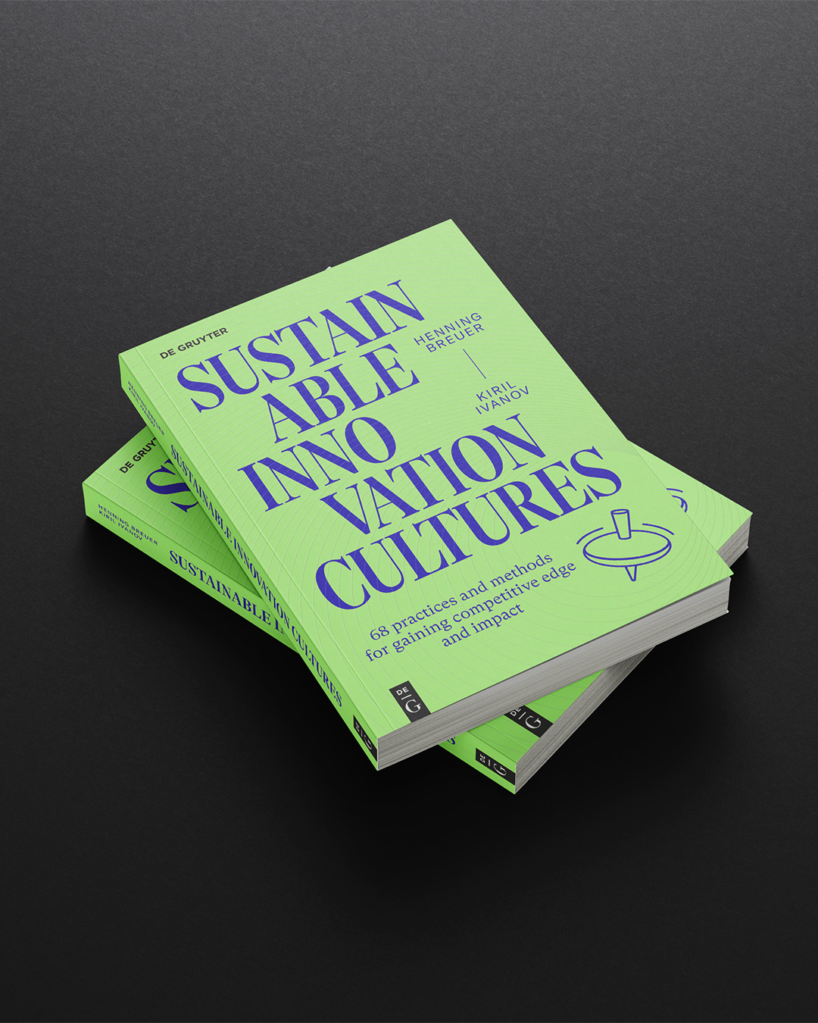
Slides
Based on the (open access) book
Slides by Henning Breuer & Kiril Ivanov based on the
open access book (CC-BY-NC-ND) published by DeGruyter:
Part III & IV co-authored by Roman Meier-Andrae, Mario Rapaccini, Raffaella Montera, Chiara Guiggiani, Alessandro Monti, Katarzyna Matras-Postolek, Piotr Beńko, Małgorzata Ciesielska, Jacek Kasz, Irena Śliwińska, Carmen Abril, Ladeja Godina Košir and Gregor A. Erkel
Thanks for copyediting to Paul Lauer. Cover design and
layout (and the picture on the right) by Elmar Birk,
illustrations by Henning Breuer Vincent Beck and Elmar Birk.
For related materials see:
www.uxberlin.com/sustainable-innovation-cultures
www.degruyterbrill.com/document/doi/10.1515/9783111375700/html
https://www.degruyterbrill.com/document/doi/10.1515/9783111375700/html

Slide 3
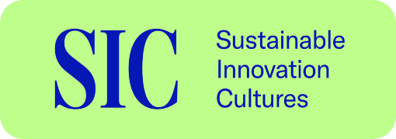
Overview
Chapters
PART I FRAMEWORK / It Takes a Whole Culture
It Takes a Whole Culture
Conceptual Foundations
A Framework for Sustainable Innovation Cultures
PART II PRACTICES AND METHODS
Conceiving Innovation Cultures
Co-creating Targeted Interventions
Cultivating Sustainable Innovation
PART III CASES
From Safety to Sustainability – The Case of an Inspection Company in Germany
Cultural Transformation in the Italian Oil Industry
Investments in People and Technology along with Management by Values in Poland
Sustainable Innovation Challenges in Science-Based Companies in Spain
PART IV CROSS-CUTTING ISSUES
Developing Sustainable Innovation Cultures during Mergers and Acquisitions: The Case of Two Breweries in Slovenia
Sustainable Finance and Investments for Sustainable Innovation Cultures
Outlook: Forward-Looking Cultures
APPENDICES
Glossary of Key Terms
About the Authors
Endnotes

Slide 4
Overview
Cases
CASE 1. Expert Insights on Four Critical Factors to Develop Sustainable Innovation Cultures
CASE 2. The Role of Healthcare Companies in the Global Sustainability Transformation
CASE 3. How Companies Integrate the SDGs into their Impact Strategies
CASE 4. Cultural Challenges to Translating Normative Guidelines into Practices and Artefacts
CASE 5. Key Value Indicators for Gauging the Impact of Information and Communication Technology Solutions
CASE 6. Ecosia Considers Partnering with a Petrol Company
CASE 7. Interface and its Outstanding Journey Towards Sustainable Innovation Culture
CASE 8. Shortcut to Understanding and Reviving Brand Values in Mid-Sized Companies
CASE 9. Insights into Sustainable Innovation Challenges and Practices from a Comparative European Study
CASE 10. Pelliconi’s Co-creating Approach to Sustainable Innovation
CASE 11. Envisioning New Mobility Business at Michelin
CASE 12. Employee-Driven Co-creating to Foster Sustainable Innovation at Interface and Xerox
CASE 13. German Railways’ Cultivation of Data-Driven Sustainability Management
CASE 14. How Ecosia’s Continuous Refinement of Values Informs Strategic Decisions
CASE 15. Informal Collaboration Practices to Reconcile Tensions in Alberta’s Healthcare System
CASE 16. Patagonia’s Approach to Financing Sustainable Transformation
CASE 17. Green Bonds in Unilever’s Sustainable Living Plan
CASE 18. Cultural Transformation and Financing Sustainable Transformation at GLS Investment

Slide 5
Overview
Approaches
APPROACH 1. Guiding Questions to Formulate Guiding Principles for an Organisation
APPROACH 2. Substantive, Procedural and Practice-Based Approaches to Analysing Sustainability Values
APPROACH 3. Key Features of the Ethnographic Approach
APPROACH 4. Guidelines and Techniques for Ethnographic Observers
APPROACH 5. Techniques to Streamline Field Interviews and Observations
APPROACH 6. Key Elements of a Storyboard for Co-creation Workshops
APPROACH 7. Co-creative Exploration of Sustainable Ecosystem Innovation
APPROACH 8. Metrics for Financial Planning
APPROACH 9. Calculating Overall Return on Investments

Slide 6
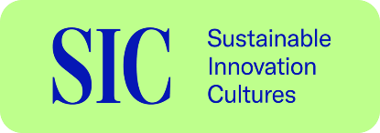


















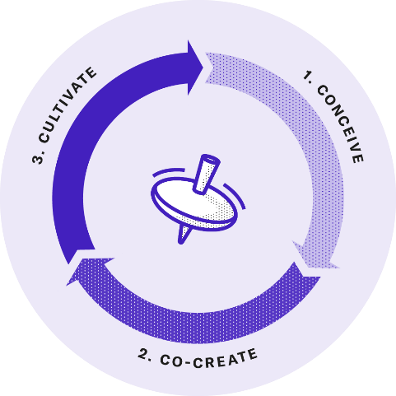











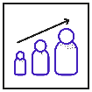
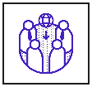









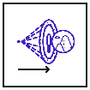
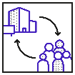

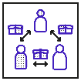











PRACTICES AND METHODS OVERVIEW
How can we professionalize practices and introduce artefacts
that ensure the positive impact of innovation efforts?
14 Overarching Practices
How can we identify implicit notions and values, practices, and artefacts to explain tensions and values-action gaps?
61. Sustainability-Oriented Management Systems
66. Sustainable Finance and Investment
Resilience Development
Moderation
Knowledge Sharing
Knowledge Management
Inclusive Deliberation
Reflexivity
Anticipation
Responsiveness
Empowerment
Decentralisation
Symbolic Ethical Leadership
Experimentation
Gamification
Human-System Collaboration
15. Contextual Inquiry
62. Materiality Assessment
63. Context-Based Reporting
64. Results Chain
65. Innovation Impact Assessment
67. Lifecycle Cost Analysis
68. Sustainable
Innovation Financing
16. Cultural
Surveys
17. Mapping
Competing Values
18. Rapid
Ethnography
19.
Memetics
20. Focus
Groups
21. Sense-
making
54 Practices and Methods of Conceiving, Co-Creating and Cultivating
3) CULTIVATE
(practices and methods 47-68)
How can we cultivate virtuous circles that lead to new sustainable value as outcome and ultimately achieve the desired impact?
1) CONCEIVE
(practices and methods 15-31)
How can we conceive our cultural practices to understand our values, their tensions and the gaps between values and action?
How can we promote sustainability-oriented collaboration,
knowledge exchange and stakeholder engagement?
How can we reflect on and become more sensitive to
proven practices and reoccurring challenges?
56. Inviting for Informal Exchange
59. Participative Decision Making
22. From Failure to Success
57. Offsite Events
58. Employee
Resource Groups
60. Stakeholder Advisory Board
23. Awareness
Raising
24. Appreciative
Inquiry
25. Dilemma
Games
26.
Empathising
How can we mainstream values and related notions to promote sustainable
innovation literacy and develop human resources to turn strategies into practice?
How can we review our values to better align them with
changing stakeholder priorities and emerging sustainability challenges?
47. Policy Communication
50.
Incentivisation
52. Attracting the
Right Talent
54. HR
Development
27. Stakeholder Values Integration
30. Identity and Policy Review
48. Cultural Dictionary
49. Tailored Communication
51. Incentivisation Schemes
53. Aspirational Narratives
55. Mandatory Training
28. Co-
construction
29. Values
Jam
31. Guiding Principles
Review
2. CO-CREATE
(practices and methods 32-46)
How can we co-create sustainable innovation practices – and strengthen existing ones – with targeted interventions?
How can we proactively explore opportunities for sustainable innovation,
avoid unintended consequences, and enhance resilience?
How can we engage external stakeholders in collaborative idea
generation and exploration of sustainable innovation practices?
How can we engage employees to collaboratively drive sustainable
innovation by experimenting with new methods and artefacts?
43. Sustainability Foresight
37. Engaging in Open Innovation
39. Sustainable Market Creation
41. Engaging in Innovation Ecosystems
32. Values-Based Ideation and Assessment
33. Facilitating Idea Management
44. Envisioning
45. Backcasting
46. Roadmapping
38. Lead User Integration
40. Values-Based Business Modelling
42. Values-Based Ecosystem Modelling
34. Sustainable Innovation Time
35. Values-Based Intrapreneurship
36. Ideation Contests and Markets

Slide 7

Preface
Facing the Greatest Challenge of Our Time
How can organisations and the people running them translate what they care about into high-impact strategies?
How can sustainability strategies be embedded in an organisation’s everyday culture?
How can we conceive our innovation culture, and how can we recreate and cultivate it to deliver sustainable innovation on a regular and reliable basis?

Slide 8
PART I FRAMEWORK / It Takes a Whole Culture
There is a well-known saying that it takes a whole village to raise a child.
For sustainable development, it takes a whole culture to make it happen. It takes sustainable innovation cultures to bring about desired changes towards sustainability on a reliable basis.
Chapters
It Takes a Whole Culture
Conceptual Foundations
A Framework for Sustainable Innovation Cultures

Slide 9

Chapter 1
It Takes a Whole Culture

Slide 10
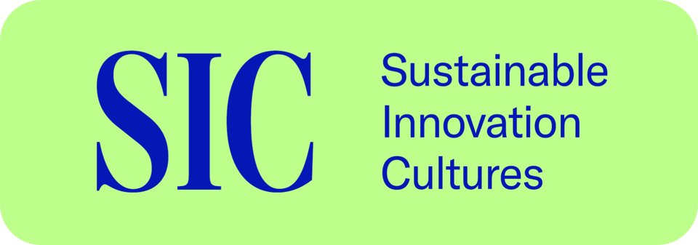
Chapter 1 / It Takes a Whole Culture
Basic concepts
Culture plays the decisive role in enabling sustainability and innovation strategies to succeed. Therefore, this is about the generative aspects of culture.
Innovation and its management generate novel outcomes that are environmentally, socially and economically valuable.
Ambitious approaches to organisational sustainability address sustainability-related challenges and promote competitiveness in the long, mid and short-term.

Slide 11
Chapter 1 / It Takes a Whole Culture
Basic concepts
Sustainable innovation culture is a dynamic configuration of values, practices and artefacts that generate environmentally, socially and economically valuable outcomes. Culture translates values into added value.
It requires a company to align its values, practices and artefacts.

Slide 12
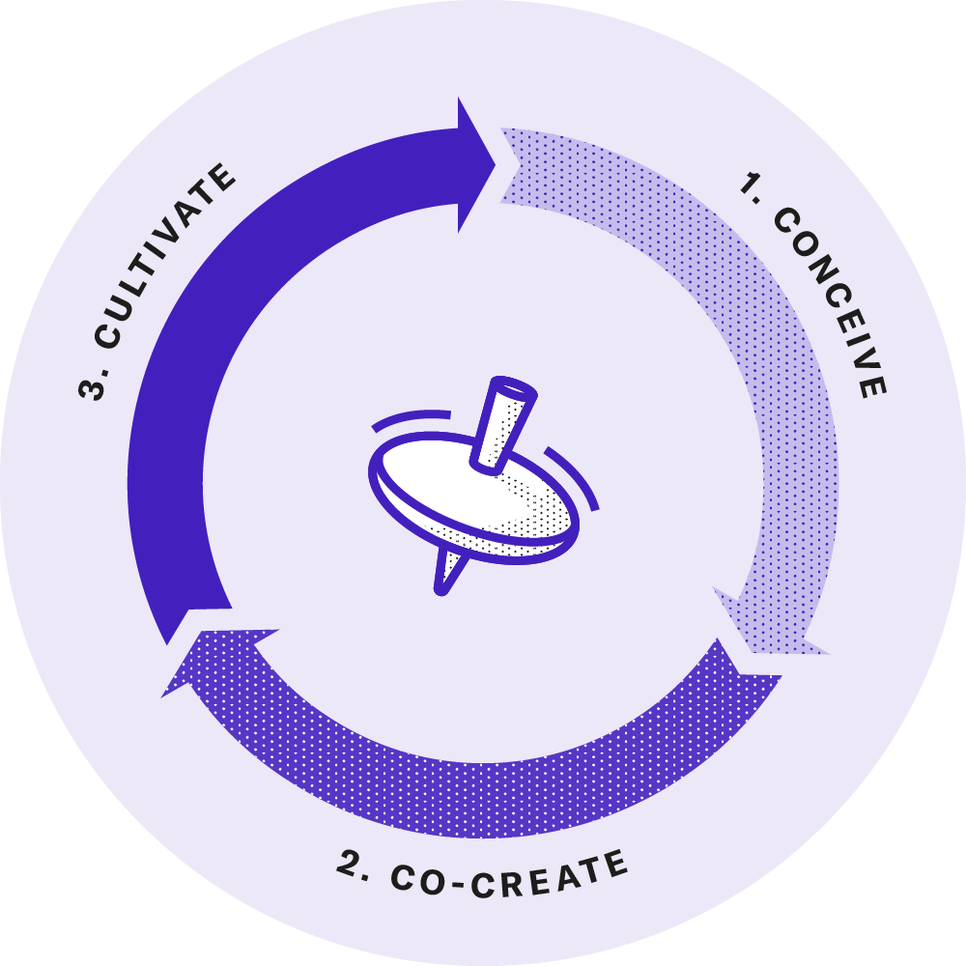
Chapter 1 / It Takes a Whole Culture
3C Framework
3) CULTIVATE:
How can we cultivate virtuous circles that lead to new sustainable value as outcome and ultimately achieve the desired impact?
1) CONCEIVE:
How can we conceive our cultural practices to understand our values, their tensions and the gaps between values and action?
2. CO-CREATE:
How can we co-create sustainable innovation practices – and strengthen existing ones – with targeted interventions?

Slide 13
Chapter 1 / It Takes a Whole Culture
3C Framework
Conceiving
First, we need to understand our current organisational culture.
Co-creating
The second step is to address specific tensions and gaps as well as to build existing strengths for sustainable innovation.
Cultivating
The third step is to embed the values, practices, tools and data deeply in the organisation’s daily practices.

Slide 14
Chapter 2
Conceptual Foundations

Slide 15
Chapter 2 / Conceptual Foundations
Sustainability and Sustainable Development
Carlowitz (1713): Sustained yield management—living off the yield of the resource (the harvest) rather than depleting the resource itself.
Brundtland Report (1987): Sustainable development as ‘intergenerational ethics in which the environmental and economic actions taken by present persons do not diminish the opportunities of future persons to enjoy similar levels of wealth, utility, or welfare’.
Paris Agreement (2015) and UN SDGs: Driving governments and businesses toward novel and viable ways to meet pressing economic, social and environmental challenges.

Slide 16
Chapter 2 / Conceptual Foundations
Sustainability Management and Value Creation
Sustainability management¹ formulates, implements and evaluates sustainability-related decisions and actions.
A business case of sustainability focuses on the potential of sustainability management to create a strategic business advantage.
Values of sustainability push management efforts towards an extended concept of value creation and a business case for sustainability².
Extended value creation: Sustainable business models propose, deliver, capture, maintain, unlock and share value with and for their stakeholders³.
System value creation⁴ aligns extended value creation to meet human needs within the Earth’s planetary boundaries.

Slide 17
Chapter 2 / Conceptual Foundations
Sustainability Reporting
Sustainability reporting has evolved from a voluntary ambition to a mandatory requirement for all sectors.
Integrated/ESG reporting requires companies to compile and disclose information on their economic, environmental and social performance.
It is criticized for being retrospective, investor-focused, and detached from scientific baselines.
Double materiality requires reporting on both outside-in impact on corporate performance and inside-out impact on society and environment.

Slide 18
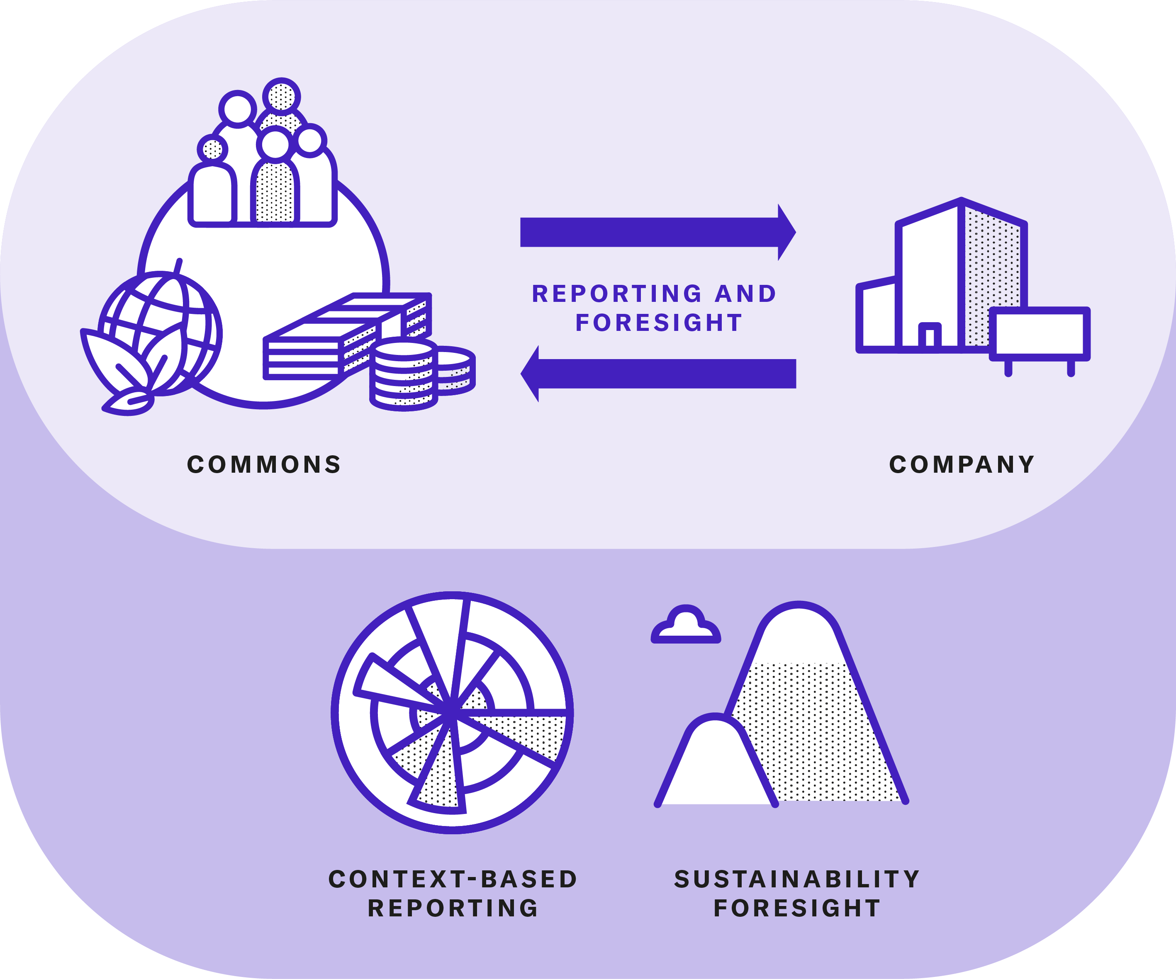
Chapter 2 / Conceptual Foundations
Sustainability Reporting

Slide 19
Chapter 2 / Conceptual Foundations
Sustainability Reporting
CONTEXT-BASED REPORTING⁵ grounds sustainability goals and practices in science-based limits, human needs and local thresholds.
FORWARD-LOOKING APPROACHES such as Sustainability Foresight complement retrospective reporting by directing efforts towards desirable outcomes.

Slide 20
Chapter 2 / Conceptual Foundations
Sustainable Innovation
We understand sustainable innovation as an overarching term for the systematic integration of sustainability-related values and considerations into innovation activities. Sustainable innovations create or redistribute economic, social and environmental value through new or changed entities (such as products, services, business models or ecosystems) or processes for an organisation and its stakeholders.
Factors driving sustainable innovation can be classified into push and pull factors.
Their importance varies depending on industry, societal expectations and sustainability topic. Together, they shape the way companies approach sustainable innovation.

Slide 21
Chapter 2 / Conceptual Foundations
A Values-Based Approach
Values-based approaches to sustainable innovation go beyond the standard success criteria for innovation.
They mainstream and establish values as practices to target qualitatively and quantitatively defined outcomes.
A safety innovation must increase safety, a health innovation improve health or cure diseases, and a sustainable innovation enhance equity and contribute to sustainable development through sustainable value creation.
‘A sustainable organization expresses its purpose, vision and mission in terms of social, environmental and economic outcomes.’⁶

Slide 22
Chapter 2 / Conceptual Foundations
Normative, strategic and operational dimensions
In the operational dimension of sustainable innovation, companies track and report the economic, social and environmental value they create, neglect or destroy⁷.
On the strategic level, they develop new sustainable business designs – such as moving from products to services or from product ownership to sharing.
On the normative level, organisations establish principles and policies that guide innovation in response to sustainability-related risks, competitor actions, customer demands and shifts in regulations and societal values.
Normative management provides ‘directional certainty’⁸ – the capability to develop and implement innovations while addressing unintended outcomes.

Slide 23
Chapter 2 / Conceptual Foundations
Organisational Culture and Its Development
The Lenses of Anthropology and Social Sciences
Dimension-Based Theories
Frameworks for Cultural Development
Values, Artefacts and Practices for Cultural Development

Slide 24
Chapter 2 / Conceptual Foundations
The Lenses of Anthropology and Social Sciences
An anthropological view identifies four characteristics of culture in a business context: culture is
  founded on shared patterns of ideas and behaviours,
  learned through processes of socialization,
  requires interpretation and
  constantly changes⁹.
Anthropological approaches to studying culture are contrasted with psychological and sociological approaches that focus on the individual, group and organisational levels⁹.
Two further ways of studying organisational cultures are the subject-oriented and object-oriented methodologies¹⁰.
Notes:
Anthropological approaches to studying culture are contrasted with psychological and sociological approaches that focus on the individual (personality and motivation), group (formation and relationships, structures, norms or conflicts) and organisational (purpose, structure, technology, environmental fit) levels⁸.

Slide 25
Chapter 2 / Conceptual Foundations
Dimension-Based Theories
Clan, Adhocracy, Market and Hierarchy (Cameron & Quinn, 2011)
Power Distribution and Cooperation Level (Handy, 1995)
Six Dimensions of National and Organisational Cultures (Hofstede, 2011)
Pathological, Bureaucratic and Generative Cultures (Westrum, 2004)
Generative cultures enable relevant, timely and clear information flows because they translate the organisational values and goals into shared criteria.

Slide 26
Chapter 2 / Conceptual Foundations
Frameworks for Cultural Development
Edgar Schein’s (2004) organisational culture model conceptualises three layers of culture according to degrees of visibility and psychological insight: basic assumptions, espoused values and artefacts. Alignment between these levels fosters organisational performance and cultural development.
Schein proposes a three-stage process of cultural development: unfreezing, cognitive restructuring and refreezing.
Other frameworks (e.g. Kotter’s Eight-Stage Process) provide further insights into how cultural development takes place and how it can be supported.¹¹ Unfortunately, many of them lack empirical evidence and are based on unchallenged assumptions.¹²
Notes:
Schein proposes a three-stage process of cultural development: ‘Unfreezing’ creates a sense of urgency and awareness about the need for change, then ‘cognitive restructuring’ introduc es new ways of thinking that challenge existing assumptions. Finally, ‘refreezing’ involves developing a new cultural identity and establishing new behaviours in interpersonal relationships and practices.

Slide 27
Chapter 2 / Conceptual Foundations
Values, Artefacts and Practices
Values define what is important and prioritised within an organisation.
‘Defining values and norms, turning these into shared rules for behaviour, is de facto creating and managing culture.’¹³
In Schein’s model, values are realised through artefacts such as individual behaviours, formal statements and the physical environment.
Values influence the adoption of practices. But they are also influenced by practices and can be reinterpreted in relation to them, creating a cycle of mutual influence that predetermines cultural development.
Notes:
In Schein’s model, values are realised through artefacts such as individual behaviours, formal statements and the physical environment. The clear communication of values is obviously an essential lever for managing organisational culture.

Slide 28
Chapter 2 / Conceptual Foundations
Case 1. Expert Insights
Expert Insights on Four Critical Factors to Develop Sustainable Innovation Cultures
OVERCOMING SHORT-TERMISM: Ensure a long-term perspective to prevent sustainable innovation projects from being abandoned prematurely.
ENSURING CULTURAL FIT: Align sustainability initiatives and practices with an organisation’s existing culture to ensure their relevance and impact.
ALIGNING SUSTAINABILITY STRATEGIES WITH LOCAL CONTEXTS: Adapt to local values and practices to prevent mission drift.
MANAGING DIVERSITY: Boost sustainable innovation through diversity within the workforce.

Slide 29
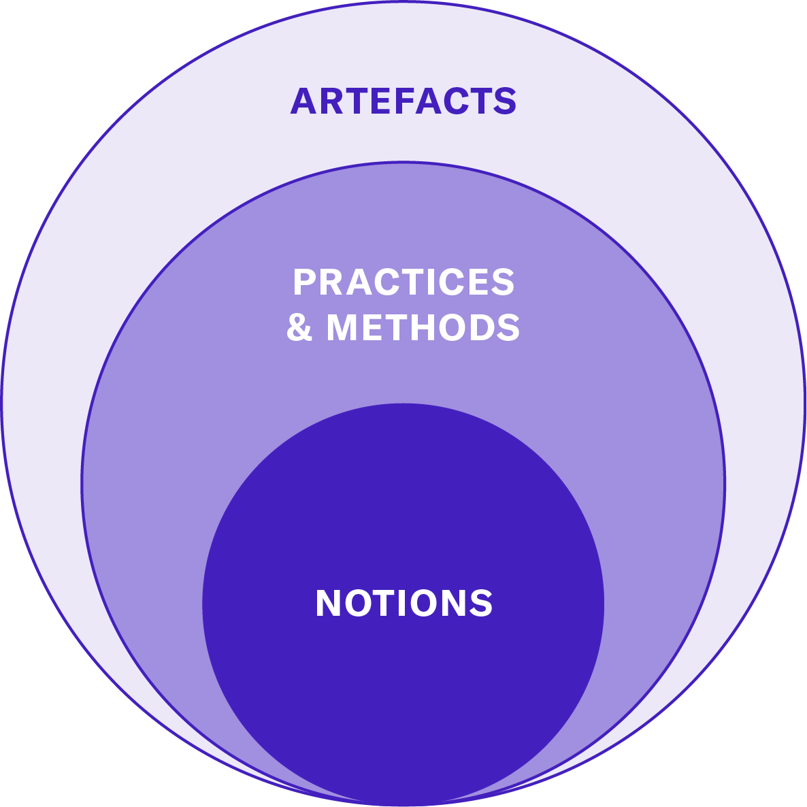
Chapter 2 / Conceptual Foundations
Three layers of Sustainable Innovation Cultures
Notes:
Artefacts are human-made objects like official statements, documents, reports, software tools, physical environments and other material media. They reflect written or unwritten values and can facilitate or limit their translation into practices.

Slide 30
Chapter 2 / Conceptual Foundations
Three layers of Sustainable Innovation Cultures
Notions refer to terms and concepts that are used colloquially and are often vague. We focus on values as notions of the desirable, as well as notions of what is technically feasible and economically viable.
Practices are the actions, behaviours and rituals that employees perform on a more or less regular basis.
Methods are purposeful interventions to address a challenge. Methods turn into practices when they are systematically applied and adapted to the needs of the organisation.
Artefacts are human-made objects that reflect values and facilitate or limit their translation into practices.
Notes:
Artefacts are human-made objects like official statements, documents, reports, software tools, physical environments and other material media. They reflect written or unwritten values and can facilitate or limit their translation into practices.

Slide 31
Chapter 2 / Conceptual Foundations
Sustainable Innovation Cultures – Key Takeaways
While sustainability cultures support compliance with corporate sustainability standards and ambitions, sustainable innovation cultures go beyond that.
They seek challenges to sustainability as opportunities for innovation.
They ensure their long-term positive impact and guard against unintended consequences.
Cultural development not only aligns the cultural layers of notions, practices and artefacts – it also translates values into criteria that guide value creation and organisational performance.
Notes:
They seek challenges to sustainability as opportunities for innovation – novel processes, products, services and business models that disrupt business as usual.

Slide 32
Chapter 3
A Framework for Sustainable Innovation Cultures

Slide 33
Chapter 3 / A Framework for Sustainable Innovation Cultures
Establishing Sustainable Innovation Cultures
Sustainable innovation cultures are:
Generative systems made up of shared notions, practices and artefacts that turn values of sustainability into novel regenerative outcomes that are economically, socially and environmentally beneficial.
Created by establishing sustainability as a priority and then aligning notions, practices and artefacts to resolve tensions between competing values and bridge gaps between values of sustainability and current practices.
Based on values that provide ethical foundation and directional certainty to create sustainable value repeatedly and reliably, against the odds of unforeseen challenges and unintended consequences.

Slide 34
Chapter 3 / A Framework for Sustainable Innovation Cultures
A Generative System
In sustainable innovation cultures, values emerge and evolve from stakeholder interactions and learning in dealing with – foreseeable and unexpected – challenges.
Each industry brings unique values and capabilities to contribute to sustainable development (e.g. environmental stewardship in mobility or equity, diversity and community welfare in social mission business models)
Political and management frameworks give shape and substance to sustainability values and innovation strategies (e.g. UN’s SDGs, European Green Deal, Paris Agreement)
An organization expresses its sustainability-related values through the intended outcomes and positive impact that it pursues and generates.
Notes:
“Rather than being imposed from the top to the bottom of the hierarchy, its properties emerge and evolve from stakeholder interactions and learning in dealing with – foreseeable and unexpected – challenges. This makes room for non-linear cultural shifts and organisational innovations arising from seemingly insignificant interactions”
Each industry brings unique values and capabilities to contribute to sustainable development (e.g. environmental stewardship in mobility or equity, diversity and community welfare in social mission business models)… „Some organisations foster values of environmental stewardship by trying to mitigate negative impact (e.g. of mobility) and to enhance positive impact by conserving biodiversity, preventing pollution or regenerating resources. Others embed val ues of social responsibility such as equity, diversity and community welfare into their business models and operations, striving for a positive impact on fair labour conditions, community development and social well-being, fostering inclusive mobility and reducing social disparities. Likewise, positive economic impact can consist in contributions to ethical labour standards, employment, fair trade and economic development.“
Political and management frameworks give shape and substance to sustainability values and innovation strategies (e.g. UN’s SDGs, the European Green Deal or the Paris Agreement)

Slide 35


Chapter 3 / A Framework for Sustainable Innovation Cultures
Case 2. The Role of Healthcare Companies in the Global Sustainability Transformation
Healthcare Industry Challenges: Balancing health impact, environmental responsibility, and ethical priorities.
Merck (Germany): Expands access in low- and middle-income countries through equitable pricing and fast-track launches.
GSK (UK): Leads transparency by publishing clinical trial design, methods, and results.
Other large pharmaceutical companies have faced criticism for failing to balance financial and ethical priorities during the COVID-19 global health crisis by prioritising intellectual property rights over equitable healthcare¹.
Notes:
A sustainable healthcare system is ‘a system that improves, maintains or restores health, while minimising negative impacts on the environment and leveraging opportunities to restore and improve it, to the benefit of the health and well-being of current and future generations’ (WHO)

Slide 36
Chapter 3 / A Framework for Sustainable Innovation Cultures
Case 3. How Companies Integrate the SDGs into their Impact Strategies
Many companies adopt UN’s SDGs as an ethical framework for system value creation.
Selected goals and targets are integrated into their impact strategy and monitored by appropriate indicators.
EXAMPLE – FASHION COMPANY
  SDG 12 (Responsible Consumption & Production)
    Circular business model → clothes made from recycled materials, fully recyclable or biodegradable within 5 years, KPI: % of recycled materials used
  SDG 8 (Decent Work & Economic Growth)
    Ensure fair wages, safe conditions, and equal opportunities across supply chain within 2 years, KPI: Number of workers in fair-wage programs

Slide 37
Chapter 3 / A Framework for Sustainable Innovation Cultures
Case 4. Cultural Challenges to Translating Normative Guidelines into Practices and Artefacts
BACKGROUND
A large technical inspection company used UN’s SDGs as a normative guideline for Innovation Impact Assessment.
CHALLENGES
Difficulty identifying relevant SDGs and indicators. Concerns that sustainability impact ratings would lead to irreconcilable differences at the expense of lower scoring projects.
SOLUTION
Adopted a Fibonacci sequence to differentiate project impact ratings. Agreed on a simplified scale (1, 2, 3, 5, 8) to avoid excessive criticism.
OUTCOME
Created a structured, transparent process to prioritize projects with higher sustainability impact and encourage improvement.

Slide 38
Chapter 3 / A Framework for Sustainable Innovation Cultures
A Deliberate Approach
Sustainable innovation cultures do not come into existence by accident or chance. It takes a deliberate approach to establish organisational values, follow up with strategic choices and turn them into daily practices.
Establishing Espoused Values
Addressing Tensions
Addressing Values-Action Gaps

Slide 39
Chapter 3 / A Framework for Sustainable Innovation Cultures
Establishing Espoused Values
Espoused values and associated guiding principles (e.g. mission, purpose, vision) are established to:
integrate organisational members, subcultures and other stakeholders under an overarching frame of reference
provide a reference for the design of artefacts such as assessment tools, incentive schemes or facilities for sustainable innovation
provide an orientation for future ambitions and long-term positive impact
go beyond profit orientation and an opportunistic search for short-term competitive advantages and market trends

Slide 40
Chapter 3 / A Framework for Sustainable Innovation Cultures
Approach 1. Guiding Questions to Formulate Guiding Principles for an Organisation
VALUES: What is most important to you? What do you care about? How would you specify values expressing equity within and across generations? How are they relevant to your organisation?
PURPOSE: What is the reason for your organisation, your company, or your pro ject to exist? How does it contribute over the long term to human wellbeing and planetary stability?
MISSION: What does your company or your project seek to achieve within the next five years, ten years, twenty years?
VISION: How would you depict a desirable, common future for our organisation in a vivid description?

Slide 41
Chapter 3 / A Framework for Sustainable Innovation Cultures
Addressing Tensions
Tensions between different ideas about how to deal with challenges, about which values and goals to pursue and about how to drive innovation are ubiquitous in organisations.
Tensions indicate the presence of two phenomena (e.g. divergent values) in a dynamic relationship that involve both competition and complementarity.²
Understanding and leveraging tensions can help organisations to rise above trade-offs and identify synergies that contribute to sustainable innovation.
Aspirational Narratives that use ‘and’ help to reconcile tensions between profit and purpose, shareholders and stakeholders, markets and society, business and ethics.³
Empathising⁴ helps stakeholders not only to reconcile their differences but to harness them for finding innovative solutions from a more holistic perspective.

Slide 42
Chapter 3 / A Framework for Sustainable Innovation Cultures
Addressing Values-Action Gaps
Values-action gaps are the discrepancies between the espoused values of an individual or an organisation and their actions.
Values-action gaps often originate in unconscious misinterpretations, e.g. conflicting stakeholder interpretations of values (see also resistance to change; Concept 4)
They perpetuate existing practices and artefacts that block transformation
Example: An organisation espouses values of collaboration. → It sporadically engages in supportive practices (e.g. Knowledge Sharing). → But legacy practices and artefacts discourage collaboration (e.g. individual performance incentives, cubicle offices).
Historical examples: The Volkswagen Dieselgate⁵ and Apple Batterygate⁶ scandals
Notes:
The Volkswagen diesel emissions scandal (also known as Die selgate) occurred in 2015 when it was revealed that the company had intentionally programmed millions of its diesel vehicles to activate their emissions controls only during the vehicles’ regular emission control inspections. This deception violated en vironmental regulations, leading to billions in fines, legal action and severe damage to Volkswagen’s reputation.
The Apple Batterygate scandal involved the company inten tionally slowing down older iPhone models through software updates, without informing users about how the updates affected device performance. When this practice was exposed in 2017, Apple faced backlash, lawsuits and accusations of planned obsolescence, forcing the company to offer reimbursements to customers and more transparency about device performance.

Slide 43
Chapter 3 / A Framework for Sustainable Innovation Cultures
Creating Sustainable Value Repeatedly and Reliably
Values provide the ethical foundation, orientation and directional certainty (see section 2.1.3) for creating sustainable value in a repeatable and reliable manner.
As opposed to easily negotiable interests, short-lived attitudes or restrictive norms, values serve as enduring sources of orientation and intrinsic motivation through out the innovation process.⁷
They also provide criteria to validate the intermediary results of innovation efforts, ensuring the reliability and repeatability of sustainable innovation outcomes.
Notes:
An attitude ‘represents a summary evaluation of a psycholog ical object captured in such attribute dimensions as good–bad, harmful–beneficial, pleasant–unpleasant, and likable–dislike able’ Ajzen, I. 2001. Nature and operation of attitudes: Annual Review of Psychology. psych, 52(1), 28. This characterises attitudes as more situational and object-specific than values, which are viewed as general and abstract as well as enduring and stable. Furthermore, while norms ‘prescribe generally expected and required behaviours in particular situations’, values are ‘consid ered to be trans-situational criteria or beliefs used by subjects to select the desirable’ Breuer, H. and F. Freund. 2017, 25. Values-based innovation management. London: Macmillan Publishers Limited.

Slide 44
Chapter 3 / A Framework for Sustainable Innovation Cultures
Case 5. Key Value Indicators for Gauging the Impact of ICT Solutions
In a use case scenario⁸ that conceived the design, development and implementation of 6G technologies in smart cities, key value indicators helped to identify and estimate how future ICT technologies can lead to positive outcomes.
The implementation of key value indicators proceeded in five steps:
    Describe the Scenario
    Identify Key Values
    Translate Each Key Value
    Analyse the Outcome
    Assess the Key Value Indicators

Slide 45
Chapter 3 / A Framework for Sustainable Innovation Cultures
Maturity Levels of Values-Based Innovation Cultures
5. Proactive
4. Managed
3. Differentiated
2. Defined
1. Implicit
Notes:
l

Slide 46
Chapter 3 / A Framework for Sustainable Innovation Cultures
Maturity Levels of Values-Based Innovation Cultures
Maturity levels progress from minimal integration of espoused values into innovation practices to higher levels of integration and continuous revision of the
espoused values in response to evolving
stakeholder values.
5. Proactive
4. Managed
Prospective management of stakeholder values becomes an integral part of innovation management and organisational learning (e.g. Ecosia; Case 6)
3. Differentiated
Values are managed with indicators and stakeholder feedback and used as a shortcut (e.g. for ideation) and evaluation criteria (e.g. Key Value Indicators)
2. Defined
Values are defined globally, involving diverse stakeholders, but also with respect to organisational subcultures or innovation projects (e.g. prioritising Experimentation in innovation teams)
1. Implicit
Organisational values are defined on a global level. (e.g. a corporate-wide sustainability strategy does not translate to sustainability practices in all departments)
Organisational values and values towards sustainable innovation initiatives are implicit (e.g. adopting new processes to meet environmental regulations)
Notes:
l

Slide 47


Chapter 3 / A Framework for Sustainable Innovation Cultures
Case 6. Ecosia Considers Partnering with a Petrol Company
Ecosia reinvests ad revenues into tree-planting projects, 250M+ trees planted by 2026
6 Core Values:
Impact, Integrity, Sustainability, Leadership, User Focus, Happiness
A ‘big petrol corporation’ approached the search engine with an offer.⁹ Ecosia’s product manager at the time recalls the case:
‘One of our core values is “integrity”… maybe if you have a partner and that allows you to reach five million people that would be a lot of trees … but if you compromise too much then you start losing integrity… in that case, we were also like: No, the cost for our integrity would be too high.’
Ecosia’s values provided a shared reference for the evaluation of strategic choices, without closing off options. This approach reflects a conscious value prioritisation (integrity vs impact) rather than following a strict ethical code to prevent mission drifts.

Slide 48
Chapter 3 / A Framework for Sustainable Innovation Cultures
Working Against Unintended Consequences and Potential Rebound Effects
Companies are facing ever increasing challenges to innovate while avoiding unintended, negative consequences (e.g. the alignment problem of AI applications¹⁰).
Cultural factors can cause innovation activities to have unintended consequences. For instance, there are five factors that limit the competence of social groups to anticipate the consequences of their actions (lack of foreknowledge, assessment errors, impervious immediacy of interest, basic values and self-defeating prophecies).¹¹
But culture also holds the potential to steer developments into more desirable directions. For instance, through practices of Sustainability Foresight, Anticipation and Responsiveness.
Notes:
‘LACK OF FOREKNOWLEDGE’ refers to the general inability to foresee all of the potential consequences of an action. This inability becomes greater with the introduction of new, potentially disruptive technologies.
‘ASSESSMENT ERRORS’ cause organisations to assume that actions which had previously achieved the desired outcome will continue to be do so. For example, renewable energy companies might assume that their past success in sustainable value creation will continue, without anticipating negative outcomes such as the environmental impact of battery disposal and resource extraction.
‘IMPERVIOUS IMMEDIACY OF INTEREST’ refers to an overemphasis on the potential beneficial consequences of an action, which overshadows the ability to anticipate its negative outcomes. For example, an organisation may believe that the positive impacts of sustainable innovations will offset their potential negative impacts. –
‘BASIC VALUES’, rigidly followed, limit the ability of social actors to consider negative consequences of their purposive actions. Strict accordance with these values ensures individuals and organisations that they are doing the right thing, but narrows their focus to ignore foreseeable unintended consequences and alternative courses of actions. For instance, organisations com mitted to reducing their greenhouse gas emissions by adopting biofuels have reportedly perpetuated rebound effects such as inflated cooking oil prices and worldwide deforestation.
‘SELF-DEFEATING PROPHECIES’ are exemplified by employees who doubt the potential of a sustainable innovation initiative to generate positive outcomes and therefore do not support it, causing it to fail or lead to unintended consequences.
The practice of Sustainability Foresight prepares organisations for alternative developments through the iterative assessment of future scenarios. This practice can be reinforced through methods such as Envisioning, which specifies desirable outcomes to detect unintended deviations early on. Iterative validation of intermediate results and outcomes in values-based approaches to in novation are designed to avoid unintended consequences. Likewise, responsible innovation practices of Anticipation and Responsiveness are aimed at avoiding and eliminating unintended consequences. practices of Anticipation systematically evaluate potential issues and available alternatives to capture both the intended and unintended outcomes of innovation on sustainable development. Practices of Responsiveness involve adjusting the innovation process if negative outcomes are predicted or observed.

Slide 49
Chapter 3 / A Framework for Sustainable Innovation Cultures
Establishing Sustainable Innovation Cultures
Recap: Sustainable innovation cultures are made up of three components:
GENERATIVE SYSTEMS: made up of shared notions, practices and artefacts that turn values of sustainability into novel regenerative outcomes that are economically, socially and environmentally beneficial.
DELIBERATE ALIGNMENT: Created by establishing sustainability as a priority and then aligning notions, practices and artefacts to resolve tensions between competing values and bridge gaps between values of sustainability and current practices.
DIRECTIONAL CERTAINTY: Values provide the ethical foundation and directional certainty to create sustainable value repeatedly and reliably, against the odds of unforeseen challenges and unintended consequences.

Slide 50

Chapter 3 / A Framework for Sustainable Innovation Cultures
Case 7. Interface and its Outstanding Journey Towards Sustainable Innovation Culture
GENERATIVE SYSTEM: shared notions, practices and artefacts
  Values: Mission Zero to eliminate all negative environmental impacts by 2020. Climate Take Back vision to become carbon-negative by 2040
  Practies: ReEntry recycling, Evergreen Service Agreement, Net-Works programme, Carbon Neutral Floors initiative, biomimicry workshops, Mandatory Training on sustainability
  Artefacts: Energy-efficient pipes, recycled fibres, biomimetic and carbon-negative carpet tiles, bio-composite carpet backings
DELIBERATE ALIGNMENT: Continuous values-based innovation despite tensions and challenges (investor and customer setbacks, cost pressures, failed product lines)
DIRECTIONAL CERTAINTY: Shared values provide a clear sense to deal with unintended consequences (e.g. grass woven tiles, carbon offsetting)
(download case as PDF handout)

Slide 51
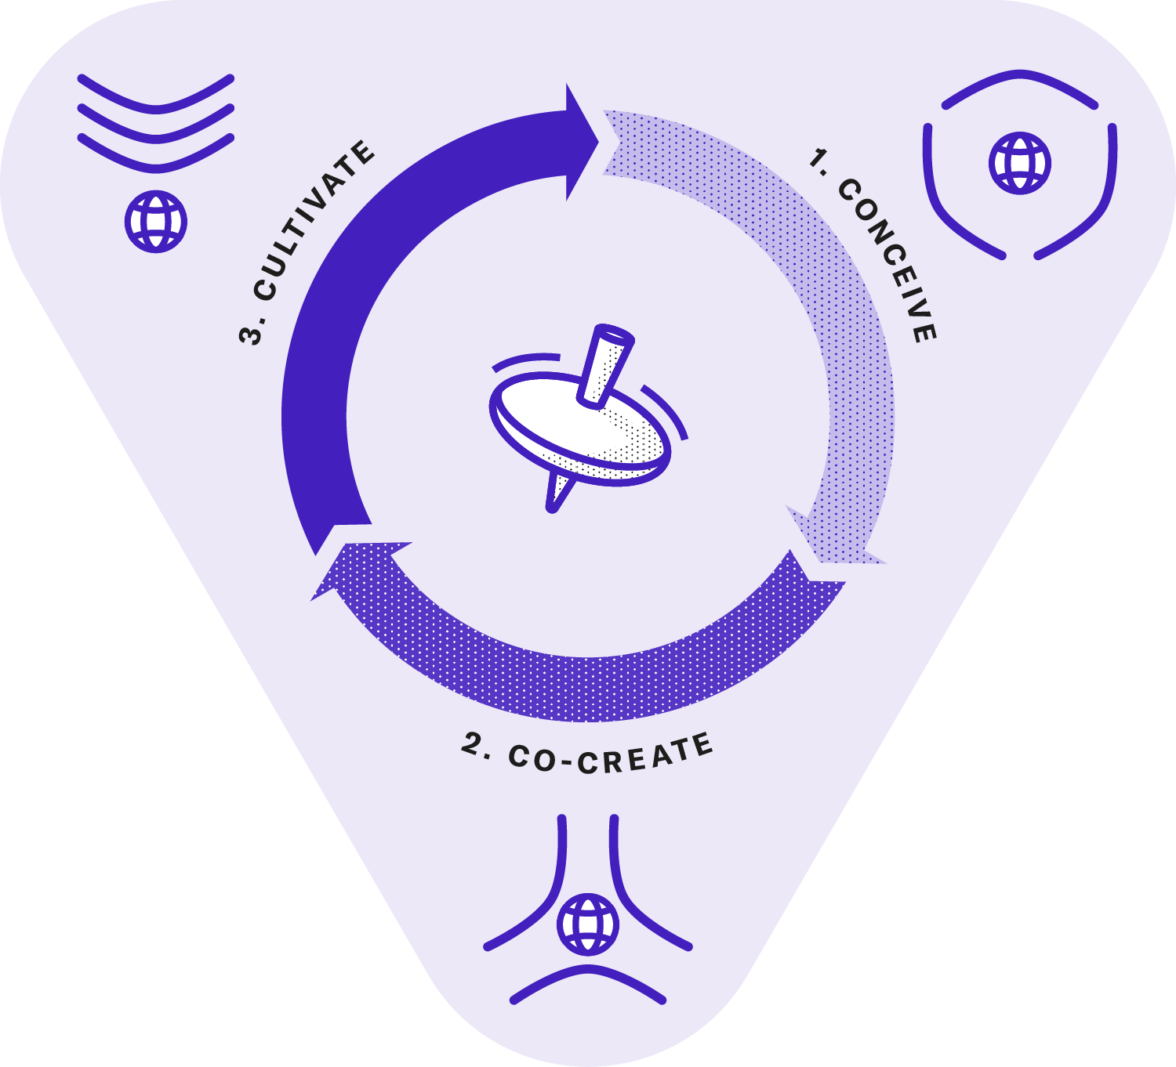
Chapter 3 / A Framework for Sustainable Innovation Cultures
The 3C Framework for Establishing Sustainable Innovation Cultures

Slide 52
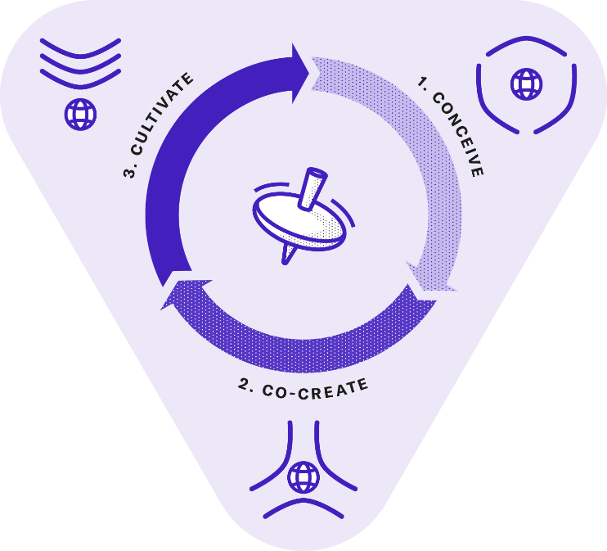
Chapter 3 / A Framework for Sustainable Innovation Cultures
The 3C Framework for Establishing Sustainable Innovation Cultures
Sustainable innovation cultures can be developed
through virtuous cycles of conceiving culture, co-creating interventions and cultivating new practices.
CONCEIVING notions, practices and artefacts, as well as the tensions and values-action gaps that hinder sustainable innovation.
CO-CREATING empowers diverse stakeholders to design and validate interventions that address tensions and values-action gaps.
CULTIVATING leverages the potential of individuals to work towards shared goals and values, to generate sustainable innovation as an outcome and ultimately achieve the desired impact.

Slide 53
Chapter 3 / A Framework for Sustainable Innovation Cultures
Overarching Practices for Conceiving, Co-creating and Cultivating in Sustainable Innovation
Overarching practices facilitate the transformation towards a sustainable innovation culture, paving the grounds for activity-specific practices and methods to unfold.
1. Resilience Development
2. Moderation
3. Knowledge Sharing
4. Knowledge Management
5. Inclusive Deliberation
6. Reflexivity
7. Anticipation
8. Responsiveness
9. Empowerment
10. Decentralisation
11. Symbolic Ethical Leadership
12. Experimentation
13. Gamification
14. Human-Systems Collaboration

Slide 54

Chapter 3 / A Framework for Sustainable Innovation Cultures
Overarching Practices /
1. Resilience Development
Continuously monitor and invest to prepare for dealing with new sustainability challenges and master cultural change.¹²
CONCEIVING: Engage in direct investment towards triggering cultural change and Stakeholder Values Integration.
CO-CREATING: Introduce policies, guidelines and sustainability-oriented Management Systems.
CULTIVATING: Anticipate future sustainability challenges and address them through innovation in products, services or business models (see Sustainable Market Creation).

Slide 55
Chapter 3 / A Framework for Sustainable Innovation Cultures
Overarching Practices /
2. Moderation
Balance the inherent tension between short-term and long-term performance objectives.¹²
CONCEIVING: Balance cultural tensions between short and long-term performance as well as the stakeholder needs and values that give rise to them.
CO-CREATING: Assess and anticipate the benefits and risks of short versus long-term performance and explore approaches to reconcile or synergise these competing demands.
CULTIVATING: Establish a reference point for the criteria used by methods and artefacts to evaluate the impact of innovation efforts. For instance, integrate both short-term and long-term indicators in Innovation Impact Assessments.

Slide 56
Chapter 3 / A Framework for Sustainable Innovation Cultures
Overarching Practices /
3. Knowledge Sharing
Foster the exchange of insights and expertise with both internal and external stakeholders.¹²
CONCEIVING: Engage cultural members in sharing their understandings of values, practices, tensions and values-action gaps.
CO-CREATING: Promote Knowledge Sharing among a wide range of stakeholders.
CULTIVATING: Promote formal Knowledge Sharing practices, artefacts and methods, such as a Cultural Dictionary.

Slide 57
Chapter 3 / A Framework for Sustainable Innovation Cultures
Overarching Practices /
4. Knowledge Management
Create, develop, assimilate and synthesise knowledge regarding new sustainable technologies, processes and innovation practices.¹³
CONCEIVING: Coordinate practices of Knowledge Management to understand cultural weaknesses due to knowledge gaps and uncertainty.
CO-CREATING: Take proactive steps to address these challenges, for example, by Engaging in Open Innovation or in Innovation Ecosystems.
CULTIVATING: Introduce artefacts (e.g. frameworks, scorecards, tools or software) to incorporate sustainability concerns across all organisational operations and strategic decisions.

Slide 58
Chapter 3 / A Framework for Sustainable Innovation Cultures
Overarching Practices /
5. Inclusive Deliberation
Engage stakeholders, such as employees, customers, communities and partners to inform innovation-related decision-making.¹⁴
CONCEIVING: Leverage methods such as Focus Groups and Values Jams to integrate internal stakeholders and elicit employee values, needs and tensions.
CO-CREATING: Discuss sustainability values with internal and external stakeholders and translate them into new innovation practices and projects.
CULTIVATING: Introduce Participatory Decision Making or Stakeholder Advisory Boards to ensure that organisational and stakeholder values are embedded across all operations and strategic decisions.

Slide 59
Chapter 3 / A Framework for Sustainable Innovation Cultures
Overarching Practices /
6. Reflexivity
Think critically about actions and responsibilities, values and motivations, knowledge and perceived realities, and how each of these affect innovation management.¹⁴
CONCEIVING: Engage employees in critical reflection, Sensemaking and retrospective thinking on what worked well and what are persisting challenges, tensions and values-action gaps.
CO-CREATING: Involve participants in critically assessing contributions and results, ensuring new initiatives are well-informed.
CULTIVATING: Ensure that efforts remain aligned with the espoused values and no mission drift occurs.

Slide 60
Chapter 3 / A Framework for Sustainable Innovation Cultures
Overarching Practices /
7. Anticipation
Address stakeholder needs and values to describe and analyse intended and unintended consequences of innovation activities on sustainable development.¹⁴
CONCEIVING: Use Sensemaking to reflect on how past and current experiences, critical incidents, values, practices, artefacts, tensions and values-action gaps suggest future outcomes.
CO-CREATING: Use Sustainability Foresight and Envisioning to specify future scenarios and their outcomes.
CULTIVATING: Use Results Chains to estimate not only positive impacts, but also potential unintended consequences of innovation.

Slide 61
Chapter 3 / A Framework for Sustainable Innovation Cultures
Overarching Practices /
8. Responsiveness
Change the direction, trajectory and pace of innovation in response to stakeholder and public values and changing circumstances.¹⁴
CONCEIVING: Manage innovation by responding to stakeholder concerns.
CULTIVATING: Ensure alignment between innovation efforts and stakeholder values and needs, for example, by leveraging Participative Decision Making or sustainability-oriented Management Systems.

Slide 62
Chapter 3 / A Framework for Sustainable Innovation Cultures
Overarching Practices /
9. Empowerment
Give employees the authority and resources to take ownership of sustainability initiatives.¹⁵
CONCEIVING: Empower employees to influence how a given culture is under stood, for example, by organising a Values Jam.
CO-CREATING: Ensure that diverse voices are heard, leading to more innovative and inclusive solutions.
CULTIVATING: Empower employees to take owner ship of sustainability projects and sustain their engagement.

Slide 63
Chapter 3 / A Framework for Sustainable Innovation Cultures
Overarching Practices /
10. Decentralisation
Empower local teams to make decisions tailored to their specific context.¹⁵
CONCEIVING: Understand the subcultures of individual teams, departments or regions where tensions and values-action gaps prevail and where new opportunities emerge.
CO-CREATING: Empower local teams to generate sustainability initiatives that are context-specific and aligned with their needs.
CULTIVATING: Enable sustainable innovation on a local level, for instance, through Tailored Communication and artefacts.

Slide 64
Chapter 3 / A Framework for Sustainable Innovation Cultures
Overarching Practices /
11. Symbolic Ethical Leadership
Actively engage organizational leaders in fostering ethical values, integrating these in their own behaviour and communicating them across the organisation.¹⁶
CONCEIVING: Understand the sustainability-related priorities and values of the leadership team and how it conveys the espoused organisational values through symbolic gestures and rituals.
CO-CREATING: Use methods like a Guiding Principles Review or an Identity and Policy Review to provide a foundation for improving alignment across hierarchical levels.
CULTIVATING: Use methods like a Guiding Principles Review or an Identity and Policy Review to to ensure consistent ethical leadership with new interventions and strategies.

Slide 65
Chapter 3 / A Framework for Sustainable Innovation Cultures
Overarching Practices /
12. Experimentation
Support the testing of innovative solutions through small-scale trials to ensure that ideas are tested before scaling.¹⁷
CONCEIVING: Experiment with methods and practices on a small scale be fore scaling up those that prove effective throughout the entire organisation.
CO-CREATING: Promote employee Experimentation through methods such as Ideation Contests and Markets or Values-Based Intrapreneurship.
CULTIVATING: Establish successful practices that originate from employee-led experiments.

Slide 66
Chapter 3 / A Framework for Sustainable Innovation Cultures
Overarching Practices /
13. Gamification
Use game elements to create transformative experiences that enhance employee awareness or capabilities or enable idea generation and experimentation to tackle grand challenges.¹⁵
CONCEIVING: Help employees to understand their culture by having them interpret and apply otherwise abstract values in direct interaction, as in Dilemma Games.
CO-CREATING: Stimulate the engagement of stakeholders, for instance, in Ideation Contests and Markets.
CULTIVATING: Integrate gamified formats into cultural artefacts, like physical environments, training and development materials or rituals.

Slide 67
Chapter 3 / A Framework for Sustainable Innovation Cultures
Overarching Practices /
14. Human-Systems Collaboration
Utilize new forms of collaboration and co-creating between humans and systems that mimic or simulate human intelligence, such as artificial intelligence, machine learning, natural language processing or robotics.
CONCEIVING: Leverage Human-Systems Collaboration to understand status quo sustainability data and communication in relation to industry benchmarks.
CO-CREATING: Source a wide range of potential responses to challenges and unlock new forms of creativity.
CULTIVATING: Leverage Human-Systems Collaboration to increase the efficiency and effectiveness of practices and methods, such as Mandatory Trainings, Knowledge Management, Innovation Impact Assessments and Result Chains.

Slide 68
Chapter 3 / A Framework for Sustainable Innovation Cultures
Digital Artefacts and Artificial Intelligence
Digital tools and media, collaborative platforms and intelligent systems provide mediating artefacts to enhance sustainability-oriented practices and methods.
Use cases
ESG & BI SOFTWARE: Tracking and reporting of sustainability data to facilitate transformation planning and compliance.
CONCEIVING: IBM’s Watson analyses sustainability reports and environmental metrics to help companies prioritise areas for improvement.
CO-CREATING: Simulating solutions before or as part of a workshop setting with digital twins. Using generative AI to assist in the design of alternative workshop formats, e.g. by drawing on Gamification design pat terns.
CULTIVATING: AI-powered training (EduBites). Preserving and systematising employee knowledge about corporate sustainability (Siemens). Real-time monitoring and strategy refinement (Microsoft).

Slide 69
PART II PRACTICES AND METHODS /
How to Create Sustainable Innovation Cultures
Chapters 4–6 delve into each of the 3C activities, providing guidance on how to apply them using proven practices and methods.
Chapters
Conceiving Innovation Cultures
Co-creating Targeted Interventions
Cultivating Sustainable Innovation

Slide 70
PART II / PRACTICES AND METHODS
How to Create Sustainable Innovation Cultures
Four dimensions apply to each of the three 3C framework activities
Notions, including the clarification of values and related tensions
Practices, including the adoption of methods
Artefacts, including the leveraging of official documents, software tools and physical environments
Consideration of outcomes in terms of sustainable innovation

Slide 71



PART II / PRACTICES AND METHODS
3C activities and their objectives in terms of notions, practices, artefacts and outcomes
 | 1. Conceiving (understanding) and reviewing the current culture | 2. Co-Creating and validating interventions to redesign and transform culture | 3. Cultivating and mainstreaming new practices across the organisation
NOTIONS | Understand prevalent values, how they are managed for innovation (maturity), and unresolved tensions between (stakehoder) values | Specify values, guiding principles and policies; resolve tensions and raise awareness | Mainstream values, principles and policies, and derive specify new business implications and innovation
PRACTICES | Identify values-action gaps | Explore new practices and methods to close values-action gaps | Establish new practices
ARTEFACTS | Identify existing and missing artefacts that mediate the mainstreaming of sustainability values and practices | Co-create new or improve existing artefacts | Introduce new artefacts
OUTCOMES | Translate insights on sustainable innovation challenges into task domains | Explore opportunities for sustainable innovation | Tap opportunities and drive sustainable innovation

Slide 72
PART II / PRACTICES AND METHODS OVERVIEW
How can we professionalize practices and introduce artefacts
that ensure the positive impact of innovation efforts?
14 Overarching Practices
How can we identify implicit notions and values, practices, and artefacts to explain tensions and values-action gaps?
61. Sustainability-Oriented Management Systems
66. Sustainable Finance and Investment
Resilience Development
Moderation
Knowledge Sharing
Knowledge Management
Inclusive Deliberation
Reflexivity
Anticipation
Responsiveness
Empowerment
Decentralisation
Symbolic Ethical Leadership
Experimentation
Gamification
Human-System Collaboration
15. Contextual Inquiry
62. Materiality Assessment
63. Context-Based Reporting
64. Results Chain
65. Innovation Impact Assessment
67. Lifecycle Cost Analysis
68. Sustainable
Innovation Financing
16. Cultural
Surveys
17. Mapping
Competing Values
18. Rapid
Ethnography
19.
Memetics
20. Focus
Groups
21. Sense-
making
54 Practices and Methods of Conceiving, Co-Creating and Cultivating
3) CULTIVATE
(practices and methods 47-68)
How can we cultivate virtuous circles that lead to new sustainable value as outcome and ultimately achieve the desired impact?
1) CONCEIVE
(practices and methods 15-31)
How can we conceive our cultural practices to understand our values, their tensions and the gaps between values and action?
How can we promote sustainability-oriented collaboration,
knowledge exchange and stakeholder engagement?
How can we reflect on and become more sensitive to
proven practices and reoccurring challenges?
56. Inviting for Informal Exchange
59. Participative Decision Making
22. From Failure to Success
57. Offsite Events
58. Employee
Resource Groups
60. Stakeholder Advisory Board
23. Awareness
Raising
24. Appreciative
Inquiry
25. Dilemma
Games
26.
Empathising
How can we mainstream values and related notions to promote sustainable
innovation literacy and develop human resources to turn strategies into practice?
How can we review our values to better align them with
changing stakeholder priorities and emerging sustainability challenges?
47. Policy Communication
50.
Incentivisation
52. Attracting the
Right Talent
54. HR
Development
27. Stakeholder Values Integration
30. Identity and Policy Review
48. Cultural Dictionary
49. Tailored Communication
51. Incentivisation Schemes
53. Aspirational Narratives
55. Mandatory Training
28. Co-
construction
29. Values
Jam
31. Guiding Principles
Review
2. CO-CREATE
(practices and methods 32-46)
How can we co-create sustainable innovation practices – and strengthen existing ones – with targeted interventions?
How can we proactively explore opportunities for sustainable innovation,
avoid unintended consequences, and enhance resilience?
How can we engage external stakeholders in collaborative idea
generation and exploration of sustainable innovation practices?
How can we engage employees to collaboratively drive sustainable
innovation by experimenting with new methods and artefacts?
43. Sustainability Foresight
37. Engaging in Open Innovation
39. Sustainable Market Creation
41. Engaging in Innovation Ecosystems
32. Values-Based Ideation and Assessment
33. Facilitating Idea Management
44. Envisioning
45. Backcasting
46. Roadmapping
38. Lead User Integration
40. Values-Based Business Modelling
42. Values-Based Ecosystem Modelling
34. Sustainable Innovation Time
35. Values-Based Intrapreneurship
36. Ideation Contests and Markets

Slide 73
Chapter 4
Conceiving Innovation Cultures

Slide 74
Chapter 4 / Conceiving Innovation Cultures
Ethnographic Inquiry to Understand Values, Tensions and Gaps
Challenges in Conceiving Cultures
Ethnography as a Practice-Based Approach to Conceiving Values
Ethnographic Approaches
Rapid Ethnography

Slide 75
Chapter 4 / Conceiving Innovation Cultures
Challenges in Conceiving Cultures
Employees often lack the reflective distance to perceive what makes up their organisational culture. An external perspective can uncover hidden insights.
Research that lacks a clear strategy or relies solely on self-reports is susceptible to bias.
  Informants overemphasising superficial aspects because they seem interesting (e.g. a charity event)
  Overlooking key aspects, they regard as trivial (e.g. decision-making routines)
  Social desirability and confirmation biases
  Generalising one’s experiences within a subculture for the entire organization
  Self-censorship when respondents feel judged or worry about being seen as overly critical
To address biases and other challenges, researchers adopt quality criteria for qualitative research (e.g. comprehensibility, empirical grounding, reflected subjectivity).²⁴
Triangulation of data sources, methods and researcher perspectives further helps to get an accurate and nuanced understanding.
A key challenge is identifying values–action gaps, which requires contextualising a company’s sustainability performance to assess their relevance and severity.

Slide 76
Chapter 4 / Conceiving Innovation Cultures
Ethnography as a Practice-Based Approach to
Conceiving Values
Ethnography is an especially effective approach to understanding values, cultural tensions and values-action gaps.
This is because ethnography sees values as intertwined with organisational practices and mediating artefacts.
This approach differs from substantive and procedural approaches to analysing sustainability values in viewing values as interactive and dynamic ‘lived realities’ and not as ‘ready-made entities’ that can be found in policy agreements or self-reports.¹

Slide 77
Chapter 4 / Conceiving Innovation Cultures
Approach 2. Substantive, Procedural and Practice-Based Approaches
Three approaches analyse sustainability-related values, tensions and values-action gaps:²
SUBSTANTIVE: Uses predefined values with broad political support (e.g. UN SDGs) as guidelines for sustainable innovation.
  Challenge: Interpreting these values in concrete contexts (e.g. privacy concerns in facial recognition).
PROCEDURAL: Relies on practices of Inclusive Deliberation and Participatory Decision Making or methods like Co-construction and Stakeholder Advisory Boards to determine which values should guide sustainable innovation.
  Challenge: Stakeholders need to reflect on their own values, articulate them openly and make compromises if they conflict.
PRACTICE-BASED: Recognises that values are dynamically realised in specific practices and can only be understood in interaction with their material, social and cultural environments, through interpretive methods such as case studies, Focus Groups or ethnographic inquiry.

Slide 78
Chapter 4 / Conceiving Innovation Cultures
Ethnographic Approaches
‘Ethnography implies a commitment, first, to the people being studied; second, to understanding what people actually do, not just what they say they do; third, to study people in the context of their regular lives, not just a circumstance created by the researchers and, fourth, to understand people within the larger context of their lives, not just the context of the transaction under study.’³

Slide 79
Chapter 4 / Conceiving Innovation Cultures
Approach 3.
Key Features of the Ethnographic Approach
Holism refers to the ability to pull back from a specific problem, event or situation under study and address questions in a larger context.
A multi-method research strategy or style typically combines interviews with observation and attention to artefacts.
Interpretation conveys a deeper understanding of what has been observed by looking for patterns and generating insights from the field material.
Reflexivity explores ‘the ways in which [the] researcher’s involvement with a particular study influence, acts upon and informs such research’.²⁷ The researcher’s own experience in the field setting and their self-reflection are an essential resource to generate insights.

Slide 80
Chapter 4 / Conceiving Innovation Cultures
Rapid Ethnography
Ethnography is considered to be a valuable approach but the cost and time of conducting such research is considerable, while the skill set of the researchers must be high.
In critical situations there is not enough time for extensive ethnographic research.
Still, a deep dive into values and culture remains indispensable for organisations seeking to enhance their sustainable innovation performance.
Rapid Ethnography refocuses and standardises established ethnographic methods by providing templates and best practice examples that streamline the conceiving of cultures.

Slide 81
Chapter 4 / Conceiving Innovation Cultures
Case 8. Shortcut to Understanding and Reviving Brand Values in Mid-Sized Companies
Rapid Ethnography helped a mid-sized family business regain clarity during a generational transition.
Interviews with shareholders and executives enabled a shared understanding of the firm’s history, values and purpose together with the challenges and potential for its future development as a company and its brands.
A two-day co-creation workshop aligned key decision-makers around core values and redefined the company’s mission and strategic priorities.
A new innovation strategy was consolidated with revised priorities for new product, brand and business model development.

Slide 82
Chapter 4 / Conceiving Innovation Cultures
Case 9. Insights into Challenges and Practices from a Comparative European Study
I Sustainable Innovation Literacy
An unevenly distributed sustainable innovation literacy stands in the way of collaboration towards shared goals and values
23. Awareness
Raising
48. Cultural Dictionary
55. Mandatory Training
II Vertical Integration
Chasm between hierarchical levels with strategic ambitions unknown at the base and bottom-up initiatives missing a response
58. Employee
Resource Groups
III Horizontal Integration
Divergent interests and interpretations of values hamper multilateral collaboration and knowledge exchange
65. Innovation Impact Assessment
IV Ecosystem Engagement
Engagement in sustainable innovation ecosystems is left to isolated initiatives - rather than being a common strategy
37. Engaging in Open Innovation
42. Values-Based Ecosystem Modelling
V Practices & Methods
Introducing and mainstreaming new approaches is a conflictual process to be carefully moderated
58. Employee
Resource Groups
65. Innovation Impact Assessment
VI Hidden Treasures
Values-based motivations of employees are not well leveraged for driving sustainability and cultural transformation
24. Appreciative
Inquiry
54. HR
Development

Slide 83
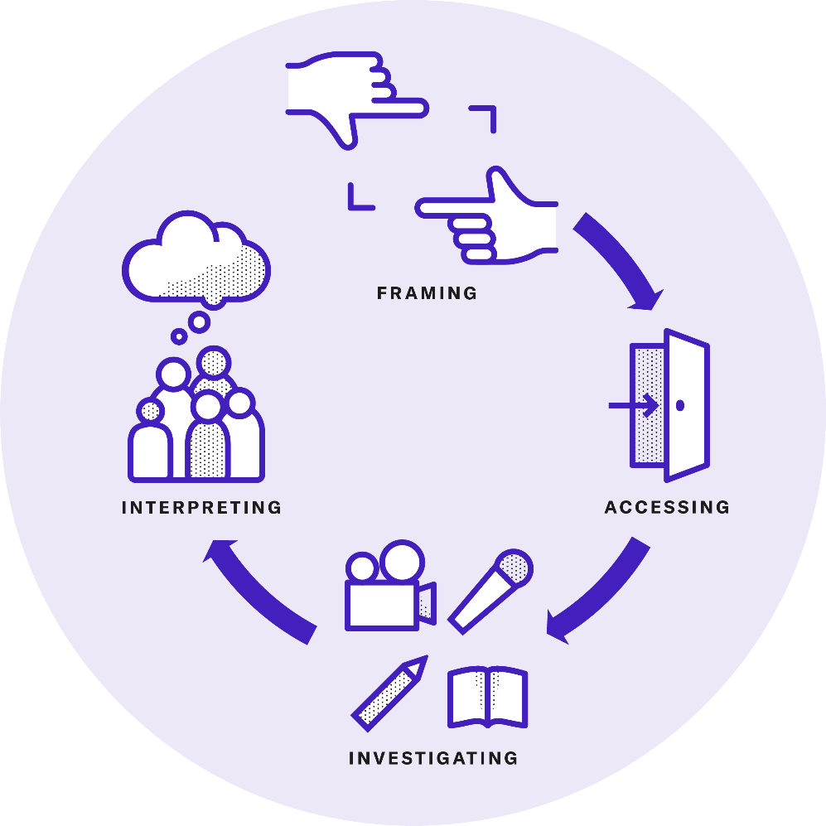
Chapter 4 / Conceiving Innovation Cultures
How to Understand One’s Own Culture

Slide 84
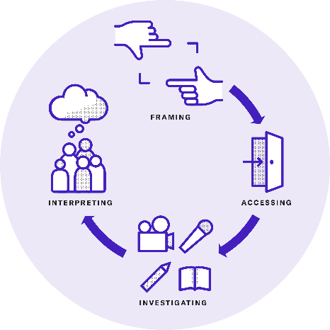
Chapter 4 / Conceiving Innovation Cultures
How to Understand One’s Own Culture
A critical view of culture begins with the realisation that no one yet sufficiently understands the innovation culture and its challenges, nor the alignment between sustainability-related notions, practices and artefacts.
Rapid Ethnography provides a structured approach to understanding innovation cultures, comprising four tasks or steps: framing, accessing, investigating and interpreting.
These steps are also applicable to other methods of understanding culture, such as Mapping Competing Values, Memetics, Focus Groups, Cultural Surveys and Sensemaking.

Slide 85
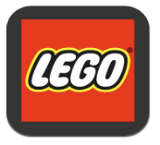


Chapter 4 / Conceiving Innovation Cultures
Framing Culture
Managers often articulate rather narrow questions that need to be translated by the researcher into broader terms to address the viewpoints of stakeholders.
‘What toys do kids want?‘
‘What is the role of play?‘⁵
‘How do we sell
sports equipment?‘
‘Is yoga a sport?
What are sports?‘⁵
‘How to improve
GM’s effectiveness?’
‘Which issues do workers face?
How to make their work lives better?’⁶

Slide 86
Chapter 4 / Conceiving Innovation Cultures
Framing Culture
In our comparative European study, we started with broad questions:
  What are good practices and methods and drivers? And what are organisational barriers and challenges for establishing a sustainable innovation culture?
Later on, we reformulated our questions to address the specific challenges of each company, e.g., in the case of a German inspection company:
  How do cultural tensions and values-action gaps in your company impede the translation of sustainability-oriented innovation strategies into everyday practice?

Slide 87
Chapter 4 / Conceiving Innovation Cultures
Framing Culture
Research questions are answered in reference to the specific culture – it is important to grasp the historical, national, economic and institutional background of the organisation.
Informants should be chosen carefully to ensure diversity of expertise, professional background and areas of responsibility.
The final framing task consists in developing interview, observation and data-collection guides as well as templates for documenting the data in brief profiles for each informant.
Notes:
In our study of an inspection company’s sustainable innovation culture, we had a number of criteria for selecting informants. They had to be sufficiently knowledgeable about the subject matter, based on their first-hand experiences; innovation and sustainability had to be part of their job profile; and they needed to represent diverse perspectives from different hierarchical levels, business units, innovation-related functions and locations and length of employment.
for our analysis of the inspection company’s culture we designed an interview guide for 2–4-hour field interview sessions, with top-level questions that were mandatory and sub-questions that were optional. They covered the following five main topics: 1) personal background and history in the company, 2) interpretation and prioritisation of corporate values, 3) practices and experiences with innovation projects, 4) relationship between sus tainability-related values and innovation management and 5) future outlook.

Slide 88
Chapter 4 / Conceiving Innovation Cultures
Accessing Culture
A key challenge when accessing the field is to reassure respondents (approach 4).
Not every research design requires extensive field observation. As work practices and findings move online, ethnographic observers are following.
Going online reduces time and costs and facilitates reviewing digital materials.
However, online observation has significant limitations:
  Overreliance on what respondents show and their skills in using digital media
  Non-verbal cues such and changes in the environment are blended out
  Building rapport is more difficult
  Reliance on suitable devices, software and online templates

Slide 89
Chapter 4 / Conceiving Innovation Cultures
Approach 4. Guidelines and Techniques for Ethnographic Observers
Your informant is in charge
Blend in
Look at the big picture
Move about
Keep it simple
Paraphrase and summarise
Record

Slide 90
Chapter 4 / Conceiving Innovation Cultures
Investigating Culture
Field interviews are the key methodology of Rapid Ethnography.
Semi-structured interview guides ensure that key topics are covered, while allowing the conversation to flow naturally and respondents to share their perspectives freely.
Several techniques help to streamline the field interview approach to uncover insights into values, tensions, practices and values-action gaps (approach 5).
In addition to interview and observational data, secondary materials (such as internal documents) can be collected in the field or from publicly available sources.

Slide 91
Chapter 4 / Conceiving Innovation Cultures
Approach 5. Techniques to Streamline Field Interviews and Observations
Structured observations
Diaries for self-observation
Open-ended questions
Specification questions
Tour questions
Laddering
Meeting protocols
Protocols of thinking aloud
Mapping tools
Roleplay
Card sorting
‘Heaven and hell’ imagination
Evocative objects

Slide 92
Chapter 4 / Conceiving Innovation Cultures
Interpreting Culture
STORYTELLING SESSION: Analyse the data and code relevant findings.
  What do you find interesting, new or surprising about each profile? What did you learn from this informant? What motivates him or her? and What is he or she struggling with?
PATTERN RECOGNITION: Cluster findings and detect of patterns.
  What is interesting or surprising? What happens again and again? What are the main differences and similarities between the findings?
INSIGHT SYNTHESIS: Identify insights that have subjective relevance and explanatory power and articulate tensions.
  What underlies each pattern? What is of overarching importance for the informants? What contributes to answering our research questions?
ETHNOGRAPHIC WRITING: Generate ‘thick descriptions’⁷ of the observed phenomena.
    Insights into sustainable innovation challenges are translated into task domains for cultural development. Using spatial metaphors, we also speak of design spaces or sustainable innovation territories.
Notes:
1. Subjective relevance: It must describe fundamental characteristics of the in formant’s emotions and behaviours from their point of view.
2. Explanatory power: It must explain the underlying reasons behind the patterned aspects of their statements and behaviours.
3. Tensions: It must articulate tensions between the informants’ desires and values on one hand and adverse circumstances on the other.

Slide 93
Chapter 4 / Conceiving Innovation Cultures
From findings to insights in an exemplary study
Research Tasks | Output | Exemplary Results
1. Storytelling | Clustered findings with illustrative quotes and materials from field interviews, or secondary data | Developing a constructive attitude towards mistakes: ‘Things simply go wrong, and we should develop a constructive attitude to it and always strive to draw something positive from these mistakes’ (Theo). Problems as sources of learning: ‘You want big enough problems so that failing gives you either a big gain or a big learning experience’ (Ronald). Resistance to change: Observation of an informant commenting on a poster found in the meeting room calling for experimentation. He comments that many colleagues still resist experimental approaches (Mark). | Teams avoid failure at early-stage development: ‘When you try new stuff you fail all the time ... Don’t build the login mechanism that works perfectly ... Move on [to] the new stuff’ (Mark). Leadership struggles to accept learning from failure: ‘When I explained this “learning from failure” concept to my boss … he struggled … He said: “We must then also do learning from success”’ (Theo). Blaming others falls back on the speaker: A photo shows the hand of an informant commenting on failure and blaming others. His index finger points one way, while three fingers point back to the person blaming (Theo).
2. Pattern Recognition | Patterns | Recognising the need for experimentation & failure tolerance | Fear of failure and being blamed
3. Insight Synthesis | Overarching insights | ‘We want to experiment and learn from failure so that we can rapidly advance towards our ambitions for sustainability-oriented innovation, but we also fear failure and finger-pointing and so we identify with the risk aversity that characterises the traditional inspection business.’
4. Ethnographic Writing | Ethnographic descriptions of insights and task domains | Insight 1: A failure-tolerant and inclusive sustainable innovation culture presented in a one-sentence summary, an illustrative statement, short description and empirical evidence supporting the insight and task domains (Fostering an Innovation Mindset and Promoting Sustainability Literacy), lessons learned from the insight and discussion of implications with reference to research.

Slide 94

Chapter 4 / Conceiving Innovation Cultures
Practices and Methods: Contextual Inquiry
The first set of practices (marked with ) and methods (marked with ) digs beneath the surface of officially espoused values and prescribed practices to uncover implicit notions, values, tensions and values-action gaps. It addresses the question:
How can we identify implicit notions and values, practices and artefacts to explain tensions and values-action gaps?

Slide 95

Chapter 4 / Conceiving Innovation Cultures
Practices and Methods:
15. Contextual Inquiry⁸
CHALLENGE: How can we gain a holistic understanding of an organisation’s innovation culture?
APPROACH: Understand an organisation’s culture by having researchers immerse themselves in their informants’ everyday work environments and collaborate with them to uncover and interpret cultural practices and implicit notions in real-time.
RELATED METHODS: Rapid Ethnography, Mapping Competing Values, Memetics, Focus Groups, Cultural Survey, Sensemaking

Slide 96

Chapter 4 / Conceiving Innovation Cultures
Practices and Methods:
16. Cultural Surveys⁹
CHALLENGE: How can we identify starting points for interventions and transformation with limited effort?
APPROACH: Reach a large sample of informants (anonymised to ensure confidentiality) and conduct comparative analysis of cultural variables based on dimensional models of culture. Employ custom-made surveys to compare specific notions, values and practices.
EXAMPLE: A survey of innovation and executive managers from 85 Austrian firms examined the relationship between competing values and sustainable innovation performance. Values emphasising internal orientation can hinder sustainable innovation, whereas values that prioritise external orientation towards stakeholders are positively linked to sustainable innovation performance.

Slide 97

Chapter 4 / Conceiving Innovation Cultures
Practices and Methods:
17. Mapping Competing Values¹⁰
CHALLENGE: How can we uncover competing values and tensions with limited effort?
APPROACH: Reveal employees’ implicit values to map typical values and behaviours across three groups of employees. ‘Star employees’ and the ‘leadership team’ represent the most highly valued values in the organisation. ‘Not so hot’ employees provide greater context and insights into values that hinder an innovation culture.
EXAMPLE: This method helped to reveal tensions between guiding values for sustainable innovation in an inspection firm: Experimentation and failure tolerance of star employees contrasted with risk aversion and performance orientation valued by the leadership team.

Slide 98

Chapter 4 / Conceiving Innovation Cultures
Practices and Methods:
18. Rapid Ethnography¹¹
CHALLENGE: How can we make it easier for organisations to do ethnographic research?
APPROACH: Use interactive exercises and staged activities to streamline the participatory observation of everyday practices. Interpret field material through storytelling, pattern recognition and insight synthesis from multiple perspectives.
EXAMPLE: Ethnographic research was used to ana lyse how unsustainable practices are reproduced in the multinational clothing company H&M and how processes of reformation and change towards sustainable practices take place. Ethnography was selected for this research because it allowed the analysis of both micro (individual) and macro (social) perspectives on sustainable innovation practices and values-action gaps.

Slide 99

Chapter 4 / Conceiving Innovation Cultures
Practices and Methods:
19. Memetics¹²
CHALLENGE: How can we effectively analyse and address different aspects of culture, including those that are informal and implicit?
APPROACH: Break down cultural elements into memes to understand how they spread and how they influence cultural transformation. Memes are cultural elements (such as notions, practices and artefacts) that evolve over time through processes of imitation, variation and selection.
EXAMPLE: Memetics helped researchers understand how individual employees of Jacobs Douwe Egberts prioritised memes of sustainability and cultural change and how these priorities could be effectively addressed with Tailored Communication by resonating with their priorities.

Slide 100

Chapter 4 / Conceiving Innovation Cultures
Practices and Methods:
20. Focus Groups¹³
CHALLENGE: How can we reveal implicit assumptions, subjective meanings, group dynamics and shared interpretations when studying organisational culture?
APPROACH: Stage social interactions, collaborative reflections and group dynamics to reveal where participants share common ground or differ in their viewpoints and clarify vague notions or implicit meanings.
EXAMPLE: The Ploutos H2020 project facilitated focus groups to identify values, enablers and obstacles for sustainable innovation in the agri-food sector. Participants discussed sustainable innovation scenarios dominated by conflicting values and multi-actor alliances based on shared values.

Slide 101

Chapter 4 / Conceiving Innovation Cultures
Practices and Methods:
21. Sensemaking¹⁴
CHALLENGE: How can we understand sustainability-related cultural notions, practices, artefacts and their alignment?
APPROACH: Engage stakeholders in deliberation on subjective experiences, interpretations of critical incidents and meanings of values, practices and artefacts to reveal tensions, values-action gaps and misleading communication. Understand how individuals and groups interpret sustainability-related notions, values, narratives, practices, artefacts and events in the organisation to derive targeted interventions.
EXAMPLE: In a Finnish financial firm and an energy company, different sensemaking frames revealed how employees’ views on sustainability reporting were shaped during their companies’ transformations.

Slide 102
Chapter 4 / Conceiving Innovation Cultures
Practices and Methods: Reviewing Practices and
Challenges
The second set of practices and related methods enhances understanding of an innovation culture by engaging employees in structured and collaborative reflection. This approach encourages them to adopt a mindset of managing risks and learning from failure. The guiding question:
How can we reflect on and become more sensitive to proven practices and recurring challenges?

Slide 103

Chapter 4 / Conceiving Innovation Cultures
Practices and Methods:
22. From Failure to Success¹⁵
CHALLENGE: How can we facilitate organisational and individual learning from experiences in sustainable innovation management?
APPROACH: Have employees draw on institutional knowledge and their own experiences in order to learn from failure and build on past achievements. Individuals who contribute to sustainable innovation are given both formal and informal recognition for their efforts.
RELATED METHODS: Awareness Raising, Appreciative Inquiry, Dilemma Games, Empathising

Slide 104

Chapter 4 / Conceiving Innovation Cultures
Practices and Methods:
23. Awareness Raising¹⁶
CHALLENGE: How can values be filled with life to better convey their meaning and relevance?
APPROACH: Raise awareness about values in strategies, policies and practices in experiential workshops, events and routines such as ‘moments of truth’. They allow employees to experience, apply, interpret and reflect on the implications and importance of values.
EXAMPLE: A large German inspection company is fostering sustainable innovation through experimentation and risk-taking. To achieve this, the company hosts events that encourage employees to learn from failure and develop a risk-bearing mindset.

Slide 105

Chapter 4 / Conceiving Innovation Cultures
Practices and Methods:
24. Appreciative Inquiry¹⁷
CHALLENGE: How can we identify cultural strengths and create a positive outlook?
APPROACH: Use Appreciative Inquiry together with problem-solving approaches to pose positive, open-ended questions and co-create a desired future culture based on the culture’s existing strengths.
EXAMPLE: Dairy Management and the mining firm, Fairmount Minerals, used Appreciative Inquiry summits to engage a large number of employees in aligning their cultural strengths and co-creating coherent, system-wide strategies and rapid prototypes for sustainable innovation.

Slide 106
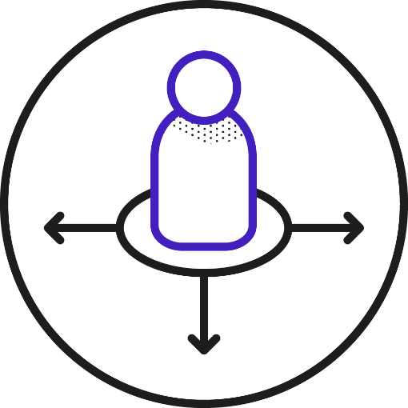
Chapter 4 / Conceiving Innovation Cultures
Practices and Methods:
25. Dilemma Games¹⁶
CHALLENGE: How can we turn abstract organisational values into actionable heuristics?
APPROACH: Prompt employees to interpret and apply values through direct interaction in Dilemma Games. Clarify employee notions, beliefs, attitudes and intentions to align individual and organisational values, sensitising individuals to potential conflicts.
EXAMPLE: The CSI game developed for Deutsche Telekom confronts players with dilemmas in corporate sustainability and values-based challenges that the players address, turning them into seeds for innovation.

Slide 107

Chapter 4 / Conceiving Innovation Cultures
Practices and Methods:
26. Empathising¹⁸
CHALLENGE: How can we tap differences and conflicts between stake holders as sources for innovation?
APPROACH: Encourage stakeholders to see their differences not as conflicts that require a middle-ground compromise, but as something to be harnessed to ideate solutions from a more holistic perspective.
EXAMPLE: Non-profit and for-profit firms are driven by different cultures comprising different sets of values. Empathising was used in eight cases of corporate and non-profit organisations partnering in the UK, resulting in sustainable innovation outcomes.

Slide 108
Chapter 4 / Conceiving Innovation Cultures
Practices and Methods: Revisiting Values and
Integrating Stakeholders
The third set of practices and methods examines the ethical and normative foundations of the organisation to advance its dynamic capabilities of learning and adaptation. This set addresses the question:
How can we review our values to better align them with changing stakeholder priorities and emerging sustainability challenges?

Slide 109

Chapter 4 / Conceiving Innovation Cultures
Practices and Methods:
27. Stakeholder Values Integration¹⁹
CHALLENGE: How can stakeholders be actively involved in transforming our organisational innovation culture?
APPROACH: Monitor stakeholders’ behaviours and viewpoints to better understand and integrate their values into the organisation’s guiding principles, policies and innovation strategy.
RELATED METHODS: Co-construction, Values Jams

Slide 110
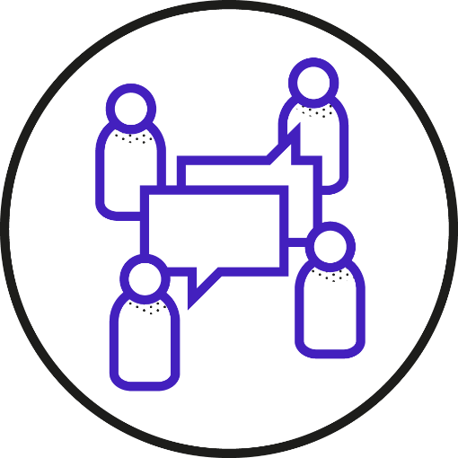
Chapter 4 / Conceiving Innovation Cultures
Practices and Methods:
28. Co-construction²⁰
CHALLENGE: How can we facilitate constructive debate and negotiation among stakeholders to ensure our values remain relevant?
APPROACH: Enhance reflexive processes among various stakeholders through constructive de bate, negotiation and learning activities.
EXAMPLE: The European ResAGorA project involved 80 stakeholders from industry, civil society, policy-making and academia in five Co-construction workshops to test and refine a governance framework for responsible innovation. The workshops aimed to clarify and recognise the varying perceptions of responsibility across different stakeholder groups.

Slide 111

Chapter 4 / Conceiving Innovation Cultures
Practices and Methods:
29. Values Jam²¹
CHALLENGE: How can an organisation’s values for innovation be collaboratively revised and broadly communicated, even across countries and time zones?
APPROACH: Engage employees in an open online communication format, a ‘jam’, to review and redefine values that guide innovation activities. A Values Jam involves extensive preparation and requires that top management follows up on its results.
EXAMPLE: IBM held a 72-hour values jam in 2003 with 50,000 employees participating with the goal of redefining values that would provide future direction for the company’s process, service and business model innovation for the following decades.

Slide 112

Chapter 4 / Conceiving Innovation Cultures
Practices and Methods:
30. Identity and Policy Review²²
CHALLENGE: How can we review and develop our organisational identity and policies?
APPROACH: Have the leadership regularly review and, if necessary, revise the organisation’s guiding principles in response to changing stakeholder expectations and market conditions. Regular reviews ensure that policies are both structured and adaptable – they translate guiding principles into action while staying aligned to support an evolving identity.
RELATED METHODS: Guiding Principles Review

Slide 113

Chapter 4 / Conceiving Innovation Cultures
Practices and Methods:
31. Guiding Principles Review²¹
CHALLENGE: How can we consolidate and align our guiding principles with sustainable innovation?
APPROACH: Review collaboratively and, if needed, redefine values, purpose, mission or vision statements serve to consolidate the guiding principles and prioritise values of sustainability.
EXAMPLE: Aravind’s founder articulated a mission to ‘eradicate needless blindness’, which aligned the entire organisation around making eye care highly efficient, inclusive and scalable. Operations are performed on a freemium basis by well trained medical staff.

Slide 114
Chapter 5
Co-creating Targeted Interventions

Slide 115
Chapter 5 / Co-creating Targeted Interventions
Co-creating for Impact
Co-creating is not just an ideation method – it is an overarching approach to address cultural challenges and explore sustainable innovation practices and methods.
Compared with the top-down approach, co-creating formats come with several benefits for cultural development. They can:
  leverage experience-based knowledge that is widely distributed inside and outside the organisation
  spur creativity through the mindful configuration and collaboration of diverse participants
  flexibly integrate different stakeholders in preparation for events and discussion of results through online or offline interaction formats
  ensure commitment and ownership through participation
  help to spread the word across different participant communities

Slide 116

Chapter 5 / Co-creating Targeted Interventions
Case 10. Pelliconi’s Co-creating Approach to Sustainable Innovation
In 1939, Pelliconi began by recycling military ration containers to make crown caps.
Today it is a global leader, producing over 30 billion caps annually.
Co‑creation drives its entire innovation process.
  Early-stage ideas are crowdsourced via the Desall platform, open‑innovation partnerships and internal Knowledge Sharing in a Champions of Innovation community.¹
  In the concept and prototyping stages, employees, users and experts help to assess the desirability, feasibility and sustainability of new products (e.g. the ‘flower cap’).¹
  In industrialisation and commercialisation, Pelliconi works with suppliers, sharing knowledge and best practices to help them adopt a more sustainability-oriented culture.¹

Slide 117
Chapter 5 / Co-creating Targeted Interventions
Preparing, Conducting and Bundling Co-creative
Activities
Setting the Right Targets
Engaging the Right Participants
Setting Up a Safe Space and Empowering Participants
Facilitation Using Storyboards
Bundling and Scaling Co-creating Activities

Slide 118
Chapter 5 / Co-creating Targeted Interventions
Setting the Right Targets
Co-creating builds on the insights gained from the conceiving activities, targeting specific challenges to sustainable innovation.
Suitable challenges are:
  broad enough to justify a collective effort
  manageable given available resources and time
  not narrow, as overly specific challenges require specialised expertise that does not always benefit from a co-creating approach
  relevant to existing initiatives: In some cases it may not be necessary to duplicate efforts. In other cases, co-creating can help redesign or simplify ongoing efforts.

Slide 119
Chapter 5 / Co-creating Targeted Interventions
Engaging the Right Participants
Large formats like Futures Search² or Open Space conferences² can be tailored to the organisation’s needs, available time and budget and adapted to smaller groups.
Co‑creation relies on direct interaction, making it essential to involve participants who bring diverse experiences and viewpoints.
Stakeholder diversity ensures that the process is holistic and inclusive, considering a wide range of insights and ideas.
Still, one needs to prioritise the most relevant stakeholders so as to ensure meaningful contributions.

Slide 120
Chapter 5 / Co-creating Targeted Interventions
Setting Up a Safe Space and Empowering Participants
Participants must feel they are in a safe space to express ideas openly. Warm‑ups and energisers help build rapport before entering the session.
They must feel empowered and understand the impact of their contributions.³ When people know how their input matters, they are more likely to support the outcomes, even if these do not align perfectly with their preferences.
The conceived challenges must be clearly defined and framed as opportunities for co-creative exploration and collaborative intervention.

Slide 121
Chapter 5 / Co-creating Targeted Interventions
Facilitation Using Storyboards
Dedicated facilitators play an essential role in the success of co-creating:
  in the preparation phase, define the session’s boundaries and focus
  during the session, introduce background information, provide clear instructions, ensure focus and engagement and moderate feedback
  post-session, highlight key takeaways, synthese results and triggering and tracking follow-up activities
A structured approach is needed to ensure the encounters run smoothly and bring about the desired results.
Storyboards are visualised in a table or map and serve as a reference during the workshop (approach 6).

Slide 122
Chapter 5 / Co-creating Targeted Interventions
Approach 6. Key Elements of a Storyboard for Co-creation Workshops
A storyboard contains the key elements of a workshop: objectives, expected results, each step of the co‑creative journey, the facilitation methods and potential challenges.
The co‑creative journey typically includes an introduction, immersion in the topic, collaborative activities and feedback, synthesis to achieve the objectives and assignment of responsibilities and follow-up actions .
Each step requires clear instructions, supportive techniques and exemplary results to illustrate expectations.
The storyboard should define the timeframe, materials, participant roles, icebreakers, warm‑up or refocusing exercises and backup activities.
Reviewing the storyboard with stakeholders before and after sessions allows it to be iteratively refined, increasing the desired impact in the next iteration.

Slide 123

Chapter 5 / Co-creating Targeted Interventions
Case 11. Envisioning New Mobility Business at Michelin
Based on a review of corporate values, purpose and ambitions we prepared a 3-phase Envisioning workshop at Michelin’s corporate headquarters in Clermont-Ferrand.
PRIORITISATION: Small teams prioritised combinations of future scenarios, corporate values and sustainability ambitions to specify business development guidelines.
ENVISIONING: Teams worked with selected local sites in Clermont-Ferrand to envision future mobility. Techniques like imagining ‘heaven and hell’ scenarios helped them to specify both hopes and risks for each location. Bundling values, ambitions and future scenarios they proposed future sustainable business model innovations at each site.
IMPLICATIONS: Participants took the roles of an EU Officer, CSR Manager and Michelin’s CEO in 2035 to comment on the pitched ideas.

Slide 124
Chapter 5 / Co-creating Targeted Interventions
Bundling and Scaling Co-creating Activities
Organisations can bundle different co-creating workflows and facilitate ongoing employee interaction and dialogue to scale up the impact of co-creation (case 12).
Decentralised autonomous organisations (DAOs) institutionalise co-creating and provide a framework for multi-stakeholder collaboration.
Building on blockchain technology DAOs maintain a transparent and unalterable record of decisions, transactions and project outcomes.

Slide 125

Chapter 5 / Co-creating Targeted Interventions
Case 12. Employee-Driven Co-creating to Foster Sustainable Innovation
Interface’s QUEST (Quality Utilising Employees’ Suggestions and Teamwork)⁴
Cross-functional teams worldwide sought pragmatic solutions to cutting waste
Teams aimed to cut waste by ten percent every year and received bonuses based on the impact of their solutions
The initiative led to significant cost savings (e.g. ‘portable creel’ system reducing scrap yarn by 54 percent)
Xerox's Earth Awards⁵
Encouraged employee-driven sustainable innovation
Enabled significant cost savings through reduced plastic waste, coversrion of waste into electric power and optimised water use

Slide 126
Chapter 5 / Co-creating Targeted Interventions
Practices and Methods:
Co-creating with Internal Stakeholders
The hidden treasure of an intrinsically motivated workforce is key to fostering sustainable innovation. The first set of practices and methods helps tap this potential by enabling employees across all levels to actively support the sustainability transition.
How can we engage employees to collaboratively drive sustainable innovation by experimenting with new methods and artefacts?

Slide 127

Chapter 5 / Co-creating Targeted Interventions
Practices and Methods:
32. Values-Based Ideation and Assessment⁶
CHALLENGE: How can we harness the potential of stakeholder values to reveal otherwise latent opportunities, boundaries and risks for sustainable innovation?
APPROACH: Apply sustainability-related values and concepts as heuristics for ideation and as criteria for the assessment of intermediary results in innovation management. This is sup ported via design methods that facilitate internal crowdsourcing, business modelling, or value-sensitive design.
RELATED METHODS: Sustainable Innovation Time, Values-Based Intrapreneurship, Ideation Contests and Markets, Values-Based Business Modelling

Slide 128

Chapter 5 / Co-creating Targeted Interventions
Practices and Methods:
33. Facilitating Idea Management⁷
CHALLENGE: How can we harness the collective intelligence of the entire workforce to ensure continuous improvement and an alignment of outcomes with stakeholder needs?
APPROACH: Facilitate the exchange of ideas, feedback and knowledge by establishing communication channels, such as social networks and innovation platforms. Ideas and associated data and feedback are collected, evaluated and prioritised, often with the help of digital platforms and AI tools.
RELATED METHODS: Sustainable Innovation Time, Values-Based Intrapreneurship, Ideation Contests and Markets

Slide 129

Chapter 5 / Co-creating Targeted Interventions
Practices and Methods:
34. Sustainable Innovation Time⁸
CHALLENGE: How can we encourage employees to tap into their values and intrinsic motivation and develop their own sustainable innovation initiatives?
APPROACH: Use Innovation Time to empower employees to propose their own projects and provide them time to pursue these projects during their regular working hours.
EXAMPLE: Philips gives scientists in its innovation department time on Fridays to work on their own sustainable innovation projects. They can also apply for three-month research fellowships to pursue ideas of interest. Philips also eases the conditions for the evaluation of these projects.

Slide 130

Chapter 5 / Co-creating Targeted Interventions
Practices and Methods:
35. Values-Based Intrapreneurship⁹
CHALLENGE: How can we foster intrapreneurship to explore unconventional ideas for sustainable innovation?
APPROACH: Employ intrapreneurship toolboxes like Adobe Kickbox to engage employees in a values-based innovation process, fostering sustainability literacy and inspiring sustainable innovation projects.
EXAMPLE: The Adobe Kickbox programme inspired Swisscom to initiate new sustainability projects and multi-disciplinary teams. All employees’ job descriptions now include proficiency in the use of the Kickbox to reinvent the telecom sector.

Slide 131

Chapter 5 / Co-creating Targeted Interventions
Practices and Methods:
36. Ideation Contests and Markets¹⁰
CHALLENGE: How can we generate new ideas, encourage the collaborative assessment of innovation projects and aggregate diverse perspectives on their potential outcomes and impact?
APPROACH: Use game elements in Ideation Contests and Markets to motivate the generation, screening and promotion of sustainable innovation ideas. To qualify for funding, ideas must meet a predefined threshold of points or virtual investments.
EXAMPLE: The CEC Shoe Design Contest engaged large manufacturers to ‘design an innovative organic shoe based on fashion trends, authentic materials, cultural values and regional techniques.’

Slide 132
Chapter 5 / Co-creating Targeted Interventions
Practices and Methods:
Co-creating with External Stakeholders
The second set of co-creating practices and methods focuses on integrating ex ternal stakeholders’ values and sustainability priorities as pivots for ideation and strategic development.
How can we engage external stakeholders in collaborative idea generation and the exploration of sustainable innovation practices?

Slide 133
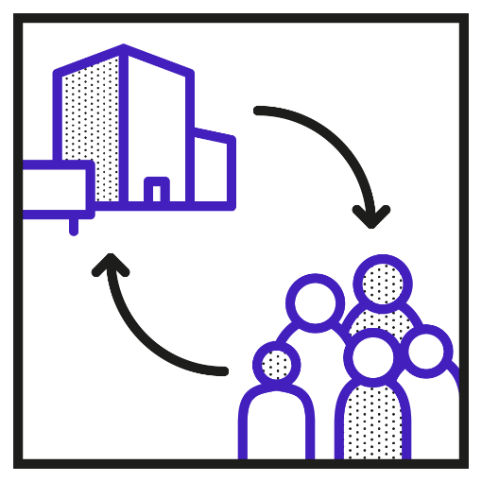
Chapter 5 / Co-creating Targeted Interventions
Practices and Methods:
37. Engaging in Open Innovation¹¹
CHALLENGE: How can we exchange resources, knowledge and technologies with a wide range of stakeholders to spur sustainable innovation?
APPROACH: Engage in outside-in, inside-out and coupled open innovation based on shared values of sustainability. Outside-in open innovation applies external knowledge, mainly from market actors such as partners and competitors. Inside-out open innovation turns knowledge and resources into external business opportunities through, for example, licensing, spin-offs, joint ventures and consulting. Coupled open innovation connects internal and external knowledge through collaborative relationships.
RELATED METHODS: Ideation Contests and Markets, Lead User Integration

Slide 134

Chapter 5 / Co-creating Targeted Interventions
Practices and Methods:
38. Lead User Integration¹²
CHALLENGE: How can we tap users’ widely distributed knowledge and ideas?
APPROACH: Engage with lead users who face sustainability challenges ahead of the market. By working with them directly or through a dedicated online community, organisations can gain valuable insights into the challenges and potential solutions before they become mainstream.
EXAMPLE: Lead users from the IKEA Hackers community creatively repurpose furniture, pro viding the company with ideas for sustainable product designs that promote reuse and mini mise environmental impact.

Slide 135

Chapter 5 / Co-creating Targeted Interventions
Practices and Methods:
39. Sustainable Market Creation¹³
CHALLENGE: How can we match latent demand with sustainable supply?
APPROACH: Create new, sustainability-oriented markets that address latent needs and shape the sustainability-oriented transformation of societal behaviours and patterns of consumption and production.
RELATED METHODS: Values-Based Business Modelling

Slide 136

Chapter 5 / Co-creating Targeted Interventions
Practices and Methods:
40. Values-Based Business Modelling¹⁴
CHALLENGE: How can we help teams specify their guiding principles and goals and assess their options before designing a new business?
APPROACH: Start by creating common ground with Values-Based Business Modelling among different stakeholder values and the organisation’s guiding principles. This provides a shared basis to generate and assess alternative sustainable business model designs. Values-based Business Modelling guardrails collaboration, providing methods for ideation and criteria for prioritising ideas or intermediary results.
EXAMPLE: The Lab of Tomorrow facilitates business model innovations grounded in the UN’s Sustainable Development Goals to incubate joint ventures between German companies and stake holders from the developing world.

Slide 137
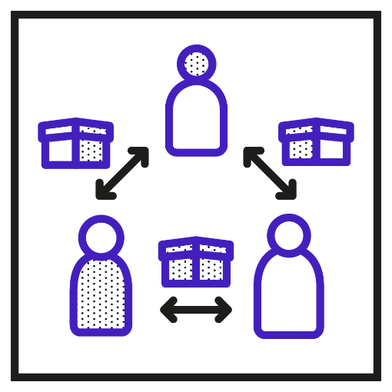
Chapter 5 / Co-creating Targeted Interventions
Practices and Methods:
41. Engaging in Innovation Ecosystems¹⁵
CHALLENGE: How can we enhance sustainable value creation by creating synergies, collaborative actions and redistributing mutual benefits among multiple stakeholders?
APPROACH: Nurture sustainable innovation through collaborative efforts over the long term, sharing resources and aligning objectives together with market and non-market actors from governments, academia, NGOs and local communities.
RELATED METHODS: Values-Based Ecosystem Modelling

Slide 138
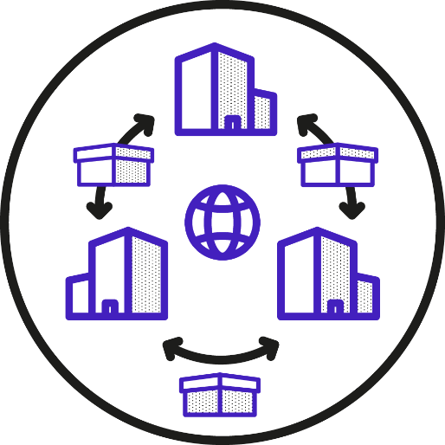
Chapter 5 / Co-creating Targeted Interventions
Practices and Methods:
42. Values-Based Ecosystem Modelling¹⁶
CHALLENGE: How can we facilitate the formation of sustainable business ecosystems based on shared values and visions?
APPROACH: Set up co-creating workshops to reflect on stakeholder values, sustainability challenges and business case drivers, leveraging shared priorities for new ecosystem development.
EXAMPLE: To envision its role in future sustainability-oriented ecosystems, an inspection company reviewed future trends, current stakeholder relations and sustainability drivers.

Slide 139
Chapter 5 / Co-creating Targeted Interventions
Practices and Methods: Sustainability Foresight
A third set of co-creating practices and methods derives strategic measures through the development of probable, possible and desirable future scenarios. It addresses the question:
How can we proactively explore opportunities for sustainable innovation, avoid unintended consequences and enhance resilience?

Slide 140
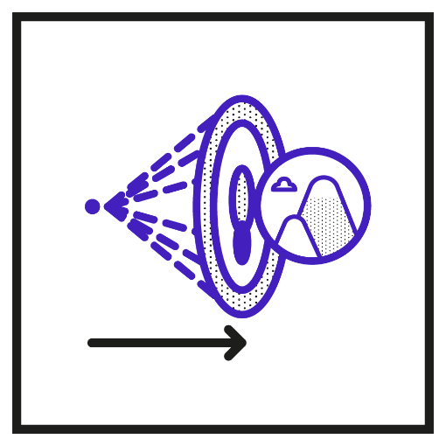
Chapter 5 / Co-creating Targeted Interventions
Practices and Methods:
43. Sustainability Foresight¹⁷
CHALLENGE: How can foresight methods and normative scenarios inform sustainable innovation management?
APPROACH: Apply foresight methods and scenario management to drive transformation. Anticipate emerging business risks to improve organisational preparedness for sustainability-related challenges and to identify opportunities for sustainable innovation.
RELATED METHODS: Envisioning, Backcasting, Roadmapping

Slide 141

Chapter 5 / Co-creating Targeted Interventions
Practices and Methods:
44. Envisioning
CHALLENGE: How can we envision sustain able futures that help stakeholders identify new business opportunities?
APPROACH: Use Envisioning to accommodate diverse stakeholder values and formulate normative scenarios for mutually desirable futures. These scenarios help formulate implementation strategies for sustainable innovation.
EXAMPLE: Envisioning was used by Michelin to collaboratively integrate the company’s values, purpose and activities into location-specific visions for sustainable mobility in 2035 and develop the potential business model innovations needed to realise this goal.

Slide 142
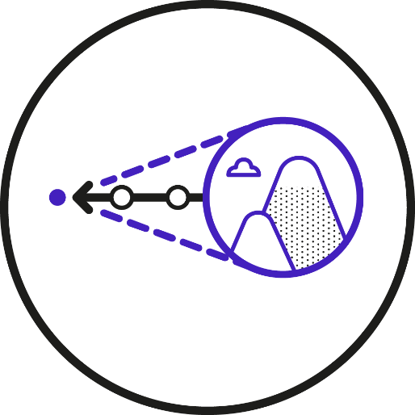
Chapter 5 / Co-creating Targeted Interventions
Practices and Methods:
45. Backcasting¹⁸
CHALLENGE: How can we specify required changes and interventions needed to work towards a future vision?
APPROACH: Start by working backwards from a desired future state to discover and implement the necessary intermediate steps to approximate that future state. Backcasting helps turn far-reaching goals and values into a sequence of actionable and measurable objectives.
EXAMPLE: Backcasting informed Electrolux’s strategy to phase out harmful chlorofluoro carbons by first adopting emission-intensive hydrofluorocarbons as an interim solution while developing safer climate-neutral hydrocarbon technology. This phased approach allowed Electrolux to address immediate environmental concerns while progressing toward a long-term sustainable solution.

Slide 143
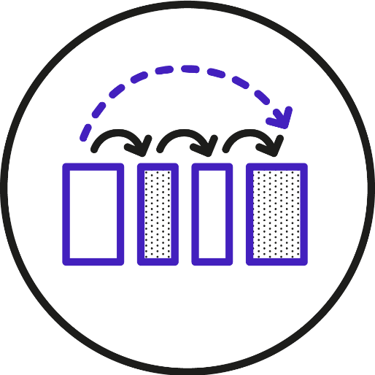
Chapter 5 / Co-creating Targeted Interventions
Practices and Methods:
46. Roadmapping¹⁹
CHALLENGE: How can we specify incremental steps and metrics to track progress in the pursuit of long-term strategies?
APPROACH: Outline the steps and milestones needed to achieve long-term strategic goals and visions with Roadmapping. Typically, the roadmap consists of short-term objectives, plans, actions and metrics to track progress.
EXAMPLE: Unilever’s Sustainable Living Plan provided a roadmap that integrated sustainable growth into the company’s long-term strategy and encouraged employees to engage in innovation projects to achieve the targets, such as the Small Actions, Big Difference Fund.

Slide 144
Chapter 6
Cultivating Sustainable Innovation

Slide 145
Chapter 6 / Cultivating Sustainable Innovation
Cultivation
Culture does not change arbitrarily, nor can it be imposed top-down, reduced to a new mindset or engineered and implemented voluntarily following a blueprint.
Simply exploring possibilities for innovation and introducing new methods is not enough. We must also cultivate sustainable innovation by prioritising critical task domains as part of a medium-term strategy.
Cultivation refers to deliberate and systematic efforts to purposefully shape, sustain and renew the innovation-related notions, practices and artefacts of an organisation – its innovation culture – in a sustainability-oriented manner.

Slide 146
Chapter 6 / Cultivating Sustainable Innovation
Origins of the Term Cultivation
Originally, the term ‘cultivation’ meant preparing soil and tending plants in agriculture.
Georg Simmel first used the term to describe how an individual’s inner subjectivity and its external objectivation as culture mutually transform each other.¹
In his view, cultivation implies developing individual and group characteristics that would not come about naturally, but for which individuals have an inherent propensity.¹
Psychologists picked up this concept to denote that the value of cultural artefacts lies in their potential to further human development.²
Accordingly, cultural development takes place not only through the interaction of individuals with social partners but also through the individual’s interactions with artefacts and the meanings that they attach to them or perceive through them.
Notes:
In its figurative sense, ‘to cultivate’ means developing qualities, relationships, skills or interests.
The other way around, the specific characteristics of artefacts provide cultural media that engender subjective possibilities and objective opportunities for the formation of the self and the development of social systems.4
The transactions between individuals, social groups and culture are thus facilitated by ‘purposively created objects, settings and other components of the culturally structured environment.’5

Slide 147
Chapter 6 / Cultivating Sustainable Innovation
Cultivating of Sustainable Innovation in an
Organisation
Both Simmel’s understanding of reciprocity and the role of artefacts in meaning-making practices yield insights into conceptualising the cultivation of sustainable innovation:
The development of an innovation culture is not a one-way street of cascading values and goals. It involves reciprocal transactions between organisatioal members and how individuals interpret, negotiate and sometimes challenge values, practices and artefacts.
Cultivating sustainable innovation requires supportive artefacts. The repeated interaction by employees with these artefacts helps them refine their understanding and application, as well as adapt them to suit their own skills, needs and preferences.
Notes:
We should not misconceive the development of an innovation culture as a one-way street where employees are expected to unquestioningly adopt the values and goals of their organisation. We are considering reciprocal transactions between an organisation’s members and how individuals actively interpret, negotiate and sometimes challenge cultural values, practices and artefacts.
Cultivating sustainable innovation requires the introduction of supportive artefacts, such as documents, templates, tools and changes to the physical environment. The repeated interaction by employees with these artefacts helps them refine their understanding and application, , as well as adapt them to suit their own skills, needs and preferences.

Slide 148
Chapter 6 / Cultivating Sustainable Innovation
Cultivating of Sustainable Innovation in an
Organisation
Both Simmel’s understanding of reciprocity and the role of artefacts in meaning-making practices yield insights into conceptualising the cultivation of sustainable innovation:
The development of an innovation culture is not a one-way street of cascading values and goals. It involves reciprocal transactions between organisatioal members and how individuals interpret, negotiate and sometimes challenge values, practices and artefacts.
Cultivating sustainable innovation requires supportive artefacts. The repeated interaction by employees with these artefacts helps them refine their understanding and application, as well as adapt them to suit their own skills, needs and preferences.
Notes:
We should not misconceive the development of an innovation culture as a one-way street where employees are expected to unquestioningly adopt the values and goals of their organisation. We are considering reciprocal transactions between an organisation’s members and how individuals actively interpret, negotiate and sometimes challenge cultural values, practices and artefacts.
Cultivating sustainable innovation requires the introduction of supportive artefacts, such as documents, templates, tools and changes to the physical environment. The repeated interaction by employees with these artefacts helps them refine their understanding and application, , as well as adapt them to suit their own skills, needs and preferences.

Slide 149

Chapter 6 / Co-creating Targeted Interventions
Case 13. German Railways’ Cultivation of Data-Driven Sustainability Management
To advance its ESG compliance, Deutsche Bahn (DB) developed its own ESG data management platform.³
The platform supports retrospective reporting, strategic transition planning and scenario modelling for DB’s sustainability goals.
A gradual cultivation process enabled the sustainability and IT departments to iteratively co-develop the solution.
  First, IT prepared uniform data-collection templates for the different sustainability teams, recognising that each team had its own metrics and varying degrees of data maturity.
  Platform development continued with iterative co-creation and continuous adaptation to the needs of the sustainability teams and further stakeholders.
  Repeated communication, workshops and retrospectives revealed where the system needed adjustments to match evolving stakeholder requirements.
Notes:
Repeated communication, workshops and retrospectives revealed insights about where the system needed adjustments – prompting the fine-tuning of workflows and reporting templates to match evolving requirements, such as team-specific metrics, DB’s internal sustainability ambitions, changes in the regulatory landscape and the growing demand for data-driven sustaina bility management.

Slide 150
Chapter 6 / Cultivating Sustainable Innovation
Cultivating Values, Practices and Artefacts for
Sustainable Innovation
Cultivating sustainable innovation requires a holistic approach that intertwines the mainstreaming of values, establishing new practices and the mediation of artefacts.
Mainstreaming Values
Establishing New Practices
Mediating Artefacts

Slide 151
Chapter 6 / Cultivating Sustainable Innovation
Mainstreaming Values
The objective of mainstreaming values is to embed shared values, identified and clarified in the stages of conceiving and co-creating, into everyday actions and decision-making processes.
The first step is to translate values that into guiding principles, actionable policies and governance structures that underpin innovation management.
The next steps depend on the maturity of the organisation’s values-based innovation culture:
  Cultivating implicit values
  Cultivating global values
  Cultivating specific values
  Cultivating active management of values
  Cultivating proactive management of values

Slide 152
Chapter 6 / Cultivating Sustainable Innovation
Mainstreaming Values
The objective of mainstreaming values is to embed shared values, identified and clarified in the stages of conceiving and co-creating, into everyday actions and decision-making processes.
The first step is to translate values that into guiding principles, actionable policies and governance structures that underpin innovation management.
The next steps depend on the maturity of the organisation’s values-based innovation culture:
  Cultivating implicit values
  Cultivating global values
  Cultivating specific values
  Cultivating active management of values
  Cultivating proactive management of values

Slide 153
Chapter 6 / A Framework for Sustainable Innovation Cultures
Case 14. How Ecosia’s Continuous Refinement of Values Informs Strategic Decisions
Ecosia’s continuous revision of organisational values reflects critical moments in its business development.⁴
The value of integrity drives Ecosia’s strong commitment to user privacy, even though this makes it ‘difficult to tailor products for users’ or increase revenue through data.
Values are revised in response to societal shifts and public debates.
  During rising protests by the Black Lives Matter movement, Ecosia revisited its core values of happiness, sustainability and user focus to update partner contracts and initiate innovation projects for enhanced web search accessibility.
The case shows how reordering or redefining core values does not indicate a lack of consistency. Rather, ongoing reflections and reinterpretations ensure a more deliberate, values-based approach.

Slide 154
Chapter 6 / Cultivating Sustainable Innovation
Establishing New Practices
Sustainable innovation practices are established as an integral element of employees’ daily work. Practices and methods can be adopted from the collection in this book or developed from informal practices initiated by individual employees or teams.
Cultivation emphasises the importance of refining these bottom-up grassroots efforts
Supportive measures empower employees to become active agents of innovation and cultural change:
  Ensuring psychological safety, Experimentation and Decentralisation as supportive measures
  Assessment and refinement
  Scaling and sustaining

Slide 155
Chapter 6 / Cultivating Sustainable Innovation
Ensuring Psychological Safety, Experimentation and Decentralisation as Supportive Measures
Psychological safety denotes an environment where employees feel safe to take risks, voice their opinions and learn from their mistakes.⁵
Employees that experience psychological safety make suggestions for new practices and are more likely to disagree with practices that appear counterproductive.⁶
Employees that feel psychologically safe are also more likely to to engage in Experimentation with new methods (e.g. case 15).
Empowerment (e.g. case 12 of Interface and Xerox) and Decentralisation (e.g. in holocracies) complement Experimentation by mobilising employee contributions that would lack resonance in traditional hierarchies and governance structures.

Slide 156
Chapter 6 / A Framework for Sustainable Innovation Cultures
Case 15. Informal Collaboration Practices to Reconcile Tensions in Alberta’s Healthcare
In 1994, Alberta (Canada) introduced a business‑like health care institutional rationale focused on cost‑effectiveness, efficiency and customer satisfaction.⁷
This created tension with the existing medical professionalism rationale centred on physician–patient relationships and expertise.
Despite an initial ‘uneasy truce’, administrative managers and physicians collaborated on establishing practices that helped to reconcile the two rationales.
Managers informally sought physicians’ input. Although physicians were excluded from administrative boards their actions influenced costs.
These informal interactions later evolved into Physician Liaison Councils, formally recognising physicians’ advisory role.
The two parties also initiated joint innovation projects in experimental sites (e.g. interprofessional teams and chronic‑care services in community centres and homes).

Slide 157
Chapter 6 / Cultivating Sustainable Innovation
Assessment and Refinement
Newly established innovation practices are assessed for their outcomes and impact on innovation performance and positive cultural change.
Theory of Change⁸ is an approach to plan and explain how a change effort can lead to long-term impact.
It outlines the steps needed to reach a goal by connecting stakeholder actions, results and outcomes in a logical sequence (see also Result Chains).

Slide 158
Chapter 6 / Cultivating Sustainable Innovation
Scaling and Sustaining
Successful pilots for new sustainable innovation practices by individual employees or teams can be scaled across an organisation.
Engaging a diverse range of stakeholders to provide feedback ensures that the practices are adaptable to various contexts within the organisation.
Scaling practices requires allocating and developing the necessary resources, knowledge and sills (e.g. via Mandatory Training and Human Resource Development programmes)
Support systems and artefacts such as mentoring, dedicated tools or platforms for collaboration further help to embed practices into daily routines.
To sustain practices, employees should be encouraged to reflect on them and make them an integral part of their individual and organisational identity (e.g. via Inviting for Informal Exchanges, Off-Site Events or Employee Resource Groups).

Slide 159
Chapter 6 / Cultivating Sustainable Innovation
Mediating Artefacts
Artefacts such as tools, materials and frameworks play a pivotal role in cultivating sustainable innovation. They facilitate the mainstreaming of organisational values and policies, and they provide stability, guidance and structure to establish and streamline desired behaviours and sustainable innovation practices.
Artefacts for governance
  Policy documents, accountability frameworks or decision-making matrices – establish clear guardrails
Artefacts for operational purposes
  User-friendly, flexible and easily scalable software, AI-powered and data management tools, checklists, templates, and visual aids streamline regular operations, standardise tasks, reduce complexity and provide guidance (e.g. for Context-Based Reporting).
Updates and flexible workflows
  E.g., streamlining tools for Innovation Impact Assessment in a technical inspection company.

Slide 160
Chapter 6 / Cultivating Sustainable Innovation
Cultivating Outcomes
Alignment between values, practices and artefacts is a necessary, but not yet sufficient condition to establishing sustainable innovation cultures.
Sustainable innovation must be understood as an outcome that creates or redistributes environmental, social and economic value.
Several practices and methods ensure that outcomes are achieved and that values of sustainability are efficiently transferred into sustainable innovations:
  Management Systems
  Sustainable Finance and Investment
  Context-Based Reporting
  Result Chains
  Innovation Impact Assessment

Slide 161
Chapter 6 / Cultivating Sustainable Innovation
Practices and Methods: Promoting Sustainability
Literacy and Capacity Building
The first set of practices and methods supports the mainstreaming of sustainability-related values and policies and putting them into practice. It addresses the unique needs, skills, competencies and awareness levels of individual employees or teams and asks the question:
How can we mainstream values and related notions to promote sustainable innovation literacy and develop human resources to turn strategies into practice?

Slide 162

Chapter 6 / Cultivating Sustainable Innovation
Practices and Methods:
47. Policy Communication⁹
CHALLENGE: How can we ensure that values, guiding principles and policies will be well understood by different stakeholders in different situations?
APPROACH: Communicate guiding principles and related policies, embedding values in practice and demonstrating how they are applied in day to-day decisions and activities.
RELATED METHODS: Cultural Dictionary, Tailored Communication

Slide 163

Chapter 6 / Cultivating Sustainable Innovation
Practices and Methods:
48. Cultural Dictionary¹⁰
CHALLENGE: How can we enhance sustainability literacy and create a common ground of under standing?
APPROACH: Disambiguate and effectively communicate cultural concepts and how to enact them with a Cultural Dictionary. It provides a common language and promotes awareness, literacy and engagement around sustainability and related values.
EXAMPLE: An energy technology company introduced a Cultural Dictionary featuring interviews where employees from different backgrounds shared how they understood and applied newly introduced sustainability values.

Slide 164

Chapter 6 / Cultivating Sustainable Innovation
Practices and Methods:
49. Tailored Communication¹¹
CHALLENGE: How can we adequately address individual communication needs and preferences?
APPROACH: Tailor messages to each individual and subculture’s sustainability literacy knowledge and ambitions. Understand your stakeholders to effectively use communication methods to target media and shape messages.
EXAMPLE: Employees of the Dutch coffee company Jacobs Douwe Egberts shaped messages about cultural change that were tailored to their employee’s individual notions of sustainability and cultural change, making them more attractive, intelligible and motivating than non-tailored messages.

Slide 165
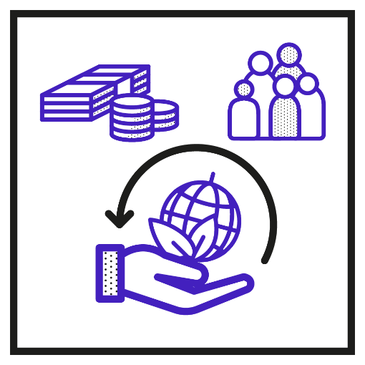
Chapter 6 / Cultivating Sustainable Innovation
Practices and Methods:
50. Incentivisation¹²
CHALLENGE: How can we keep up the motivation of all employees to actively contribute to sustainable innovation initiatives?
APPROACH: Continuously align performance measurement, award systems and positive recognition with employee contributions to sustainable value creation and the achievement of sustainability-related objectives.
RELATED METHODS: Incentivisation Schemes

Slide 166
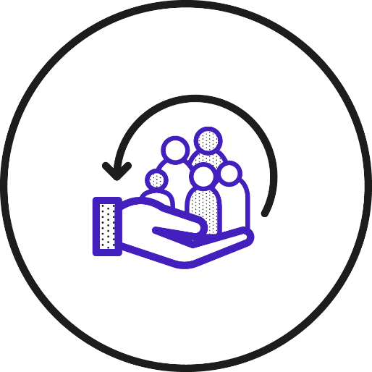
Chapter 6 / Cultivating Sustainable Innovation
Practices and Methods:
51. Incentivisation Schemes¹³
CHALLENGE: How can we motivate contributions to sustainable innovation projects?
APPROACH: Use indicators to assess employees and incentivise desirable behaviours or valuable results of a sustainable innovation project. Awards and bonuses are balanced with non-financial benefits such as access to professional development.
EXAMPLE: The Dutch paint and chemicals company, AkzoNobel, introduced a bonus system to reward senior managers for meeting long-term sustainability targets. The system ties 30 percent of the managers’ long-term incentive bonus to the company’s sustainable innovation performance.

Slide 167

Chapter 6 / Cultivating Sustainable Innovation
Practices and Methods:
52. Attracting the Right Talent¹⁴
CHALLENGE: How can we discover and engage highly motivated, skilled and knowledgeable talent to drive sustainable innovation?
APPROACH: Implement ‘a recruitment and selection process that takes into account both competencies and sustainability-oriented values’.
RELATED METHODS: Aspirational Narratives

Slide 168

Chapter 6 / Cultivating Sustainable Innovation
Practices and Methods:
53. Aspirational Narratives¹⁵
CHALLENGE: How can we craft narratives that inspire proactive and purpose-driven engagement for sustainable innovation?
APPROACH: Frame the pursuit of sustainability related values as an organisational purpose with Aspirational Narratives and formulate hopeful and ambitious objectives for sustainable innovation.
EXAMPLE: A comparative multi-case study demonstrated that the Aspirational Narratives in an American textiles company and a Belgian household goods company were related with more innovation-supportive values (i.e. flexibility, freedom, risk-taking, experimentation, continuous learning and change) compared to other companies with ambiguous and accountable (focused on compliance and metrics) narratives of sustainability.

Slide 169

Chapter 6 / Cultivating Sustainable Innovation
Practices and Methods:
54. Human Resource Development¹⁶
CHALLENGE: How can we empower employees with the skills and competences needed to drive sustainable innovation?
APPROACH: Foster personal growth, motivation and a sense of flow through ‘onboarding and clear communication of values to new employees’, employee training, career development and succession planning.
RELATED METHODS: Mandatory Training

Slide 170

Chapter 6 / Cultivating Sustainable Innovation
Practices and Methods:
55. Mandatory Training¹⁷
CHALLENGE: How can we mainstream a shared understanding of the organisational values and convey the competences needed to turn them into practice?
APPROACH: Further sustainability literacy and the acquisition of knowledge across teams with Mandatory Training. It imparts essential sustain able innovation skills and competencies.
EXAMPLE: Interface provides mandatory sustain ability training to all new employees to inform them of ongoing activities and encourage them to engage in sustainable innovation. Optional advanced training is also offered to develop societal problem-solving skills.

Slide 171
Chapter 6 / Cultivating Sustainable Innovation
Practices and Methods:
Promoting Social Interactions
The next set of practices and methods focuses on cultivating social interactions. These are a significant factor in both hindering and facilitating the mainstreaming of values and the establishment of new practices. They range from the daily informal exchanges that take place between employees to more deliberate forms of collaboration and knowledge exchange, together with interactions with stakeholders outside of the organisation:
How can we promote sustainability-oriented collaboration, knowledge exchange and stakeholder engagement?

Slide 172

Chapter 6 / Cultivating Sustainable Innovation
Practices and Methods:
56. Inviting for Informal Exchange¹⁸
CHALLENGE: How can we facilitate the sharing of sentiments and ideas employees might other wise conceal?
APPROACH: Create opportunities for informal verbal or non-verbal interpersonal communication. Facilitate the flow of ideas, knowledge and emotions in everyday activities that are not focused on problem-solving.
RELATED METHODS: Off-Site Events, Employee Resource Groups

Slide 173

Chapter 6 / Cultivating Sustainable Innovation
Practices and Methods:
57. Off-Site Events⁴
CHALLENGE: How can we use special spaces and times to promote interpersonal experiences and facilitate deliberation?
APPROACH: Bring employees away from their usual workplace to detach them from their daily routines with Off-Site Events. Have them work together on unfamiliar yet important tasks and participate in team-building activities.
EXAMPLE: In 2020, the green search engine, Ecosia, responded to the heated debates stirred by the Black Lives Matter movement by engaging its employees in an Off-Site Event with the goal of establishing accessibility and inclusivity as guiding values for product development.

Slide 174
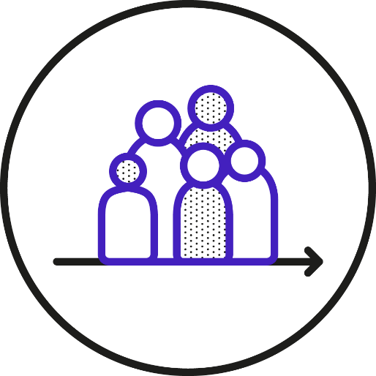
Chapter 6 / Cultivating Sustainable Innovation
Practices and Methods:
58. Employee Resource Groups¹⁹
CHALLENGE: How can we encourage ongoing cross-functional collaboration among motivated employees?
APPROACH: Form sustainability-oriented resource groups by identifying (e.g. via surveys) and bringing together employees with strong commitment to sustainability. They can be supported as intrapreneurial teams or promotors of sustainability literacy.
EXAMPLE: A project manager in a large science-based manufacturer started a resource group to inspire sustainable innovation efforts. By promoting the group at company events, she mainstreamed the initiative in other departments.

Slide 175

Chapter 6 / Cultivating Sustainable Innovation
Practices and Methods:
59. Participative Decision Making²⁰
CHALLENGE: How can we translate stakeholder contributions into actionable strategies and policies for sustainable innovation?
APPROACH: Actively involve stakeholders in decision-making processes concerning sustainable development to ensure that innovation development is aligned with values of equity.
RELATED METHODS: Stakeholder Advisory Board

Slide 176
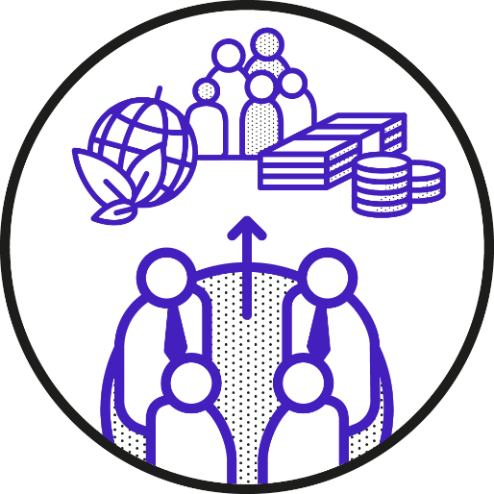
Chapter 6 / Cultivating Sustainable Innovation
Practices and Methods:
60. Stakeholder Advisory Boards²¹
CHALLENGE: How can we assimilate impartial, expert contributions that question internal assumptions and ensure that sustain able innovation projects meet standards and thresholds?
APPROACH: Establish advisory boards to receive constructive critique on issues of integrity and sustainable development from a competent external perspective.
EXAMPLE: Siemens maintains an external perspective on its sustainability-related performance and challenges by regularly consulting with its Sustainability Advisory Board. It is made up of eight leading experts from academia and industry from a range of disciplines and regions around the world.

Slide 177
Chapter 6 / Cultivating Sustainable Innovation
Practices and Methods: Ensuring Positive Impact
The final set of cultivating practices and methods ensures that sustainable innovation efforts lead to desirable outcomes and have a substantial positive impact. They promote accountability, transparency and the alignment of innovation practices and material artefacts with respect to sustainability values.
How can we professionalise practices and introduce artefacts that ensure the positive impact of innovation efforts?

Slide 178

Chapter 6 / Cultivating Sustainable Innovation
Practices and Methods:
61. Management Systems²²
CHALLENGE: How can we establish transparent, systematic and reliable processes to ensure sustainable innovation pro jects are successful?
APPROACH: Introduce standardised management systems for innovation management, environ mental management and quality management to consolidate good management practices. They can be introduced and certified to establish policies, processes and criteria for sustainable innovation management, professionalising the integration of sustainability values in innovation projects and the screening and redirecting of innovation projects that fail to make material contributions to sustainable development.
RELATED METHODS: Materiality Assessment, Context-Based Reporting, Results Chain, Innovation Impact Assessment

Slide 179
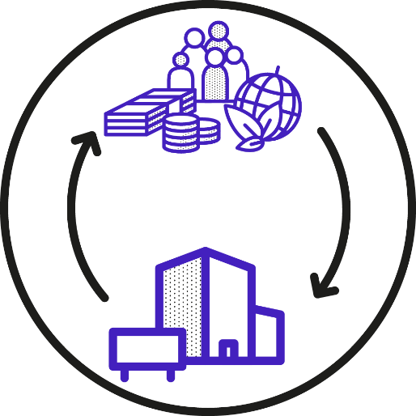
Chapter 6 / Cultivating Sustainable Innovation
Practices and Methods:
62. Materiality Assessment²³
CHALLENGE: How can we prioritise and focus our efforts on sustainability challenges that matter most to our business and its stakeholders?
APPROACH: Identify and prioritise key issues that affect an organisation’s ability to create long term value with Materiality Assessments. They help organisations to optimise resource allocation and improve risk management in sustainable innovation projects.
EXAMPLE: A case study of Port Esbjerg, Denmark’s leading port for shipping offshore wind turbines, combined a double materiality assessment with business model analysis, linking business model configurations to financial materiality and material impacts on sustainable development. This integrated approach informed the prioritisation of ten material impacts and related KPIs, such as energy and water efficiency on the port premises, green energy investments and stewardship of oil and gas regulations.

Slide 180

Chapter 6 / Cultivating Sustainable Innovation
Practices and Methods:
63. Context-Based Reporting²⁴
CHALLENGE: How can we reliably assess our sustainability performance and define the design space for sustainable innovation efforts?
APPROACH: Ground sustainable innovation ambitions and practices on scientific insights and fair allocation of resources using Context-Based Reporting. It addresses evidence-based limits, regional sustainability thresholds and the allocation of usable resources to provide a reliable structure not just for reporting a relative progress, but for ‘authentic sustainability assessment’.
EXAMPLE: The companies SK Hynix, Mondragon and Weleda, among others, have adopted sustainable development performance indicators in their reporting strategies, reflecting global sustainability norms and local resource boundaries.

Slide 181

Chapter 6 / Cultivating Sustainable Innovation
Practices and Methods:
64. Results Chains²⁵
CHALLENGE: How can we estimate and communicate the long-term results and positive impact of sustainable innovation projects?
APPROACH: Establish a structure with Results Chains to assess, manage and demonstrate how business activities trigger different levels of change, from outputs to outcomes and ultimately development impact and perceived value.
EXAMPLE: The GIZ development agency uses Results Chains to help business environment reform projects to identify their expected results, test whether the intervention rationale is sound, identify critical success factors and effectively communicate the expected project results with stakeholders.

Slide 182

Chapter 6 / Cultivating Sustainable Innovation
Practices and Methods:
65. Innovation Impact Assessment²⁶
CHALLENGE: How can we systematically assess sustainable innovation projects against criteria that measure their potential impact?
APPROACH: Translate sustainability values into indicators, heuristics and criteria that inform decision-making at different innovation stages with Innovation Impact Assessments. They are co-developed to ensure alignment with organisational and departmental goals and values.
EXAMPLE: A German inspection company has customised ten indicators derived from the SDGs to inform innovation stage-gate decisions. Peer to-peer assessments are introduced to break silos and inspire heterogeneous subsidiaries (e.g. IT and mobility) to learn from each another.

Slide 183

Chapter 6 / Cultivating Sustainable Innovation
Practices and Methods:
66. Sustainable Finance and Investment²⁷
CHALLENGE: How can we manage financial resources and investments in innovation projects that lead to long-lasting, positive and measurable social and environmental impacts?
APPROACH: Integrate sustainable transformation and financial planning for sustainable innovation to provide employees with the necessary funding and resources for putting sustainable innovation strategies into practice.
RELATED METHODS: Life Cycle Cost Analysis, Sustainable Innovation Financing

Slide 184
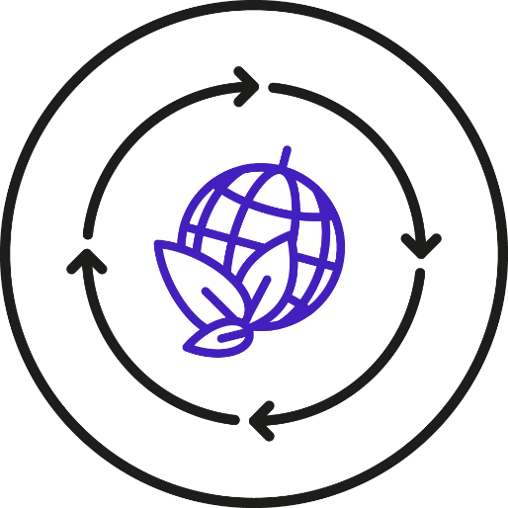
Chapter 6 / Cultivating Sustainable Innovation
Practices and Methods:
67. Life Cycle Cost Analysis²⁸
CHALLENGE: How can we assess the long-term advantages of innovative sustainable solutions and ensure that they outweigh costs of a major investment?
APPROACH: Life Cycle Cost Analysis helps project teams assess the true value of sustainable innovations over time, ensuring that short-term expenses do not detract from long-term gains.
EXAMPLE: A Life Cycle Cost Analysis of a construction project in the US Pacific Northwest found that, while initial costs for mass timber building are higher than those for concrete, it reduces emissions and offers long-term economic benefits, including energy efficiency and lower maintenance expenses. This validated the advantages of a higher initial investment in mass timber construction.

Slide 185

Chapter 6 / Cultivating Sustainable Innovation
Practices and Methods:
68. Sustainable Innovation Financing²⁹
CHALLENGE: How can we secure funding for sustainable innovation projects, despite uncertain short-term returns?
APPROACH: Employ sustainability-related financing instruments to create financial flexibility, enabling investment in sustainable innovation at reduced costs of capital.
EXAMPLE: Walmart supports its suppliers in reducing their emissions and improving energy efficiency through a collaboration with HSBC. The bank provides early invoice payments to eligible suppliers as well as financing rates linked to their carbon emissions, science-based sustainability targets and impact reporting.

Slide 186
PART III CASES / Companies on their Journeys to Establish Sustainable Innovation Cultures
Part III is dedicated to all the companies and organisations around the world that are struggling to put their sustainability strategies into action. We worked with eleven of them in Germany, Italy, Spain and Poland to understand their strategies and practices together with the persistent challenges they are facing.
Chapters
From Safety to Sustainability – The Case of an Inspection Company in Germany
Cultural Transformation in the Italian Oil Industry
Investments in People and Technology along with Management by Values in Poland
Sustainable Innovation Challenges in Science-Based Companies in Spain

Slide 187
Chapter 7
From Safety to Sustainability – The Case of an Inspection Company in Germany
by Henning Breuer, Kiril Ivanov, Roman Meier -Andrae

Slide 188
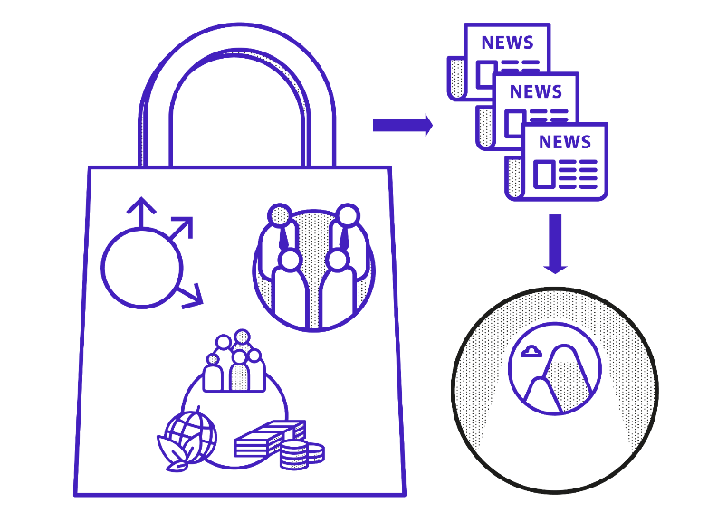
Chapter 7 / From Safety to Sustainability
From Safety to Sustainability – The Case of an Inspection Company in Germany
From the Adoption of New Values to the Formation of New Ecosystems
Good Practices and Persisting Challenges of an Inspection Company
Insight into Ecosystem Capabilities
Lessons Learned from the Insight
Co-creating with Values-Based Ecosystem Modelling
Lessons Learned from the Project
Key Takeaways

Slide 189
Chapter 7 / From Safety to Sustainability
From internal values to ecosystem mobilization.
Shift from safety to sustainability: A German technical inspection company (TIC) expands its long-standing values of safety and impartiality to include sustainability as a core strategic value, reflecting a natural evolution of its historic mission.
Strengths and tensions in innovation culture: Ethnographic study reveals six key tensions—sustainable innovation culture, vertical integration, horizontal collaboration, ecosystem capabilities, practices/methods, and hidden values—that shape how sustainability is adopted internally.
Ecosystem opportunities and gaps: While TIC already engages with universities, legislators, customers, and partners, findings show underused potential in coordinated ecosystem action, reputation building, and leveraging internal expertise for outward sustainability impact.

Slide 190
Chapter 7 / From Safety to Sustainability
From internal values to ecosystem mobilization.
Co creation via Values-Based Ecosystem Modelling: A structured workshop process (trend mapping, stakeholder evaluation, sustainability drivers, business opportunity generation, and ecosystem modelling) helps identify future business opportunities such as predictive inspections, sustainability assessments, and data-driven mobility ecosystems.
Emerging sustainability-focused business ideas: Four building blocks—proof-on-demand inspection, technical sustainability inspection, data platforms for component lifespan, and sensor-based sustainable driving—illustrate new strategic directions supported by TIC’s reputation and expertise.
Inside-out and outside-in value creation: The chapter concludes that sustainable innovation culture must scale beyond the company, using partnerships, shared expertise, and collaborative ecosystems to amplify impact while building on TIC’s strengths in safety, trust, and impartiality.

Slide 191
Chapter 7 / From Safety to Sustainability
Approach 7. Co creative Exploration of Sustainable Ecosystem - Innovation
MAPPING FUTURE TRENDS: What affects the future of our ecosystem?
EVALUATING STAKEHOLDER RELATIONSHIPS: How can we build on our stakeholder relations?
ELABORATING SUSTAINABILITY DRIVERS: How can sustainability drivers enhance our future ecosystem?
ENVISIONING NEW BUSINESS OPPORTUNITIES: What are we doing in the future? How did we make it there?
ECOSYSTEM MODELLING: What should our future sustainable business ecosystem look like?

Slide 192
Chapter 8
Cultural Transformation in the Italian Oil Industry
by Raffaella Montera (Sapienza University of Rome),
Chiara Guiggiani (Foundation for Research and Innovation, University of Florence),
Alessandro Monti (Foundation for Research and Innovation, University of Florence),
Mario Rapaccini (University of Florence)

Slide 193

Chapter 8 / Cultural Transformation
Cultural Transformation in the Italian Oil Industry

Slide 194

Chapter 8 / Cultural Transformation
Overview
Sustainable Innovation Challenges
Ethnography to Conceive Sustainable Innovation Culture
Co-creating to Enhance Alpha’s Innovation Strategy and Cultural Transformation
Key Takeaways

Slide 195
Chapter 8 / Cultural Transformation
Sustainable innovation challenges
There is an increasing global emphasis on transitioning away from fossil fuels and towards renewable energy sources to mitigate climate change.
Energy technology companies need comprehensive sustainable strategies to mitigate their environmental impact.
A key step in this transformation is the cultivation of sustainable innovation cultures based on Participatory Decision Making and Stakeholder Values Integration
Energy technology companies are increasingly prioritizing values of sustainability, integrating them into both their internal operations and their external market strategies.
According to this, more and more energy companies are investing in clean energy and undertaking a profound organizational shift for establishing sustainable innovation cultures

Slide 196
Chapter 8 / Cultural Transformation
Ethnography to Conceive Sustainable Innovation Culture
As case study, Alpha company's official values and strategy are centered on advancing energy solutions that are cleaner, safer and more efficient
Alpha’s strategic focus is on technology innovation, digital transformation and sustainable development
Using Rapid Ethnography, Alpha’s sustainable innovation culture was conceived, identifying seven key insights:
  SUSTAINABILITY LITERACY
  VERTICAL INTEGRATION
  REDUCTIONIST APPROACH
  AUTHENTIC COMMUNICATION
  ORCHESTRATING STAKEHOLDER RELATIONSHIPS
  ESTABLISHING PRACTICES FROM BOTTOM UP
  BALANCING DIVERSITY

Slide 197
Chapter 8 / Cultural Transformation
Co-creating to enhance Alpha’s Innovation Strategy and Cultural Transformation
To address challenges with co-creating, a work in close cooperation with Alpha’s IT branch and its senior managers was carried out.
A number of insights based on criteria such as current corporate interests and strategic alignment was selected, which led to address two of the mentioned challenges. In a second stage, such challenges were shaped in three co-creating measures:
  IDEATION CONTEST FOR NEW SUSTAINABLE INNOVATION PROJECTS, to enable the evaluation, selection and sponsorship of bottom-up initiatives
  CO-CREATING AN INNOVATION IMPACT ASSESSMENT, as an iterative approach to ensure that sustainability criteria are incorporated throughout all innovation stages and with respect to all three sustainability dimensions: economic, environmental and social
  BUNDLING CO-CREATING EFFORTS TO DRIVE CULTURAL TRANSFORMATION, to help synergize parallel efforts for greater impact and mark a significant step towards cultural transformation

Slide 198
Chapter 8 / Cultural Transformation
Key Takeaways
The case study presented demonstrates that the cultural transformation towards sustainable innovation is a complex and ongoing journey that requires concerted effort and collaboration across all organizational levels
This transformation requires a re-evaluation of existing values and practices and the adoption of new mindsets
Cultivation of sustainable innovation is not only an opportunity for every energy technology company and its value chain, but also a necessity
Value chain players can benefit from the leadership and guidance of the Alpha company and follow the same path

Slide 199
Chapter 9
Investments in People and Technology along with Management by Values in Poland
by Katarzyna Matras-Postołek, Piotr Beńko, Małgorzata Ciesielska, Jacek Kasz (Cracow University of Technology) & Irena Śliwińska (Krakow University of Economics)

Slide 200
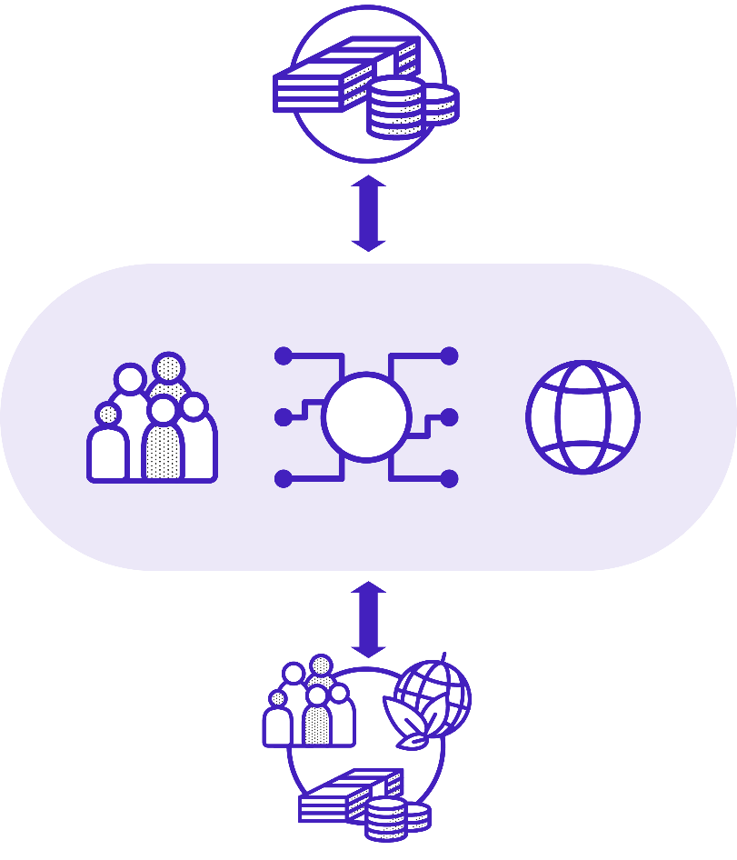
Chapter 9 / Investments in People and Technology along with Management by Values
Investments in People and Technology along with Management by Values in Poland

Slide 201
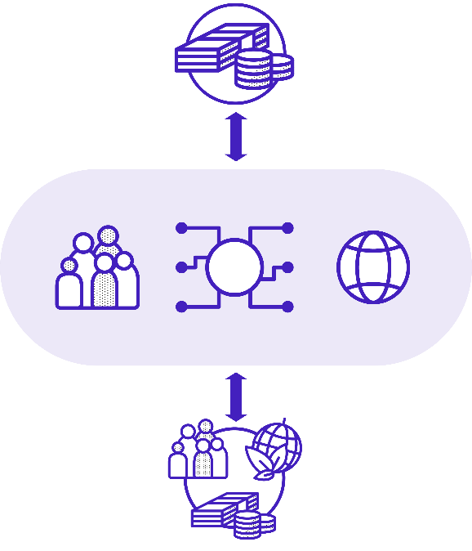
Chapter 9 / Investments in People and Technology along with Management by Values
Overview
Sustainable Innovation Challenges
Ethnographic Insights
Conceiving Innovation Culture
Co-creative Assessment of Challenges, Practices and Foundations
Key Takeaways

Slide 202
Chapter 9 / Investments in People and Technology along with Management by Values
Sustainable Innovation Challenges
Ethnographic findings indicate that Polish engineering companies still struggle with systemic obstacles and regulatory constraints.
Technological limitations remain a significant barrier, slowing down companies’ ability to implement sustainable solutions.
Companies transitioning toward sustainable innovation must navigate a complex environment to become competitive in Poland and internationally.

Slide 203
Chapter 9 / Investments in People and Technology along with Management by Values
Case study ASTOR
Through field interviews, we identified ASTOR’s sustainable innovation practices:
A VALUES-BASED APPROACH TO MANAGING STAKEHOLDER RELATIONSHIPS
ASTOR manages its relationships with clients and partners by seeking common ground based on shared values.
SUSTAINABLE BUDGET PLANNING BASED ON INVESTMENT IN TECHNOLOGY - ASTOR TECHNOLOGY INDEX (ITA)
ASTOR introduced the ASTOR Technology Index (ITA) as an innovative tool for assessing companies’ technological capital.

Slide 204
Chapter 9 / Investments in People and Technology along with Management by Values
Key Takeaways
Innovation development in companies requires long-term investments in PEOPLE and TECHNOLOGY, along with MANAGEMENT BY VALUES to generate sustainable outcomes and financial returns in the future.
PEOPLE are crucial to introducing sustainable innovation.
Sustainable innovation requires systematic investments in TECHNOLOGY to optimise the use of resources and ensure long-term efficiency, including eco-efficiency.
VALUES‑BASED MANAGEMENT provides the strategic foundation for these efforts, requiring leaders to clearly communicate the corporate sustainability vision, mission and values, thereby aligning stakeholders and inspiring win‑win collaboration.

Slide 205
Chapter 10
Sustainable Innovation Challenges in Science-Based Companies in Spain
by Carmen Abril, Complutense University Madrid

Slide 206
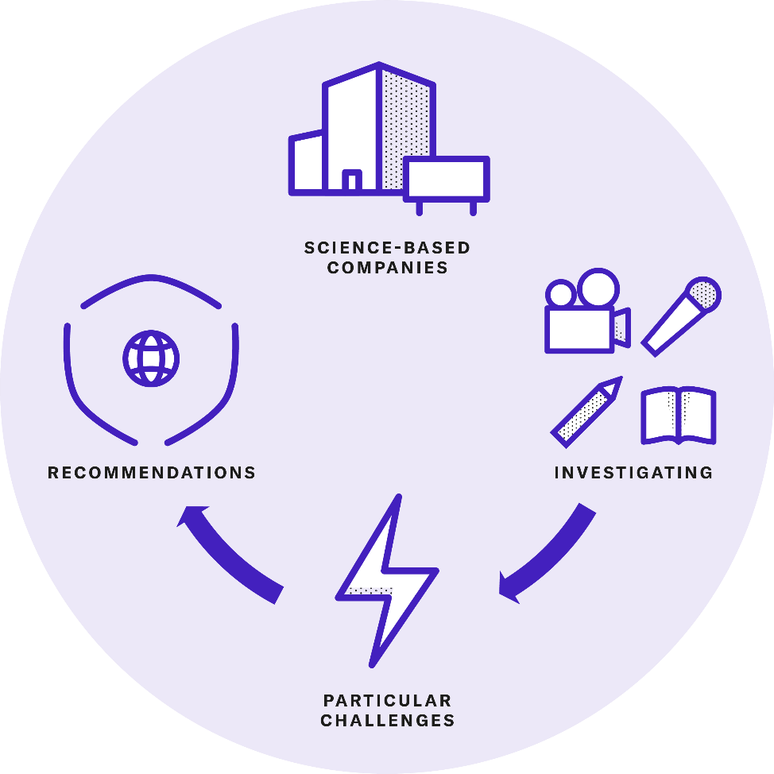
Chapter 10 / Challenges in Science-Based Companies
Sustainable Innovation Challenges in Science-Based Companies in Spain

Slide 207
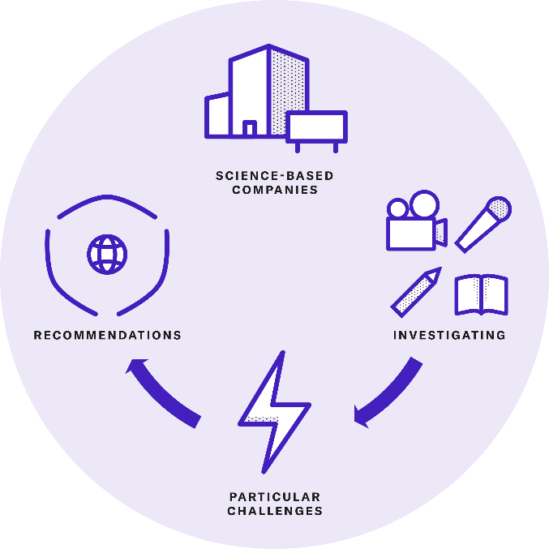
Chapter 10 / Challenges in Science-Based Companies
Overview
The Case of Two Science-Based Companies
Unique Cultures for Sustainable Innovation
Four Insights
Co-creating to Address Communication Challenges
Bridging Theory and Practice
Key Takeaways

Slide 208
Chapter 10 / Challenges in Science-Based Companies
The Case of Two Science-Based Companies
﻿Science-based companies, grounded in scientific rigour and knowledge, face unique challenges when managing sustainable innovation. Their distinct cultural characteristics add complexity to the process.
﻿Science-based companies are distinguished by their deep commitment to rigorous scientific knowledge, high specialisation and expertise and a focus on technical innovation to satisfy highly demanding customers.
﻿We study the specific sustainability challenges in science-based companies through the eyes of two lead companies. Company A is a global leader in general science and industrial products. Company B is a European frontrunner in the aerospace industry.

Slide 209
Chapter 10 / Challenges in Science-Based Companies
Unique Cultures for Sustainable Innovation
﻿Science-based companies, particularly in sectors like chemicals and aerospace, face a unique set of hurdles in adopting sustainable innovation stemming from the complexities of their core technologies, the stringent regulatory landscape and the need to protect intellectual property while pursuing open innovation
﻿These companies are often structured around specialised technological expertise, driving both incremental and radical innovations that are foundational to their market positions.
﻿Process inertia and conservative mindset to minimize risk, interdisciplinary silos due to specialization, secrecy in research and development to protect IP and, driven demand, characterized the organizational culture of most science-based companies.

Slide 210
Chapter 10 / Challenges in Science-Based Companies
Four Insights
﻿ Narrow scope of sustainable innovation; ﻿
  we observed that science-based companies tend to limit the scope of their sustainable innovation efforts, often focusing exclusively on the environmental dimension of sustainability
  They tend to focus in the latest stage of the product lifecycle
  The existing specialization provokes a lack of literacy on the multidisciplinary impact on sustainability impeding a shared understanding of the sustainability impact
  ﻿ The multinational nature of these companies make them navigate different regulatory landscapes and cultural attitudes towards sustainability, introducing more complexity
﻿Reactive sustainable innovation
  ﻿Our research revealed a persistent tension between embracing a proactive sustainable innovation strategy that could deliver broad, longer-term value and meeting the immediate needs of customers

Slide 211
Chapter 10 / Challenges in Science-Based Companies
Four Insights
﻿3. ﻿Communication and engagement for sustainable innovation
  ﻿The technical requirements of business units and functions in these companies complicate the establishment of a cohesive, global communication strategy.
  Communication on sustainability achievements is done at corporate level in yearly basis
﻿4. Misaligned metrics for Embedding Sustainability Values
  ﻿In the companies we studied, key performance indicators (KPIs) for sustainable innovation are primarily aggregated at the overall corporate level and designed for high-level reports that are communicated only on an annual basis.
  This approach to Innovation Impact Assessment, introduces two major challenges : ﻿ low individual ownership of KPIs, which can lead to disengagement, and narrow focus on manufacturing processes

Slide 212
Chapter 10 / Challenges in Science-Based Companies
Co-creating to Address Communication Challenges
﻿Improving communication around sustainable innovation would not only address persistent cultural tensions and values-action gaps but could also indirectly support the resolution of related challenges﻿. The following actions were agreed.
  ﻿Appoint a dedicated sustainable innovation communication team responsible for consistent, clear
  and aligned sustainable innovation messaging.
  2. ﻿ Develop a comprehensive, multi-channel and tailored communication strategy
  3. ﻿ Expand the focus of messages to include diverse and broader sustainability achievements
  4. ﻿ Create regular, interactive channels (e.g. workshops, intranet updates) for Awareness Raising about ongoing sustainable innovation projects
  5. ﻿ Provide sales training on sustainability value propositions and integrate sustainable innovation into
  the customer interaction process
  6. ﻿ Simplify technical sustainable innovation achievements for broader audiences, equipping sales and
  customer-facing teams with accessible, impactful messages to share
  7. ﻿ Develop a strategic plan for influencing tender criteria, emphasising the inclusion of sustainability
  metrics and benefits as core evaluation elements

Slide 213
Chapter 10 / Challenges in Science-Based Companies
Bridging Theory and Practice
﻿1. ﻿We disclose how the practical implementation of sustainable innovation in science-based companies often diverges from theoretical models.
2. We highlight the challenge of cross-functional alignment in science-based companies, where function-specific silos and the lack of tailored sustainable innovation metrics contribute to a fragmented approach.
3. looking at science-based companies, we provide an answer to fill a gap in knowledge regarding drivers of green product innovation practices from a sectorial perspective.
4. We contribute to the open debate on the role of informal, bottom-up initiatives in driving sustainable innovation culture development in structurally and hierarchically complex organisations. ﻿

Slide 214
Chapter 10 / Challenges in Science-Based Companies
Key Takeaways
﻿To cultivate a holistic sustainable innovation culture, firms need to encourage cross-functional alignment and foster a shared understanding of sustainability across all departments
Tailored Communication around sustainable innovation remains a challenge, with companies often using top-down messaging and adopting an overly modest stance when communicating achievements.
﻿Sustainable innovation metrics tend to focus on corporate-level indicators ﻿often overlook function-specific KPIs that could make sustainability feel relevant to every function.
﻿Recognising and supporting bottom-up initiatives could build a culture of sustainability from the ground up, sparking greater engagement and innovation across the company.

Slide 215
PART IV CROSS-CUTTING ISSUES / Mergers, Financing and Forward-Looking Cultures
Chapters
Developing Sustainable Innovation Cultures during Mergers and Acquisitions:
The Case of Two Breweries in Slovenia
Sustainable Finance and Investments for Sustainable Innovation Cultures
Outlook: Forward-Looking Cultures

Slide 216
Chapter 11
Developing Sustainable Innovation Cultures during Mergers and Acquisitions
by Ladeja Godina Košir, Circular Change (Slovenia)

Slide 217

Chapter 11 / Mergers and Acquisitions
Developing Sustainable Innovation Cultures during Mergers and Acquisitions

Slide 218

Chapter 11 / Mergers and Acquisitions
Overview
A Tale of Two Local Rivals
Effective Actions for Sustainable Transformation
Systemic Change in Mergers and Acquisitions
The Power of Mentorship

Slide 219
Chapter 11 / Mergers and Acquisitions
Developing Sustainable Innovation Cultures during Mergers and Acquisitions
A Tale of Two Local Rivals: Two iconic national breweries. Deep-rooted identities. Fierce local loyalty.
  First: a merger of historic rivals
  Then: acquisition by a global brewing group with corporate sustainability embedded at its core
This case explores the tension between:
  locally embedded heritage and global sustainability mandates
  sponsorship-driven CSR and strategically integrated sustainability
  market-based KPIs and sustainability performance indicators
Central question: Can sustainable innovation cultures be developed during turbulent M&A processes without eroding organisational identity?

Slide 220

Chapter 11 / Mergers and Acquisitions
Effective Actions for Sustainable Transformation
Sustainable transformation required cultural and structural alignment
Key intervention mechanisms:
Establishment of a cross-functional sustainability task force representing core organisational units
Development of a roadmap integrating sustainability into operational processes
Practices of Inclusive Deliberation (co-creation workshops, values-based ideation and assessment)
Strong leadership endorsement and integration of sustainability into core KPIs
The process shifted sustainability:
from a peripheral reporting function
to an embedded strategic and operational principle.

Slide 221
Chapter 11 / Mergers and Acquisitions
Systemic Change in Mergers and Acquisitions
The Role of Mentorship and Cultural Alignment
Transformation unfolded across multiple dimensions:
Alignment of values, practices, and performance indicators
Employee engagement to address skepticism and foster ownership
Integration of sustainability targets (e.g., carbon neutrality by 2030) into corporate strategy
Extension of sustainability across the value chain and stakeholder relations
The external sustainability advisor facilitated shared understanding, trust-building, and systemic integration — until full ownership transitioned to internal leadership.
Core insight: In mergers and acquisitions, structural integration alone is insufficient. Long-term competitiveness depends on developing a sustainable innovation culture that reconciles heritage with future-oriented transformation.

Slide 222
Chapter 12
Sustainable Finance and Investments for Sustainable Innovation Cultures

Slide 223
Chapter 12 / Sustainable Finance and Investments
Overview
Financing Sustainable Transformation
Financial Planning for Sustainable Innovation
Financial Accounting and Transformation Within the Finance Function
Building Financially Resilient Sustainable Innovation Cultures

Slide 224
Chapter 12 / Sustainable Finance and Investments
Financing Sustainable Transformation
This chapter explores the interconnected roles of financial planning, financing and organisational transformation in the finance functions of sustainable innovation cultures.
It shows how to effectively allocate financial resources, how to finance the transformation and how to cultivate sustainable innovation without compromising financial stability or other strategic objectives.
Proven practices to finance sustainable transformation include:
  the reallocation of resources (e.g. using complementary practices and methods like Results Chain Matrix, Innovation Impact Assessment and Adopting Sustainable Management Systems),
  the use of external financing options (such as green bonds, sustainability-linked loans and impact investment funds)
  sustainable business model design (see Lüdeke-Freund, Breuer & Massa, 2026).

Slide 225

Chapter 12 / Sustainable Finance and Investments
Case 16. Patagonia’s Approach to Financing Sustainable Transformation
Patagonia builds its strategy around long‑term sustainability, not short‑term profit, and has done so since the 1970s.
The company invests in sustainable materials and R&D (e.g., recycled polyester, organic cotton) and improves supply‑chain transparency and labour conditions.
Its governance focuses on environmental protection, fair labour practices, and social responsibility, including donating 1% of sales through the Earth Tax.
Despite long-term investments in sustainability, the company benefits from strong brand loyalty, steady sales growth, and a positive employer reputation, showing that sustainability and financial success can reinforce each other.

Slide 226
Chapter 12 / Sustainable Finance and Investments
Financial Planning for Sustainable Innovation
A range of practices allows financial planners to support the development of a sustainable innovation culture in their organisation.
They include:
  establishing dedicated funds,
  flexible budget allocation,
  multi-year planning and
  evaluating ROI (return on investments) in a comprehensive manner.

Slide 227
Chapter 12 / Sustainable Finance and Investments
Approach 8. Metrics for Financial Planning
Long‑term value is captured through reputation, loyalty, and regulatory compliance.
Environmental metrics track emissions, resource use, waste reduction, and biodiversity impact.
Financial metrics focus on sustainable revenue growth, cost savings, risk reduction, brand strength, and investor confidence.
Investment metrics assess NPV, long‑term ROI, and market‑share growth in sustainable products.

Slide 228
Chapter 12 / Sustainable Finance and Investments
Approach 9. Calculating Overall Return on Investments
Consider tangible and intangible benefits in the example of installing solar panels for a manufacturing facility.
Calculate an overall return on investments in four steps:
  Quantify tangible benefits such as energy‑cost savings, subsidies, excess‑energy revenue, and property value gains.
  Estimate intangible benefits, including stronger brand perception, higher customer retention, price premiums, and avoided regulatory penalties.
  Calculate total costs, covering upfront investment and ongoing maintenance.
  Determine NPV by discounting all future savings, revenues, and intangible gains to present value.

Slide 229
Chapter 12 / Sustainable Finance and Investments
Financial Planning for Sustainable Innovation
Key practices for financial accounting include using customised KPIs, and methods of life cycle costing and risk management. Together they contribute to a profound transformation of the finance function.
This transformation allows finance functions to not only monitor expenditures, but also to play an active role in cultivating sustainable innovation by balancing cost control with an understanding of sustainable value creation.
Sustainable innovation cultures emerges when organisations align long‑term financial planning with adaptive, impact‑oriented practices. This enables firms like Interface, Patagonia and Novozymes to pair environmental and social value creation with resilient, future‑ready business performance.

Slide 230
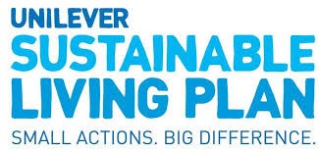
Chapter 12 / Sustainable Finance and Investments
Case 17. Green Bonds in Unilever’s Sustainable Living Plan
Unilever financed major sustainability projects through green bonds, directing capital specifically toward environmental improvements.
Green‑bond funding supported sustainable product design, packaging reduction, and responsible sourcing.
By integrating green bonds into its financial strategy, Unilever strengthened its ESG profile and aligned investment decisions with long‑term sustainability goals.
The use of green bonds reinforced Unilever’s link between sustainability performance and financial outcomes, supporting both resilience and growth.

Slide 231

Chapter 12 / Sustainable Finance and Investments
Case 18. Cultural Transformation and Financing Sustainable Transformation at GLS Investment
GLS cultivates a values‑based, people-centered culture, using practices like informal exchange, employee resource groups, and stakeholder advisory to anchor sustainability in everyday behaviour.
A core cultural challenge is overcoming the “harmony trap”—the tendency to avoid conflict in a values‑based organisation—which they address through open dialogue, reflection spaces, and conflict‑capable communication.
Externally, investment decisions follow principles‑driven, case‑by‑
case expert assessments, prioritising social and environmental value over automated ESG scoring.
Innovation focuses on creating impact‑oriented financial instruments (e.g., green bonds, alternative funds, evergreen models) and shaping new sustainable finance ecosystems through partnerships and regulatory engagement.
We interviewed the two managing directors of GLS Investments, Marvin Mechelse and Karsten Kührlings, to understand their approach to sustainable finance and to learn from their experiences in establishing a sustainable innovation culture.

Slide 232
Chapter 13
Outlook: Forward-Looking Cultures
by Henning Breuer

Slide 233
Chapter 13 / Outlook:
Forward-Looking Cultures
Three emerging global challenges face those seeking to establish sustainable innovation cultures:
  a crisis of supportive institutions,
  the ecosystem challenge and
  new technological frontiers in innovation development.
Practices and methods from this book (such as Context-Based Reporting, Sustainable Finance and Sustainability Foresight, Employee Resource Groups, Empathising and Sensemaking) contribute to mastering the higher art of developing a sustainable innovation culture.
It takes a whole culture to bring about sustainable innovation on a reliable basis. In this book, we showed how such cultures can be developed. It’s now up to you to begin creating your own sustainable innovation culture.

Slide 234
APPENDICES
Glossary of Key Terms
About the Authors
Endnotes

Slide 235
Appendices
Glossary of Key Terms
ARTEFACTS: Human-made objects bearing cultural significance. They include tools designed to perform a specific task or function, also software and data (section 2.3.4)
3C ACTIVITIES: The three basic activities of the 3C framework are 1) conceiving values and related notions, practices and artefacts to address cultural challenges; 2) co-creating interventions to address these challenges; and 3) cultivating sustainable innovation by mainstreaming values and related notions, establishing new practices and introducing new artefacts.
CO-CREATING: A methodology involving several practices and methods to engage stakeholders in collaborative interventions to promote a sustainable innovation culture. A 3C framework activity, co-creating follows up on conceiving and serves to clarify and specify basic notions, resolve tensions, close values-action gaps and explore forward-looking opportunities for sustainable innovation (section 5.1).
COMMONS: Social, environmental, and economic resources accessible to all members of society (section 2.1.1).
COMPETENCES: Areas of expertise that are directly associated with work results required to achieve team or organisational goals and are typically linked to specific tasks, roles or professional domains.
COMPETENCIES: Specific combinations of critical skills, knowledge, behaviours and attitudes that are required to achieve competences and to be successful in a role.
CONCEPTION: The second 3C framework activity involves, with respect to notions and values, the review of guiding principles and policies in order to identify implicit tensions within the organisation’s systems of priorities, between the values of different stakeholders and how values are managed for innovation. With respect to practices, conceiving means identifying values-action gaps and understanding the role of mediating artefacts that can facilitate or hinder attempts to align practices with organisational values (section 4.1).
CULTIVATING: The third 3C framework activity involves deliberate and systematic efforts to shape, sustain and renew culture. In our context the system of notions, practices and artefacts make up an organisational innovation culture (section 6.1).
ORGANISATIONAL CULTURE: A generative system of notions, practices and artefacts that distinguishes one organisation from another, translating organisational values into new forms of value creation.
GUIDING PRINCIPLES: Values that are codified by the organisation as value, purpose, mission, and/or vision statements. Guiding principles are reinforced through management measures (section 3.1.2).

Slide 236
Appendices
Glossary of Key Terms
IMPACT: a positive or negative, intended or unintended, actual or desirable change on natural, human, social, intellectual, constructed or financial capitals¹ resulting from the aggregated outcomes of an implemented innovation.
INNOVATION: A ‘new or changed entity, realizing or redistributing value’. These entities can be a product, service, process, model or method (section 2.1.2). ²
MANAGEMENT: ‘Coordinated activities to direct and control an organization’, here ‘with regard to innovation’.³ Normative management deals with establishing principles, policies and values that define an organisation’s identity and aspirations to generate a specific impact. Strategic management deals with business design and development to achieve differentiation and competitive advantage based on the principles, policies and values defined by normative management. Operational management deals with translating an organisation’s normative and strategic agendas into daily operations (section 3.1.3).
MATERIALITY: In the context of auditing, accounting and reporting, materiality refers to the significance of information for the user’s decision-making. In the context of sustainability management, materiality defines the sustainability issues that matter most to an organisation and its stakeholders. Materiality Assessments typically identify and prioritise environmental, social and governance (ESG) factors based on their impact on a company’s financial performance (outside-in) and the company’s impact on society and the environment (inside-out). In Context-Based Reporting, materiality is grounded in science, human needs and local social and environmental thresholds that constrain sustainable development (sections 2.1.1 and 6.3.3).
METHOD: In our case, purposeful and replicable approach or intervention addressing a particular challenge to cultural development. When methods are systematically applied over time and adapted to the needs of the organisation, they turn into practices (section 2.3.4).
NARRATIVE: A coherent framework of meaning through which an organisation interprets its identity, purpose, values and direction over time. It contains but differs from stories, i.e., textual passages relating a course of events arranged in a timeline.⁴
NOTION: An understanding of a term in ordinary language, shaped by its use in practice and context. Values as notions of the desirable as well as notions of what is considered feasible and viable are critical to sustainable innovation culture (section 2.3.4).
OUTCOME: a positive or negative, intended or unintended change in the current situation or the future potential to meet the needs of any stakeholder, resulting from the aggregated outputs of innovation activities, practices and projects.⁵

Slide 237
Appendices
Glossary of Key Terms
OUTPUT: tangible and measurable results that are directly produced by completing (innovation) project tasks and activities.⁶
PARTICIPATORY OBSERVATION: An immersive research method where a researcher actively participates in the day-to-day activities of the cultural group he or she is studying, while simultaneously observing and recording their experiences (chapter 4).
PRACTICE: Actions, behaviours and rituals that employees perform on a more or less regular basis (section 2.3.4).
SKILLS: Specific, learned abilities to perform tasks or activities effectively.
STAKEHOLDER: Any person or group of people affected by or contributing to the success or failure of an organisation’s activities (section 2.1.1).
STRATEGY: A deliberate and integrated set of choices that position the organisation to achieve its aspirations. They do this by providing guardrails for operational management and everyday practice (section 3.1.1).
SUSTAINABLE INNOVATION LITERACY: Integration of shared sustainability values and a common understanding of key concepts and skills across the organisation, complemented by role-specific competences in individual departments (section 4.1.5).
SUSTAINABILITY: ‘A form of intergenerational ethics in which the environmental and economic actions taken by present persons do not diminish the opportunities of future persons to enjoy similar levels of wealth, utility, or welfare’⁷ (section 2.1.1).
SUSTAINABLE DEVELOPMENT: Development that ‘meets the needs of the present without compromising the ability of future generations to meet their own needs’; ‘a process of change in which the exploitation of resources, the direction of investments, the orientation of technological development; and institutional change are all in harmony and enhance both current and future potential to meet human needs and aspirations.’⁸ (section 2.1.1).
SUSTAINABILITY MANAGEMENT: An organisation’s concerted efforts to contribute to sustainable development (section 2.1.1).

Slide 238
Appendices
Glossary of Key Terms
SUSTAINABLE INNOVATION: The systematic integration of sustainability-related values and considerations into innovation activities to create or redistribute economic, social and environmental value through new or changed entities – such as products, services, business models or ecosystems – or processes for an organisation and its stakeholders (section 2.1.3, also for sustainability innovation and sustainability-oriented innovation).
SUSTAINABLE INNOVATION CULTURES: Generative systems made up of shared notions, practices and artefacts that turn values of sustainability into novel regenerative outcomes that are economically, socially and environmentally beneficial.
SYSTEM VALUE: ‘Value that accrues in dynamic balance across all capitals and the systems associated with them.’ The various types of capital include natural, human, social, intellectual, constructed and financial.⁹
3C FRAMEWORK: A structured approach for steering iterative development of sustainable innovation cultures in a virtuous cycle of three interconnected activities: 1) conceiving values and related notions, practices and artefacts to address cultural challenges; 2) co-creating interventions to address these challenges; and 3) cultivating sustainable innovation by mainstreaming values and related notions, establishing new practices and introducing new artefacts.
VALUE CREATION: The process by which organisations generate benefits for stakeholders. In standard economic theory, this refers to benefits for customers, economic returns for shareholders and investors and broader economic activity that benefits society. An extended concept of value creation includes not only financial outcomes but also the maintenance, unlocking and sharing of social, environmental and other non-monetary benefits for a wide range of stakeholders.¹⁰ In contrast, value damage refers to the harmful social and environmental impacts of organisations (section 2.1.1).
VALUES-BASED INNOVATION MANAGEMENT: A management framework that integrates the values of different stakeholders into managing innovation processes and activities in order to ensure long-term positive impact.¹¹
VALUES OF SUSTAINABILITY: Notions of the desirable in an organisation related to sustainable development, regularly expressed by the intended outcomes and positive impact that an organisation pursues. Besides values of intergenerational and intragenerational justice and equity of opportunities as core values of sustainable development, ¹² values of environmental stewardship and social responsibility are also relevant (section 3.1.1).
UNINTENDED CONSEQUENCES: Outcomes or impacts of innovation activities that are not intended or foreseen (sections 2.1.3 and 3.1.3).
VALUES: Subjective notions of the desirable¹³ and ordered systems of priorities that act as criteria for decisions and evaluations (section 2.2.4).

Slide 239
Appendices
About the Authors
HENNING BREUER
Henning Breuer researches, teaches and consults in the fields of innovation management and business psychology. He is a Professor of Business and Media Psychology at the Media University Berlin, founder of UXBerlin – Innovation Consulting, and has worked in executive education and consulting with universities and companies in Europe and the United States.
Since 2001, Henning has worked with multinational corporations, SMEs, public organisations and start-ups, providing consultancy services in the areas of sustainable innovation culture and business models, future scenarios and ethnographic stakeholder research. Henning has co-authored publications for journals, conferences and textbooks on values-based innovation management, sustainable business model design, gamification for innovators and entrepreneurs, and sustainable innovation cultures. As a visiting researcher and professor, he has worked at the University of Chile (Santiago) and Waseda University (Tokyo). He studied psychology, philosophy and law in Berlin and Tübingen, and received his PhD in psychology from the University of Magdeburg.

Slide 240
Appendices
About the Authors
KIRIL IVANOV
Kiril Ivanov has completed a doctorate at the Centre for Sustainability Management at the Leuphana University Lüneburg, with a dissertation focused on values-based and sustainable innovation. As a researcher at the Media University of Applied Sciences, he has contributed to EU-funded research projects on gamification, values-based innovation cultures and strategic foresight for sustainability. He teaches courses in innovation and entrepreneurship, business anthropology and gamification for organisations, while also collaborating with UXBerlin – In novation Consulting on projects involving ethnography and values-based business development.

Slide 241
Endnotes

Slide 242
Endnotes
Chapter 2
Starik, M. and Kanashiro, P. 2013. Toward a Theory of Sustainability Management. Organization & Environment 26 (1): 7–30. doi: 10.1177/1086026612474958.
Schaltegger, S., Hörisch, J., and Freeman, R. 2019. Business Cases for Sustainability: A Stakeholder Theory Perspective. Organization & Environment 32 (3): 191–212. doi: 10.1177/1086026617722882.
Lüdeke-Freund, F., Froese, T., Dembek, K., Rosati, F., and Massa, L. 2024. What Makes a Business Model Sustainable? Activities, Design Themes, and Value Functions. Organization & Environment 37 (2): 194–220. doi: 10.1177/10860266241235212.
Bill Baue follows the International Integrated Reporting Council’s proposition of six essential capitals that are involved in system value creation: natural, human, social and relationship, intellectual, manufactured and financial; see system value in the glossary of key terms and Baue, B. 2020. From Monocapitalism to Multicapitalism: 21st Century System Value Creation. r3.0 White Paper No.1.
Ilcheong, Y., Bruelisauer, S., Utting, P., McElroy, M., et al. 2022. Authentic Sustainability Assessment: A User Manual for the Sustainable Development Performance Indicators. Geneva, Switzerland: UNRISD.
Stubbs, W. and Cocklin, C. 2008. Conceptualizing a ‘Sustainability Business Model’. Organization & Environment 21 (2): 103–127. doi: 10.1177/1086026608318042.
Bocken, N.., Rana, P. and Short, S. 2015. Value mapping for sustainable business thinking, Journal of Industrial and Production Engineering, 32:1, 67-81, DOI: 10.1080/21681015.2014.1000399
Paech, N. 2007. Directional certainty in sustainability-oriented innovation management. In: Innovations towards sustainability: Conditions and consequences: 121–139. Heidelberg, Physica-Verlag HD.
Jordan, A. 2013. Business anthropology. Long Grove, Ill.: Waveland Press.
Janicijevic, N. 2011. Methodological approaches in the research of organizational culture. Economic Annals 56 (189): 69–99. doi: 10.2298/EKA1189069J.
Todnem By, R. 2005. Organisational change management: A critical review. Journal of Change Management 5 (4): 369–380. Routledge. doi: 10.1080/14697010500359250.
Appelbaum, S., Habashy, S., Malo, J.-L., and Shafiq, H. 2012. Back to the future: revisiting Kotter's 1996 change model. Journal of Management Development 31 (8): 764–782. Emerald Group Publishing Limited. doi: 10.1108/02621711211253231.
Schein, E. 2015. Organizational Psychology Then and Now: Some Observations. https://www.annualreviews.org/content/ journals/10.1146/annurev-orgpsych-032414-111449. Annual Review of Organizational Psychology and Organizational Behavior 2 (Volume 2, 2015): 1–19. Annual Reviews. doi: 10.1146/an nurev-orgpsych-032414-111449.
242

Slide 243
Endnotes
Chapter 3
Donaldson, T. 2023. Value creation and CSR. Journal of Business Economics: 1–21. doi: 10.1007/s11573-022-01131-7.
Haffar, M. and Searcy, C. 2017. Classification of Trade-offs Encountered in the Practice of Corporate Sustainability. Journal of Business Ethics 140 (3): 495–522. doi: 10.1007/s10551-015-2678-1.
Freeman, R. E., Parmar, B. L., & Martin, K. 2019. The power of and: Responsible business without trade-offs. Columbia University Press. Freeman, R.E., Dmytriyev, S., and Phillips, R. 2021. Stakeholder Theory and the Resource-Based View of the Firm. Journal of Management 47 (7): 1757–1770. doi: 10.1177/0149206321993576.
Watson, R., Wilson, H., Smart, P., and Macdonald, E. 2018. Harnessing Difference: A Capability-Based Framework for Stake holder Engagement in Environmental Innovation. Journal of Prod uct Innovation Management 35 (2): 254–279. doi: 10.1111/jpim.12394.
Aurand, Timothy W., Wayne Finley, Vijaykumar Krishnan, Ursula Y. Sullivan, Jackson Abresch, Jordyn Bowen, Michael Rackauskas, Rage Thomas, and Jakob Willkomm. 2018. The VW Diesel Scandal: A Case of Corporate Commissioned Greenwashing. Journal of Organizational Psychology 18 (1). doi: 10.33423/jop.v18i1.1313.
Rodríguez-Vidal, J., Carrillo-de-Albornoz, J., Gonzalo, J., and Plaza, L. 2021. Authority and priority signals in automatic summary generation for online reputation management. Journal of the Association for Information Science and Technology 72 (5): 583–594. doi: 10.1002/asi.24425.
An attitude ‘represents a summary evaluation of a psycholog ical object captured in such attribute dimensions as good–bad, harmful–beneficial, pleasant–unpleasant, and likable–dislike able’ Ajzen, I. 2001. Nature and operation of attitudes: Annual Review of Psychology. psych, 52(1), 28. This characterises attitudes as more situational and object-specific than values, which are viewed as general and abstract as well as enduring and stable. Furthermore, while norms ‘prescribe generally expected and required behaviours in particular situations’, values are ‘consid ered to be trans-situational criteria or beliefs used by subjects to select the desirable’ Breuer, H. and F. Freund. 2017, 25. Values-based innovation management. London: Macmillan Publishers Limited.
Wikström, G., Bledow, N., Matinmikko-Blue, M., Breuer, H., Costa, C., Darzanos, G., ... & Wunderer, S. 2024. Key value indicators: A framework for values-driven next-generation ICT solutions.
Ivanov, K. 2022. Values-Based Business Model Innovation– The Case of Ecosia and Its Business Model. International Journal of Innovation Management 26 (05). doi: 10.1142/ S1363919622400023.
Christian, B. 2020. The alignment problem. Machine learning and human values. New York, NY: W.W. Norton & Company.
Merton, R. 1936. The Unanticipated Consequences of Purpo sive Social Action. American Sociological Review 1 (6): 894. doi: 10.2307/2084615.
Ketprapakorn, N. and Kantabutra, S. 2022. Toward an organizational theory of sustainability culture. Sustainable Production and Consumption 32: 638–654. doi: 10.1016/j.spc.2022.05.020.
243

Slide 244
Endnotes
Chapter 3
Lubberink, R., Blok, V., van Ophem, J., and Omta, O. 2017. Lessons for Responsible Innovation in the Business Context: A Systematic Literature Review of Responsible, Social and Sustainable Innovation Practices. Sustainability 9 (5): 721. doi: 10.3390/su9050721.
Stilgoe, J., Owen, R., and Macnaghten, P. 2013. Developing a framework for responsible innovation. Research Policy 42 (9): 1568–1580. doi: 10.1016/j.respol.2013.05.008.
Gadomska-Lila, Katarzyna. 2024. Changing organizational culture for sustainability. In: The Human Dimension of the Circular Economy, Eds. Aldona Glińska-Neweś, and Pauliina Ulkuniemi, 206–230. Edward Elgar Publishing.
Preuss, L., Walker, H. 2011. Psychological Barriers in The Road to Sustainable Development: Evidence from Public Sector Procurement. Public Administration 89 (2): 493–521. doi: 10.1111/j.1467-9299.2010.01893.x.
Inderberg, T., Håkon J., Iris L., and Hege W. 2023. Institutional context, innovations, and energy transitions: Exploring solar photovoltaics with hydrogen storage at a secondary school in Norway. Energy Research & Social Science 101: 103147. doi: 10.1016/j.erss.2023.103147.
Thomke, S. (2020). Building a culture of experimentation. Harvard Business Review, 98(2), 40-47.
244

Slide 245
Endnotes
Chapter 4
Steinke, I. (2004). 4.7 Quality criteria in qualitative research. A Companion to Qualitative Research, 184.
Boenink, M., & Kudina, O. (2020). Values in responsible research and innovation: from entities to practices. Journal of Responsible Innovation, 7(3), 450-470.
Miller, D. 1997. Capitalism. An ethnographic approach. Oxford, Washington, DC: Berg.
Nightingale, D. and Cromby, J. 1999. Social constructionist psychology: A critical analysis of theory and practice. McGraw-Hill Education (UK).
Madsbjerg, C. and Rasmussen, M. 2014. Moment of Clarity. Us ing the Human Sciences to Solve Your Toughest Business Problems. Boston, MA: Harvard Business Review Press.
Fiske, S. 2007. Improving the Effectiveness of Corpo rate Culture. Anthropology News 48 (5): 44–45. doi: 10.1525/ an.2007.48.5.44.
Geertz, C. 2008. “Thick description: Towards an interpretive theory of culture.” In: The cultural geography reader. Routledge.
Daae, J. and Boks, C. 2015. A classification of user research methods for design for sustainable behaviour. Journal of Cleaner Production 106: 680–689. doi: 10.1016/j.jclepro.2014.04.056. Holzblatt, K. 2016. Contextual Design: Design for Life. Morgan Kaufmann.
Reiman, T. and Oedewald, P. 2002. The assessment of organisational culture. A methodological study 2140. Espoo: Technical Research Centre of Finland.
Santoriello, A. 2000. Assessing Unique Core Values with the Competing Values Framework: The CCVI Technique for Guiding Organisational Culture Change. doi: 10.15760/etd.2312.
Breuer, H. 2022. Eliciting stakeholder values for strategic and values-based innovation management. Proc. XXXIII ISPIM Conference: 1-12.
Ye, K. 2024. Using a memetics lens to better understand tailored messages for organisational change toward sustainability. Master's thesis.
Gutiérrez, J. and Macken-Walsh, Á. 2022. Ecosystems of Collaboration for Sustainability-Oriented Innovation: The Importance of Values in the Agri-Food Value-Chain. Sustainability 14 (18): 11205. doi: 10.3390/su141811205.
Onkila, T., Mäkelä, M., and Järvenpää, M. 2018. Employee Sensemaking on the Importance of Sustainability Reporting in Sustainability Identity Change. Sustainable Development 26 (3): 217–228. doi: 10.1002/sd.1696.
Geradts, T. & Bocken, N. 2019. Driving sustainability-oriented innovation: a sustainable corporate entrepreneurship approach. MIT Sloan Review (Winter 2019).
Breuer, H., Bessant, J., Gudiksen, S. 2022. Gamification for Innovators and Entrepreneurs. De Gruyter. doi: 10.1515/9783110725582.
Cooperrider, D. and McQuaid, M. 2012. The Positive Arc of Systemic Strengths: How Appreciative Inquiry and Sustainable Designing Can Bring Out the Best in Human Systems. Journal of Corporate Citizenship 2012 (46): 71–102. doi: 10.9774/GLEAF.4700.2012.su.00006.
245

Slide 246
Endnotes
Chapter 4
Watson, R., Wilson, H., Smart, P., and Macdonald, E. 2018. Harnessing Difference: A Capability‐Based Framework for Stakeholder Engagement in Environmental Innovation. Journal of Product Innovation Management 35 (2): 254–279. doi: 10.1111/jpim.12394.
Barile, S., Grimaldi, M., Loia, F., and Sirianni, C. 2020. Technology, Value Co-Creation and Innovation in Service Ecosystems: Toward Sustainable Co-Innovation. Sustainability 12 (7): 2759. doi: 10.3390/su12072759. Breuer, H. & Lüdeke-Freund, F. 2019. Values-Based Stakeholder Management – Concepts and Methods. In: Wunder, T. (Ed.): Rethinking Strategic Management. Competing Through a Sustainability Mindset. Berlin: Springer.
Lindner, R., Kuhlmann, S., Randles, S., Bedsted, B., Gorgoni, G., Griessler, E., Loconto, A., and Mejlgaard, N. 2016. Navigating towards shared responsibility in research and innovation. Approach, process and results of the Res-AGorA Project. https://hal.science/hal-01298406. Germany: Fraunhofer Institute for Systems and Innovation Research (ISI).
Breuer, H. and Freund, F. 2017. Values-based innovation management. London: Macmillan Publishers Limited.
See Leadership Review in Visser, W. 2018. Creating Integrated Value Through Sustainable Innovation: A Conceptual Framework: 129–150. doi: 10.1007/978-3-319-73503-0_7.
246

Slide 247
Endnotes
Chapter 5
Giacomarra, M., Crescimanno, M., Sakka, G., and Galati, A. 2020. Stakeholder engagement toward value co-creation in the F&B packaging industry. EuroMed Journal of Business 15 (3): 315–331. Emerald Publishing Limited. doi: 10.1108/EMJB-06-2019-0077.
Bentivegna, E. & D'Angelo, S. 2020. La co-creazione al centro dell’innovazione di Pelliconi (food & beverage). https://www.economyup.it/innovazione/la-co-creazione-al-centro-dellinnovazione-di-pelliconi-food-beverage/. Accessed: 1 June 2025.
Weisbord, M. and Janoff, S. 2010. Future Search: An Action Guide to Finding Common Ground in Organizations and Communities. Berrett-Koehler Publishers.
Rill, B. and Hämäläinen, M. 2018. Understanding Co-creation: 17–38. doi: 10.1007/978-981-10-8500-0_2.
Delbard, O. 2021. How to create sustainable value? Some learnings from Interface Inc.’s 25-year journey. ESCP Impact Paper No 2021-01-EN. https://academ.escpeurope.eu/pub/IP%202021-01-EN.pdf. Accessed: 1 June 2025.
Deckert, A. 2009. Xerox lauds employees with Earth Awards. https://rbj.net/2009/07/15/xerox-lauds-employees-with-earth-awards/. Rochester Business Journa. Accessed: 1 June 2025. Projects were evaluated based on their innovativeness, direct benefits to Xerox, project duration, and documented, measurable results. Running for over 15 years, this programme saved over $10 million in 2010 alone. Kaye, L. 2010. Xerox employees' green ideas save company $10.2 million. The Guardian. https://www.theguardian.com/sustainable-business/ xerox-employees-green-ideas-save. Accessed: 1 June 2025.
Related practices from the literature: Balanced Use of Ecological, Social, and Economic Values as Ideation Heuristics in Stock, T., Obenaus, M., Slaymaker, A., and Seliger, G. 2017. A Model for the Development of Sustainable Innovations for the Early Phase of the Innovation Process. Procedia Manufacturing 8: 215–222. doi: 10.1016/j.promfg.2017.02.027
Environmental Championing in Eikelboom, M., Gelderman, C., and Semeijn, J. 2018. Sustainable innovation in public procurement: the decisive role of the individual. Journal of Public Procurement 18 (3): 190–201. doi: 10.1108/JOPP-09-2018-012.
Directed Search Patterns Based on Sustainability Values in Chen, Q., Magnusson, M., and Björk, J. 2023. Selection bias of ideas for sustainability-oriented innovation in internal crowdsourcing. Technovation 124: 102761. doi: 10.1016/j.technovation.2023.102761
Value-sensitive Design in Stilgoe, J., Owen, R., and Macnaghten, P. 2013. Developing a framework for responsible innovation. Research Policy 42 (9): 1568–1580. doi: 10.1016/j.respol.2013.05.008.
Values-Based Business Modelling in Breuer, H. and Freund, F. 2017. Values-based Network and Business Model Innovation. International Journal of Innovation Management 21 (03). doi: 10.1142/S1363919617500281.
Related practices from the literature: Sustainability Idea Management in Perez, A., Larrinaga, F., and Curry, E. 2014.. The Role of Linked Data and Semantic-Technologies for Sustainability Idea Management. In Software Engineering and Formal Methods, Eds. Steve Counsell, and Manuel Núñez, 306–312Cham: Springer International Publishing. Communication Links in Gadomska-Lila, K. 2024.
247

Slide 248
Endnotes
Chapter 5
Geradts, T. & Bocken, N. 2019. Driving sustainability-oriented innovation: a sustainable corporate entrepreneurship approach. MIT Sloan Review (Winter 2019).
Kruszelnicki, J. and Breuer, H. 2021. Challenges, Lessons and Methods for Developing Values-Based Intrapreneurial Culture: 381–395. doi: 10.1007/978-3-030-69380-0_22.
Breuer, H., Bessant, J., Gudiksen, S. 2022. Gamification for Innovators and Entrepreneurs. De Gruyter. doi: 10.1515/9783110725582.
Related practices found in Chakrabarti, R., Henneberg, S., and Ivens, B. 2020. Open sustainability: Conceptualization and considerations. Industrial Marketing Management 89: 528–534. doi: 10.1016/j.indmarman.2020.04.024.
Networking with Actors with Compatible and Opposing Values in Lubberink, R., Blok, V., van Ophem, J., and Omta, O. 2017. Lessons for Responsible Innovation in the Business Context: A Systematic Literature Review of Responsible, Social and Sustainable Innovation Practices. Sustainability 9 (5): 721. doi: 10.3390/su9050721.
Peuckert, J. and Kern, F. 2023. How user innovation communities contribute to sustainability transitions. An exploration of three online communities. Environmental Innovation and Societal Transitions 49: 100785. doi: 10.1016/j.eist.2023.100785.
Lai, S.-L. and Shu, L. 2014. Do-it-yourselfers as Lead users for Environmentally Conscious Behavior. Procedia CIRP 15: 431–436. doi: 10.1016/j.procir.2014.06.078
Related practices from the literature: Market Creation in Darroch, J., Miles, M., and Jardine, A. 2015. Market Creation: A Path to Sustainable Competitive Advantage: 331.
Creating and Projecting New Sustainable Consumption Needs in Kneipp, J., Gomes, C., Bichueti, R., Frizzo, K., and Perlin, A. 2019. Sustainable innovation practices and their relationship with the performance of industrial companies. Revista de Gestão 26 (2): 94–111. doi: 10.1108/REGE-01-2018-0005; Darroch, J., Miles, M., and Jardine, A. 2015. Market Creation: A Path to Sustainable Competitive Advantage: 331.; Market Maker pattern in Lüdeke-Freund et al. (2022).
Breuer, H. & Lüdeke-Freund, F. 2018. Values-Based Business Model Innovation: A Toolkit. In: Moratis, L., Melissen, F. & Idowu, S.O. (Eds.). Sustainable Business Models, 395-416. Springer.
Related practices from the literature: Innovation Ecosystems in Nylund, P., Brem, A., and Agarwal, N. 2021. Innovation ecosystems for meeting sustainable development goals: The evolving roles of multinational enterprises. Journal of Cleaner Production 281: 125329. doi: 10.1016/j.jclepro.2020.125329..
Integration with Local Communities in Kneipp, J., Gomes, C., Bichueti, R., Frizzo, K., and Perlin, A. 2019. Sustainable innovation practices and their relationship with the performance of industrial companies. Revista de Gestão 26 (2): 94–111. doi: 10.1108/REGE-01-2018-0005.
Cooperation with Academia in Marques, J., Franco, M., and Rodrigues, M. 2023. International universities-firms cooperation as a mechanism for environmental sustainability: a case study of EdgeWise. Journal of Applied Research in Higher Education 15 (4): 966–987. Emerald Publishing Limited. doi: 10.1108/JARHE-05-2022-0170.
248

Slide 249
Endnotes
Chapter 5
Hallingby, H.-S., Gavras, A., Mesogiti, I., Bledow, N., Darzanos, G., Frizzell, R., Breuer, H., Rokkas, T., and Fernandez Vega, L. 2023. 5G and Beyond 5G Ecosystem Business Modelling. White paper. https://www.izt.de/publikationen/5g-and-beyond-5g-ecosystem-business-modelling/. Zenodo. doi: 10.5281/zenodo.7640478. Accessed: 1 June 2025.
Breuer, H. (2023). Sustainability Foresight – Practices and Methods for Future-Oriented Innovation Management. XXXIV ISPIM Innovation Conference, Ljubljana. https://www.uxberlin.com/wp-content/uploads/2024/04/2023_Sustainability_Foresight_ISPIM.pdf. Accessed: 1 June 2025.
Broman, G. and Robèrt, K. 2017. A framework for strategic sustainable development. Journal of Cleaner Production 140: 17–31. doi: 10.1016/j.jclepro.2015.10.121.
Behrendt, S. 2009. Integriertes Technologie-Roadmapping. In: Popp, R., Schüll, E. (eds) Zukunftsforschung und Zukunftsgestaltung. Zukunft und Forschung. Springer, Berlin, Heidelberg. https://doi.org/10.1007/978-3-540-78564-4_19.
249

Slide 250
Endnotes
Chapter 6
Simmel, G. and Rammstedt, O. 2016. Gesamtausgabe. Band 11. Frankfurt am Main: Suhrkamp.
Csikszentmihalyi and Rochberg-Halton point to material arte facts as a shared reference for goal-directed activity and learning experiences. Fuhrer proposes the ideas of a cultured mind and identity as meaning-making practices; Csikszentmihalyi, M. and Rochberg-Halton, E. 2012. The Meaning of Things. Cambridge University Press. doi: 10.1017/cbo9781139167611. Fuhrer, U. 2004. Cultivating minds: Identity as meaning-making practice. New York, N.Y.: Taylor & Francis.
Mengering, K. & Hein, C. Gewinne Zukunft Podcast. 2024. #61 ESG-Ziele, Reporting und Datenstrategie vereinen - so macht es die Deutsche Bahn. https://gewinnezukunft.podigee.io/63-esg-datenstrategie. Accessed: 1 June 2025.
Ivanov, K. 2022. Values-Based Business Model Innovation– The Case of Ecosia and Its Business Model. International Journal of Innovation Management 26 (05). doi: 10.1142/ S1363919622400023.
Edmondson, A. and Bransby, D. 2023. Psychological Safety Comes of Age: Observed Themes in an Established Literature. Annual Review of Organisational Psychology and Organisational Behavior 10 (1): 55–78. doi: 10.1146/annurev-orgpsych-120920-055217.
Liang, J., Farh, C. and Farh, J. 2012. Psychological Antecedents of Promotive and Prohibitive Voice: A Two-Wave Examination. Academy of Management Journal 55 (1): 71–92. doi: 10.5465/ amj.2010.0176.
Reay, T. and Hinings, C. 2009. Managing the Rivalry of Competing Institutional Logics. Organisation Studies 30 (6): 629–652. doi: 10.1177/0170840609104803.
Taplin, D. H., Clark, H. N., Collins, E., & Colby, D. C. 2013. Theory of change. https://www.actknowledge.org/resources/documents/ToC-Tech-Papers.pdf. New York. Accessed: 10 October 2024.
Related practices from the literature: A clear direction in Geradts, T. & Bocken, N. 2019. Driving sustainability-oriented innovation: a sustainable corporate entrepreneurship approach. MIT Sloan Review (Winter 2019)
Providing Active Guidance for the Implementation of Normative Statements in Ivanov, K. 2024. Values-Based Barriers and Good Practices in Sustainability-Oriented Innovation Management. https://doi.org/10.1002/csr.3016. Corporate Social Responsibility and Environmental Management 1 (19).
R. Montera, A. Monti, M. Rapaccini. 2022. Case of Oil & Gas Corporation in ethnographic study for the IMPACT Erasmus+ project.
Haumer, F., Schlicker, L., Murschetz, P. and Kolo, C. 2021. Tailor the message and change will happen? An experimental study of message tailoring as an effective communication strategy for organisational change. Journal of Strategy and Management 14 (4): 426–443. Emerald Publishing Limited. doi: 10.1108/JSMA-08-2020-0207.
Kreuter, M., Lukwago, S., Bucholtz, D., Clark, E. and Sanders-Thompson, V. 2003. Achieving cultural appropriateness in health promotion programs: targeted and tailored approaches. Health education & behavior: the official publication of the Society for Public Health Education 30 (2): 133–146. doi: 10.1177/1090198102251021
250

Slide 251
Endnotes
Chapter 6
Related practices from the literature: Positive Reinforcement in Geradts, T. & Bocken, N. 2019.
Eco-friendly Reward System in Islam, M., Tseng, M.-L. and Karia, N. 2019. Assessment of corporate culture in sustainability performance using a hierarchical framework and interdependence relations. Journal of Cleaner Production 217: 676–690. doi: 10.1016/j.jclepro.2019.01.259
See ‘The Need for Accountability’ in Geradts, T. & Bocken, N. 2019.
Related practices from the literature: Attracting the Right Talent in Geradts, T. & Bocken, N. 2019.
Human Resource Management in Gadomska-Lila, K. 2024. Changing organisational culture for sustainability: 206–230. doi: 10.4337/9781035314225.00020
Sustainable Recruitment and Selection in Jepsen, D. and Grob, S. 2015. Sustainability in Recruitment and Selection: Building a Framework of Practices. Journal of Education for Sustainable Development 9 (2): 160–178. doi: 10.1177/0973408215588250
Mead, T., Jeanrenaud, S. and Bessant, J. 2022. Sustainability oriented innovation narratives: Learning from nature inspired innovation. Journal of Cleaner Production 344: 130980. doi: 10.1016/j.jclepro.2022.130980.
Related practices from the literature: Onboarding Training in Geradts, T. & Bocken, N. 2019.
Human Resource Management in Gadomska-Lila, K. 2024. Changing organizational culture for sustainability. In: The Human Dimension of the Circular Economy, Eds. Aldona Glińska-Neweś, and Pauliina Ulkuniemi, 206–230. Edward Elgar Publishing.
Geradts, T. & Bocken, N. 2019.
See Interpersonal Communication in slam, M., Tseng, M.-L. and Karia, N. 2019. Assessment of corporate culture in sustainability performance using a hierarchical framework and interdepend ence relations. Journal of Cleaner Production 217: 676–690. doi: 10.1016/j.jclepro.2019.01.259
Rolf, S., Schlachter, S. and Welbourne, T. 2016. Leading Sustainable Global Change from Within: The Case of Environmental Employee Resource Groups. Employment Relations Today 43 (2): 17–23. doi: 10.1002/ert.21564.
Gadomska-Lila, K. 2024.; Islam, M., Tseng, M.-L. and Karia, N. 2019.
Spitzeck, H., Hansen, E., Lenssen, G., Bevan, D. and Fontrodona, J. 2010. Stakeholder governance: how stakeholders influence corporate decision making. Corporate Governance: The international Journal of Business in Society 10 (4): 378–391. Emer ald Group Publishing Limited. doi: 10.1108/14720701011069623
Related practices from the literature: Embedding Values in Organisational Policies: Reficco, E., Gutiérrez, R., Jaén, M. and Auletta, N. 2018. Collaboration mechanisms for sustainable innovation. Journal of Cleaner Production 203: 1170–1186. doi: 10.1016/j.jclepro.2018.08.043
Embedding Values in Organisational Controls in Rauter, R., Globocnik, D. and Baumgartner, R. 2023. The role of organisational controls to advance sustainability innovation performance. Technovation 128: 102855. doi: 10.1016/j.technovation.2023.102855; Ronalter, L. M., & Bernardo, M. 2023. Integrated management systems and sustainability–a review on their relationships. Total Quality Management & Business Excellence 34 (11-12): 1438–1468.
Adopting Management Systems in Islam, M., Tseng, M.-L. and Karia, N. 2019
251

Slide 252
Endnotes
Chapter 6
Garst, J., Maas, K. and Suijs, J. 2022. Materiality Assessment Is an Art, Not a Science: Selecting ESG Topics for Sustainability Reports 65 (1): 64–90. doi: 10.1177/00081256221120692.
Ilcheong, Y., Bruelisauer, S., Utting, P., McElroy, M., et al. 2022. Authentic Sustainability Assessment: A User Manual for the Sustainable Development Performance Indicators. Geneva, Switzerland: UNRISD.
OECD Development Assistance Committee. 2014. Measuring and managing results in development co-operation. A review of challenges and practices among DAC members and observers. https://www.oecd.org/content/dam/oecd/en/publications/reports/2014/11/measuring-and-managing-results-in-development-co-operation_b71067a7/c7762fac-en.pdf. Accessed: 1 June 2025.
Breuer, H. and Ivanov, K. 2022. Case of Inspection Company in ethnographic study for the IMPACT Erasmus+ project.
see also Environment and Social Impact Assessment, Health Technology Assessment and Product Impact Tool in Guimarães, C., Santos, J. and Almeida, F. 2024. Practical tools for measuring and monitoring sustainable innovation. Innovation and Green Development, 3(4), 100172.
Cunha, d., Meira, E. and Orsato, R. 2021. Sustainable finance and investment: Review and research agenda. Business Strategy and the Environment 30 (8): 3821–3838. doi: 10.1002/bse.2842.
Liang, S., Gu, H. and Bergman, R. 2021. Environmental Life-Cycle Assessment and Life-Cycle Cost Analysis of a High-Rise Mass Timber Building: A Case Study in Pacific Northwestern United States. Sustainability 13 (14): 7831. doi: 10.3390/su13147831.
Atz, U., van Holt, T. and Liu, Z. 2022. Do Corporate Sustainability and Sustainable Finance Generate Better Financial Performance? A Review and Meta-analysis. http://dx.doi.org/10.2139/ssrn.3708495. Journal of Sustainable Finance and Investment. doi: 10.2139/ssrn.3708495.
252

Slide 253
Endnotes
Glossary
Baue, B. 2020. From Monocapitalism to Multicapitalism: 21st Century System Value Creation. r3.0 White Paper No.1.
ISO 56000. 2020. Innovation management — Fundamentals and vocabulary. https://www.iso.org/obp/ui/es/#iso:std:iso:56000:ed-1:v1:en. Accessed: 1 June 2025.
ISO 56000. 2020. Innovation management — Fundamentals and vocabulary. https://www.iso.org/obp/ui/es/#iso:std:iso:56000:ed-1:v1:en. Accessed: 1 June 2025.
Rimmon-Kenan, S. 2002. Narrative fiction: Contemporary poetics (2nd ed.). London, England: Routledge.
Adapted from Dembek, K., Lüdeke‐Freund, F., Rosati, F. and Froese, T. 2023. Untangling business model outcomes, impacts and value. Business Strategy and the Environment 32 (4): 2296–2311. doi: 10.1002/bse.3249.
Brundtland, G. 1987. The Brundtland report: ‘Our common future’. Report of the World Commission on Environment and Development 4 (1).
Adapted from Leonelli, L. 2024. Deliverables, Outputs, Outcomes, and Benefits: A Deeper Dive. https://www.linkedin.com/pulse/deliverables-outputs-outcomes-benefits-deeper-dive-lorenzo-leonelli-lbisf/. Accessed 1 June 2025.
Meadowcroft, J. 2025. Sustainability. Encyclopedia Britannica. https://www.britannica.com/science/sustainability. Accessed 1 June 2025.
Brundtland, G. 1987.
McElroy, Mark. 2008 “The Carrying Capacities of the Capitals,” Social Footprints: Measuring the social sustainability performance of organizations, Dissertation, University of Groningen. pp104-105
Lüdeke-Freund, F., Froese, T., Dembek, K., Rosati, F., and Massa, L. 2024. What Makes a Business Model Sustainable? Activities, Design Themes, and Value Functions. Organization & Environment 37 (2): 194–220. doi: 10.1177/10860266241235212.
Breuer, H. and Freund, F. 2017. Values-based innovation management. London: Macmillan Publishers Limited. (p. 59).
Brundtland, G. 1987.
Schwartz, S. 2012. An Overview of the Schwartz Theory of Basic Values. Online Readings in Psychology and Culture 2 (1). doi: 10.9707/2307-0919.1116.
253

Slide 254

Sustainable Innovation Cultures
Slides
www.degruyterbrill.com/document/doi/10.1515/9783111375700/html
We thank everyone who contributed, especially our co-authors Roman Meier-Andrae, Mario Rapaccini, Raffaella Montera, Chiara Guiggiani, Alessandro Monti, Katarzyna Matras-Postolek, Piotr Beńko, Małgorzata Ciesielska, Jacek Kasz, Irena Śliwińska, Carmen Abril, Ladeja Godina Košir and Gregor A. Erkel
Thanks for copyediting to Paul Lauer. Cover design and
layout (and the picture on the right) by Elmar Birk,
illustrations by Henning Breuer Vincent Beck and Elmar Birk. For related materials see:
www.uxberlin.com/sustainable-innovation-cultures
https://www.degruyterbrill.com/document/doi/10.1515/9783111375700/html

